Slide 1
A COUNTRY OF ONE
Briefed by:
Mr. Harvey Johnson
Deputy Assistant Secretary, ORMDI
Notes:
Welcome to the Course: 1 minutes
I’m going to give you a little primer on our Customer Experience Institute courses where we focus on teaching a Human Centered Design way of thinking

Slide 2
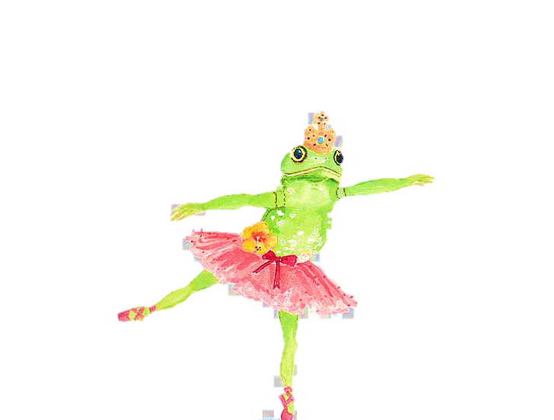

The Story of the Frog
One day, a little green frog decided to climb a tall, tall tree.
Notes:
Duration: 1 minute (1:05)
Facilitator Notes: For today’s lecture I’m going to cover these three areas:
Briefly review the session objectives:
Introduce customer experience (CX) and human-centered design (HCD) principles and terminology and
Connect CX mindsets to everyday work at VA.

Slide 3

What Unites Us
Declaration of Independence
We hold these truths to be self-evident, that all men are created equal, that they are endowed by their Creator with certain unalienable Rights, that among these are Life, Liberty and the pursuit of Happiness.
Constitution
We the People of the United States, in Order to form a more perfect Union, establish Justice, ensure domestic Tranquility, provide for the common defense, promote the general Welfare, and secure the Blessings of Liberty to ourselves and our Posterity, do ordain and establish this Constitution for the United States of America.
Notes:
Duration: 3 mins (1:05-1:07) 3mins
Facilitator Notes:
Human Centered Design is about tapping into that creative part of our brain.
Let’s do a little exercise.
Pull out a piece of paper and a writing utensil.
You have 30 sec to draw a vase. Don’t’ worry about what it looks like, just draw a vase.
Now I’m going to give you 60 secs to think about and draw as many ways as you can think of for how to enjoy flowers.
Be creative, be unique. Answer this question, how would you like to enjoy flowers and draw that.
After 60 sec: Drop your most unique ways in the chat.
So Human Centered Design is a lot like this. It takes a common problem and asks you to think about things differently and from a unique perspective.
Like the variety of vases that I’m sure exist out there, there are probably twice or three times as many creative ideas about ways to enjoy flowers.

Slide 4
E Pluribus Unum
Our Foundation | Our Future
The Declaration of Independence | Our Shared Commitment
Life, Liberty, and the Pursuit of Happiness | Oneness
The Constitution | Our Shared Values
We the People of the United States | Diversity & Human Dignity
in Order to form a more perfect Union | Inclusion & Freedom
establish Justice, insure domestic Tranquility | Equity
provide for the common defense | Safety & Peace through Strength
promote the general Welfare | Access
secure the Blessings of Liberty to ourselves and our Posterity | Justice for All, Family Values
do ordain and establish this Constitution for the United States of America | E Pluribus Unum

Slide 5







Where Do You Stand
Happy
Harmony
Empathy
Peaceful
Conscious
Love
Above the Line
Thinking
Understanding
Compassion
Trust
Graceful
Joy
Kind
Drifting
Hate
Anger
Insensitive
Fear
Below the Line Thinking
Indifference
Arrogant
Jealous
Ego
Judgmental
Envy
Assumption
Inactive

Slide 6
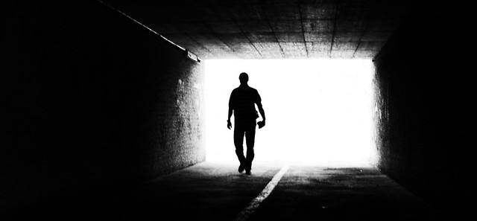
The Key of Wisdom

Slide 7
Oneness: The Era of Change
The Arc of Moral Progress
Brought together by our common humanity
Working together towards a shared purpose – a call to action
Union of Opposites
Life, Liberty, & the Pursuit of Happiness
A pure and loving society
Driven by empathy
The right to become the highest version of oneself
A Country Striving for Inclusion, Diversity, Equity & Access

Slide 8
THE WORLD I SEE
The world I see
is the world I want it to be
I see a world where people
are physically and psychologically safe
I see communities that fairly represent
the diversity of our world
I see communities that are inclusive
I see a world where not only doctors, but all of us,
find our purpose in helping to heal
our fellow human beings
I see a world where we’re asking: what about cultural health?
(as much as we’re taking physical temperatures)
I see world where all people are accepted and included
I see a world where people are free to innovate;
not trapped by dogma
I see a world with less structure, hierarchy, rules;
more openness, inclusion, principles, acceptance
I see a scientific world; an intelligent world;
a world that’s evolving, transforming, progressing
into alignment, civility, conscious equity
I see us awakening, re-imagining, re-emerging from a slumber into our role in a new civil rights era
Always, walking in kindness--we’ve got this.
We are Stronger together, E Pluribus Unum “Out of Many – One”

