Slide 1
Employee Experience (EX)
Overview

Slide 2
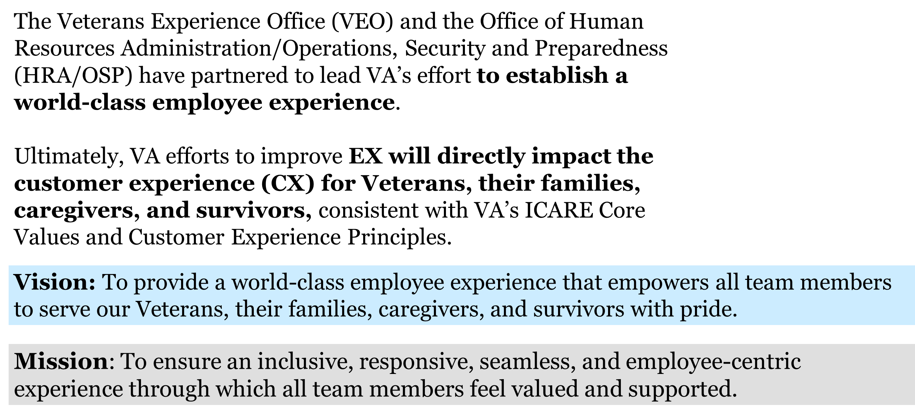

Employee Experience (EX) Overview

Slide 3
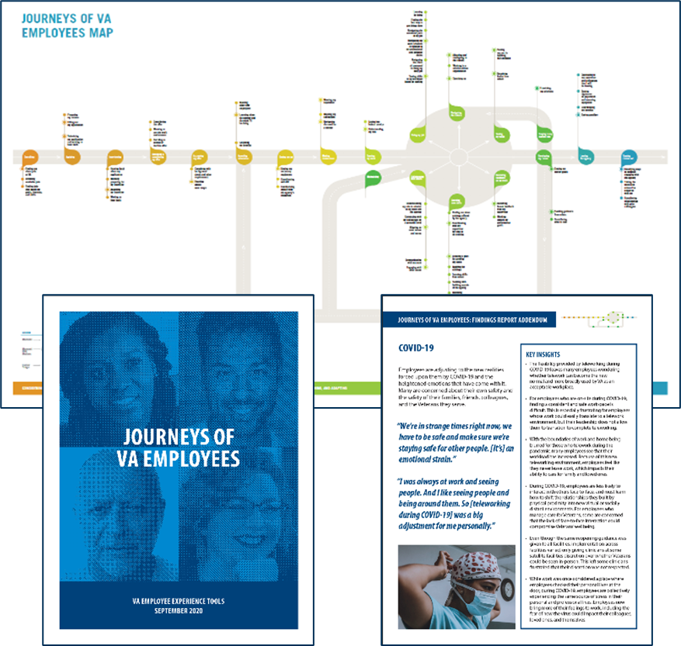
EX Journey Map & Insights
Our Recent Efforts Have Provided Insight into the VA Employee Journey
Modeled after the Journey of Veterans Map to create the federal government’s first-ever EX Journey Map
Collected 11,000+ insights from a diverse set of VA employees (WG-SES, clinical, frontline, clerical, technical, etc.) across 33 geographic areas
Identified 5 “phases” and 30 key “Moments that Matter” (bright spots and pain points) for VA employees along their employment journey
2

Slide 4

The Six Core Relational Attributes impact the way employees experience VA at every moment along their journey.
Inclusion - Diversity, Equity & Accessibility
WORK
WELL-BEING
The relationship I have with the work I do, the norms, methods and tools I use to get work done, and how my work strengthens me
The relationship I have with my personal life, identities, goals, and worldview and my ability to bring my whole, authentic self to work
PEOPLE
ORGANIZATION
The relationship I have with the customers
I serve, the people I manage, report to, collaborate with, partner with, and engage with in my work community
The relationship I have with the mission, purpose, culture, and leadership behaviors of the organization, and its policies, programs, and rewards
VA Employee
PLACES
TECHNOLOGY
The relationship I have with where I do work and the physical space in which work gets done
The relationship I have with the technologies that connect me to my work, workforce, and workplace
This framework, in the context of an employee's journey through the organization, can help VA understand and strategically redesign the most impactful parts of experience.
3

Slide 5
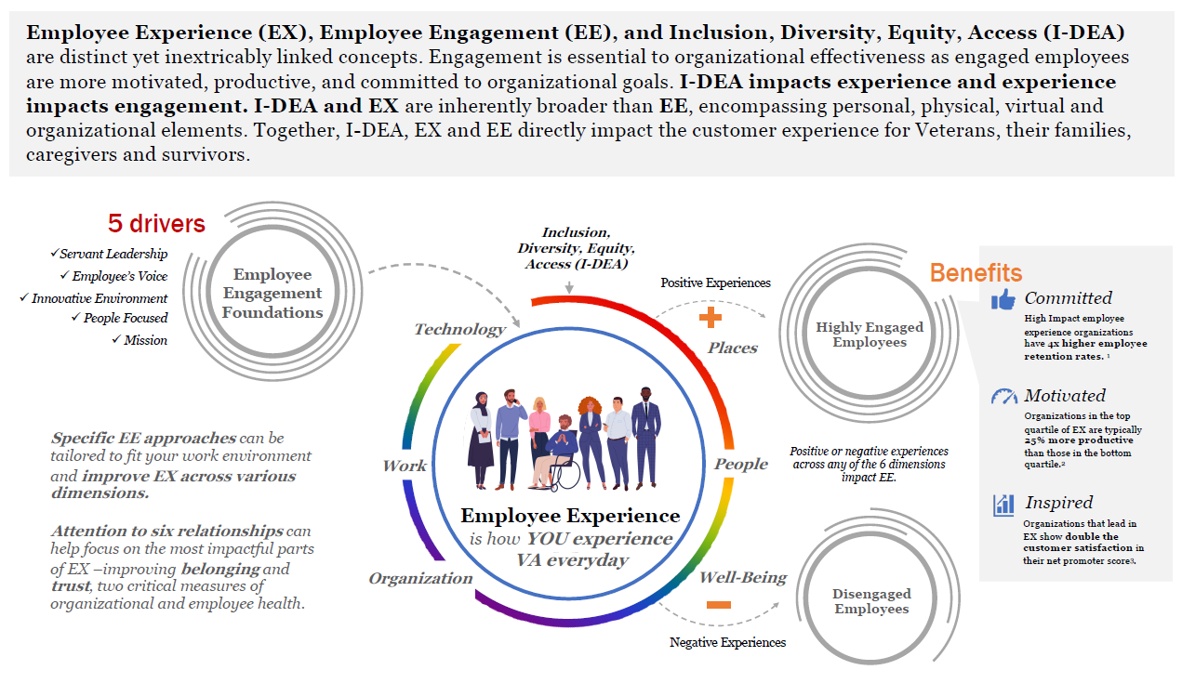
Experience VS. Engagement

Slide 6

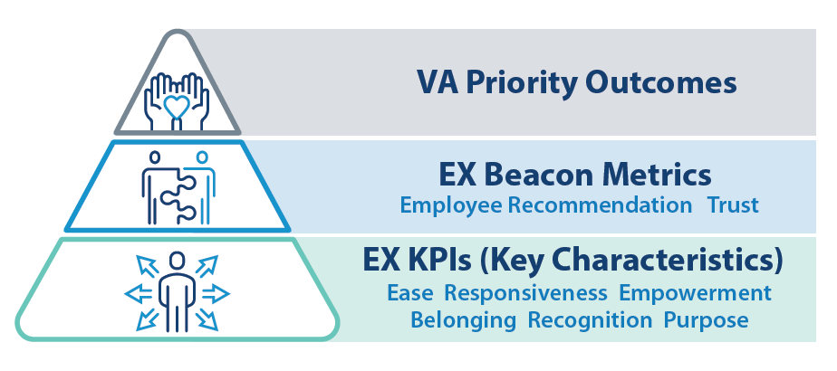
Employee Signals (ESignals)
ESignals will serve as a listening platform to capture the Voice of the Employee
        Survey types include:
        Beacon Metric
        The quarterly Beacon Metrics indicate the overall health of the Employee Experience across the Department.
        As our EX “thermometers,” they can alert us to bright spots or problem areas across the organization to further investigate.
        Moments That Matter
        Transactionally-triggered surveys tied to the employee journey, such as onboarding and entrance surveys.
        Customized Individual Organizational Surveys
        Surveys driven by a particular office that are employee-facing (e.g. OIT surveys of internal customers and their own employees) that offers multiple options and perspectives.
5
Recognition
Purpose

Slide 7
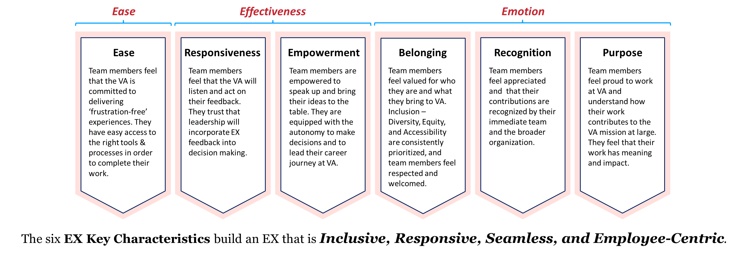
EX Key Performance Indicators and the Three E’s
The Key Characteristics align to the core values of customer experience (CX) at VA. By expanding upon the 3 E’s of CX, we enable further analysis and strategic coordination between EX and CX while building a framework that is uniquely tailored to the employee.

Slide 8
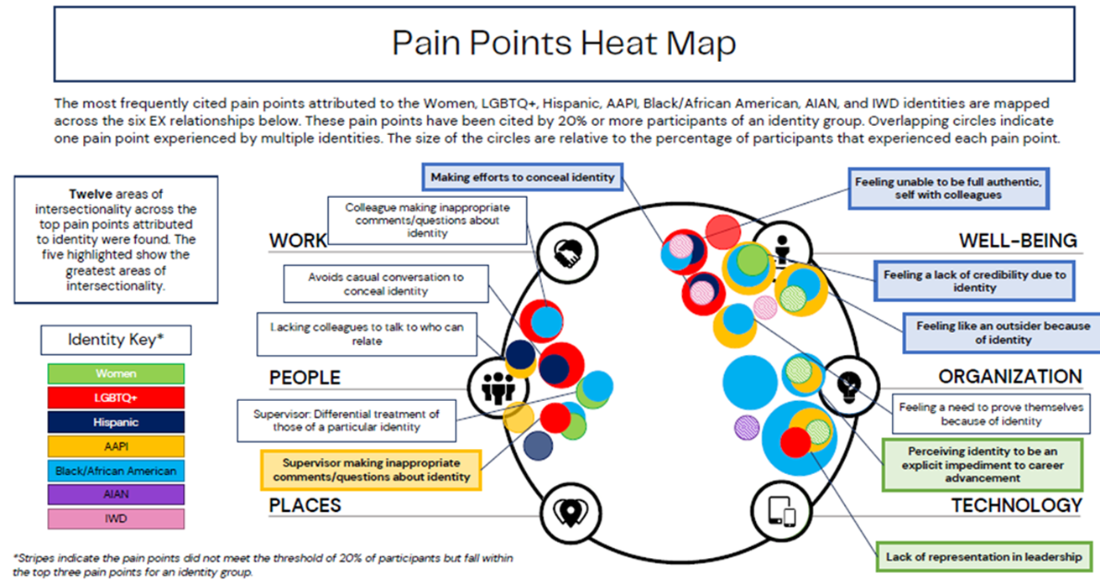
Identity Insights with ORMDI
Partnering with the Office of Resolution Management, Diversity & Inclusion on an I-DEA project that examines the experiences of employees across eight identity groups through an intersectional lens to understand challenges, needs, pain points, and opportunities.
Identity Groups : American Indian and Alaska Native, Asian American & Pacific Islander, Black/African American, Hispanic, Age (Baby Boomers), Individuals with Disabilities, LGBTQ+, & Women.
Conducted through 8 months of employee interviews and focus groups followed by collation and analysis of insights.
Design team has completed 2 rounds of research sprints for LGBTQ+, Black/African American, Women, Asian American & Pacific Islander, Hispanic, American Indian & Alaskan Native, Individuals w/ Disabilities, and Baby Boomers.
ORMDI/VEO are now expanding the project to a second phase to examine the experiences of six new identities which include: Employees Who Are Veterans, Individuals Born between 1965 and 1980 (Generation X), Individuals Born between 1981 and 1996 (Millennials), Middle Eastern/North African, Caucasian, and Individuals practicing a Minority Religion.

Slide 9







Additional EX Projects
Anonymous Job Application Deep Dive: The “Anonymous Job Application” concept explores the possibility of revising job applications to solely focus on an employee's skills, removing PII to help mitigate bias in job promotions and acquiring new roles. The EX team plans to refine, prototype, and test the concept.
Federal Women’s Program Coalition Project: VEO is partnering with ORMDI & the Federal Women’s Program Coalition (FWPC) to research identify “career seasons” for women employees at VA and develop corresponding personas. Insights from the project can be used to improve experiences of women employees, through policy making and/or service design.
ActiVAte, New Employee Welcome Kit: Based on feedback received from employees who recently onboarded through VACO, the Welcome Kit will be a physical and digital packet that can be sent to new employees to provide a warm welcome and need-to-know information. The packet is being tested and is in final refinement stages.
Employee Whole Health: Working with Employee Whole Health to integrate the EX-Journey Map with Whole Health resources. Using HCD, the tool will offer Whole Health resources relevant at specific periods of a VA employee’s journey.
EX Across VA Knowledge Management: Beginning in June 2022, the EX team is researching and performing Human Centered Design interviews with staff across the enterprise (VBA, NCA, VHA, the Board) to build an eco-system map of all employee experience and engagement groups and activities.
New Employee Buddy Program: Through this initiative, new employees and transfers would each receive a buddy who would be present during each phase of onboarding to assist with questions and paperwork and help new colleagues get acclimated. The focus of this effort is to increase employee satisfaction during onboarding and ultimately contribute to improved retention. The project is currently is the final testing phase prior to pilot launch.
Ask Me Anything (AMA): The AMA concept aims to provide meetings/events to offer career guidance while promoting transparent communication and providing access to leadership and human resource professionals. The EX team plans to refine, prototype, test, and pilot the concept.

Slide 10

Employee Experience
Interested in learning more about EX? Contact us at VAEX@VA.GOV

