Slide 1
Engaging a Virtual Workforce
Marissa Caylor, Board of Veterans Appeals
Michelle Hayes, Veterans Experience Office

Slide 2
Learning Objectives
Explain the importance of Employee Engagement and its overall impact on the organization
Explore tactics and techniques for engaging employees in a virtual environment
Identify resources available for those looking to improve employee engagement

Slide 3

The workplace is changing
We are not returning to the same workplace we left
The Great Reshuffling is now 2022’s Great Experiment
Leaders may need to rethink traditional work structure
Engaging and connecting to employees never mattered more
Notes:
Add stats of what e
Failing to offer flexible work arrangements is a risk for organization
Hybrid work must be productive and engaging, not just a policy or pe
Onsite vs. remote: Key benefits
Unpacking what incentivizes the federal worker to want to be in-person versus remote can help agencies create a hybrid work model that maximizes employees’ time and productivity, while keeping them engaged and satis
mployees want and what successful leaders

Slide 4
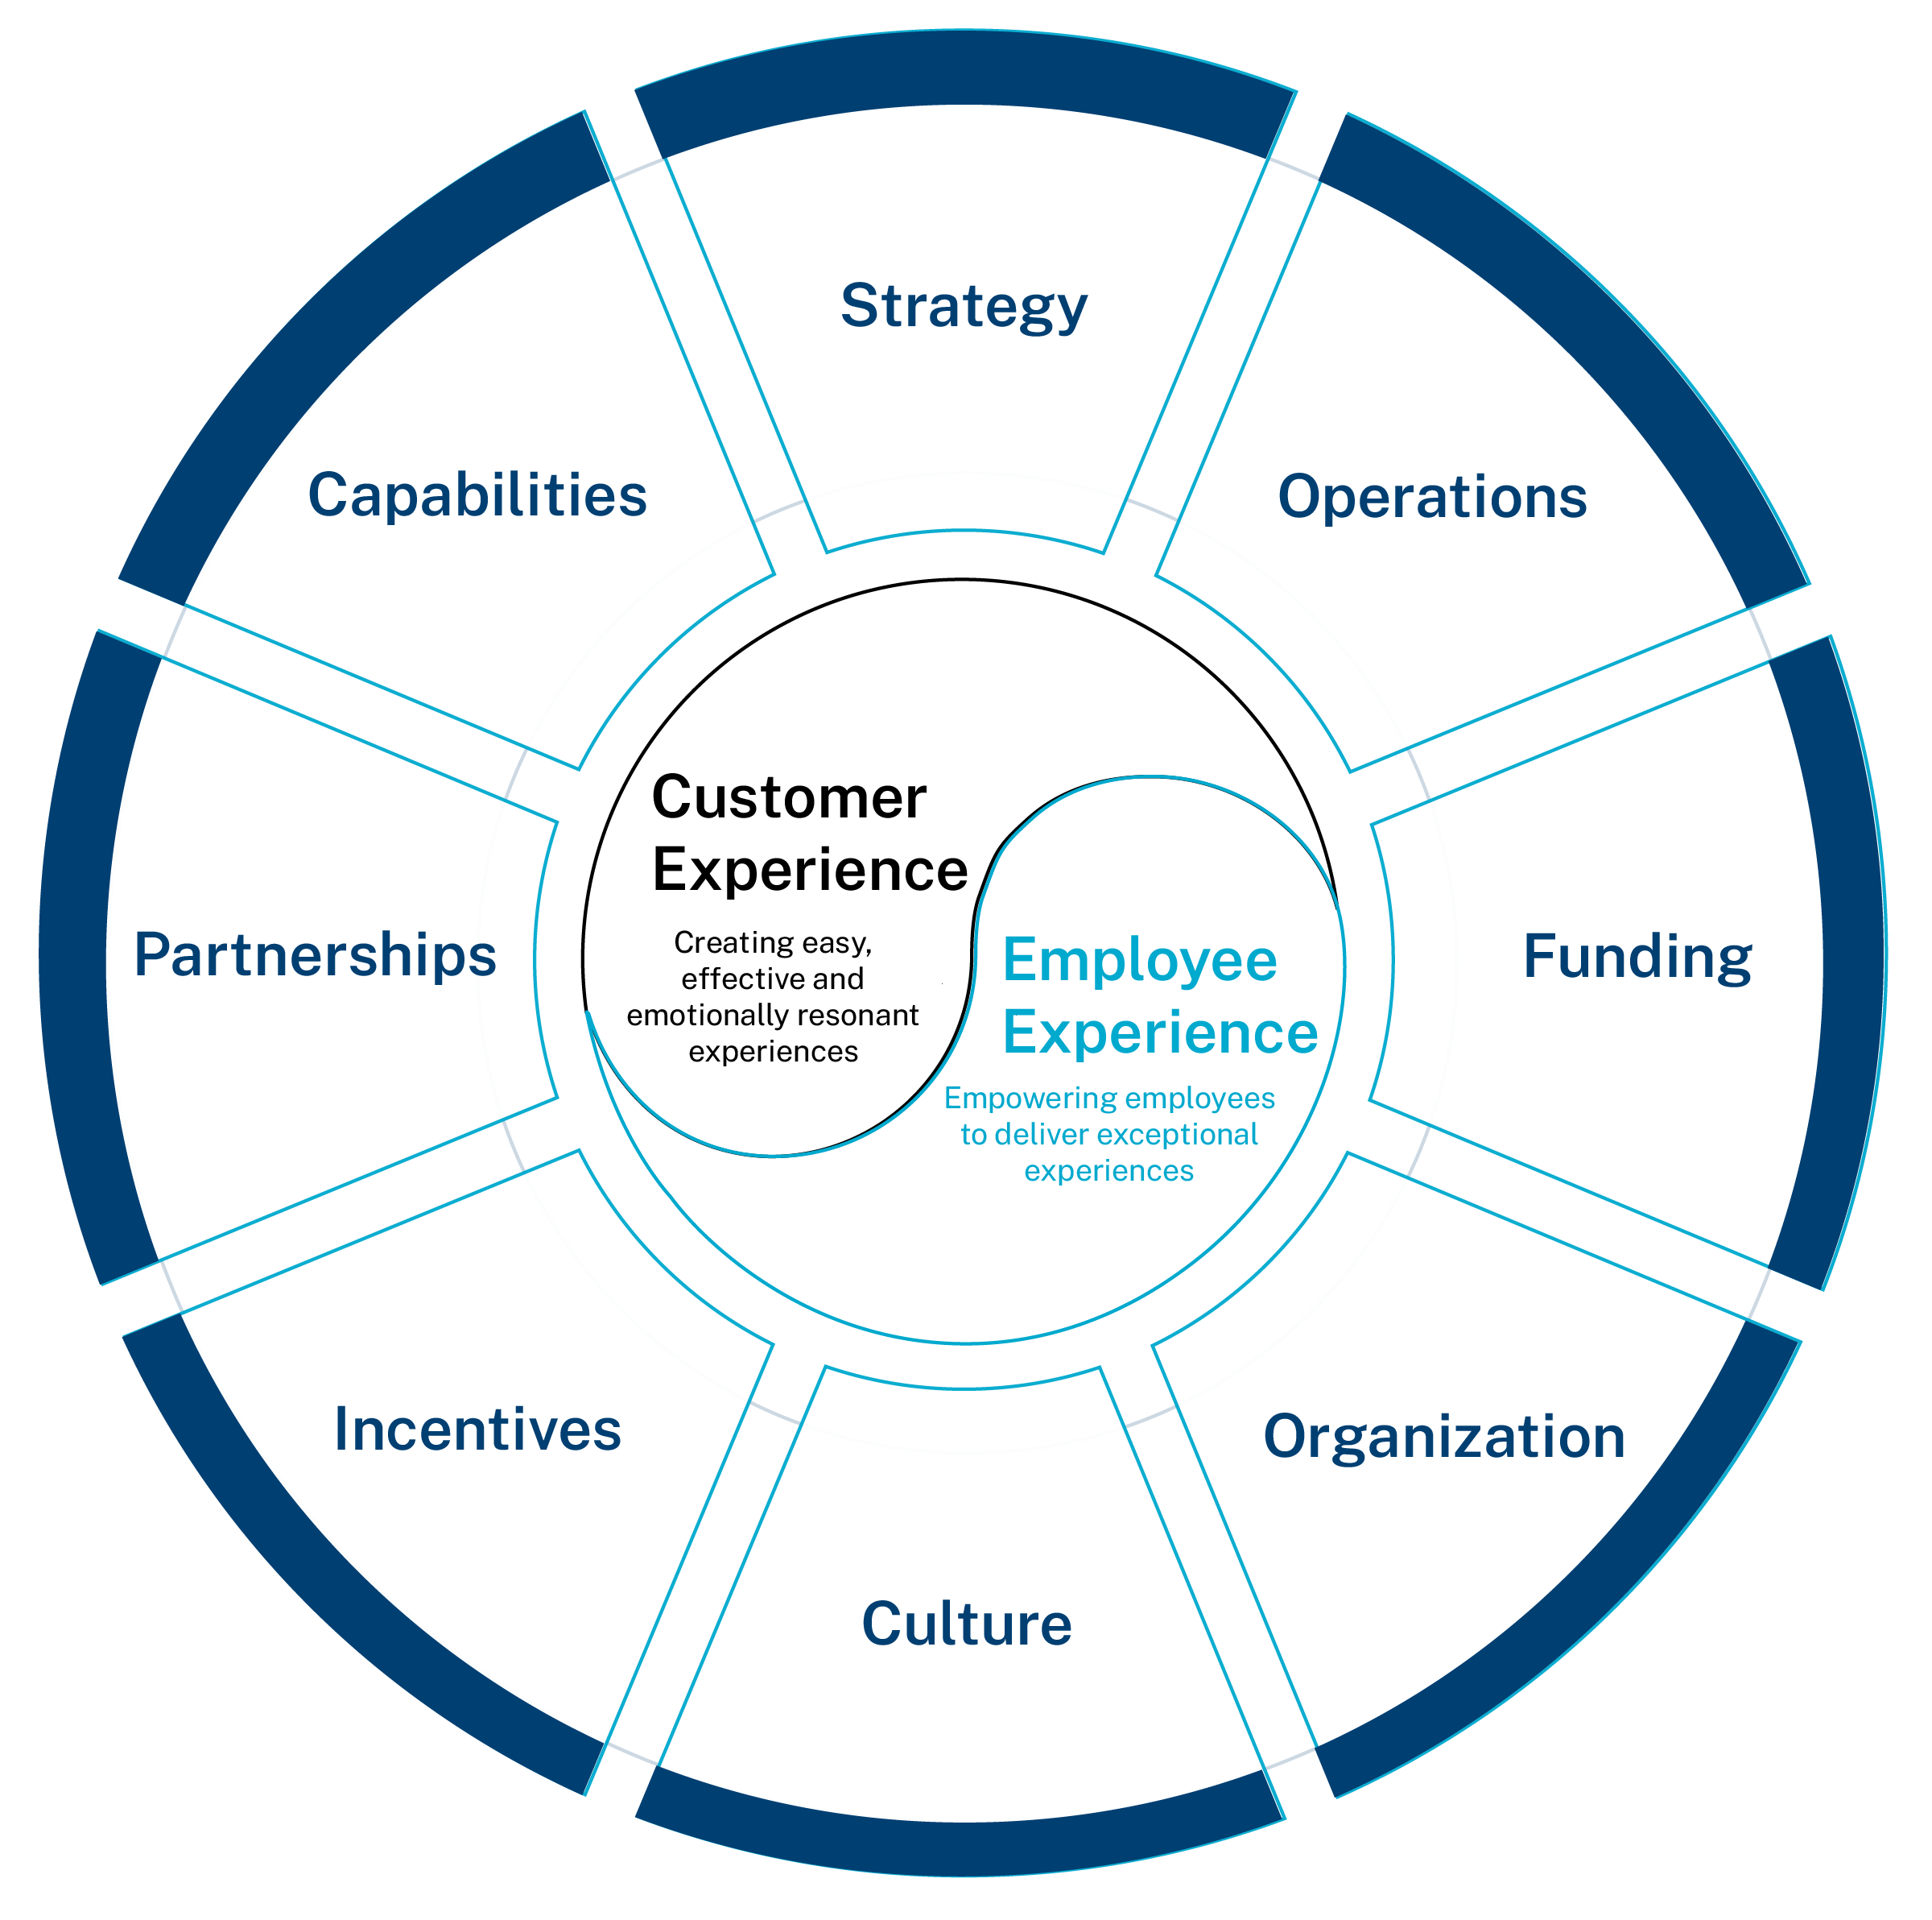
Let’s Talk Employee Engagement
What is Employee Engagement?
Why is Employee Engagement Important?
What part does it play in Customer Experience?
How is Employee Engagement different in the new workplace?
3
Notes:
Definitions of employee engagement
Signs that employees are engaged
AES questions
Lower absenteeism
Higher innovation
Higher CX
Effectiveness
Recruitment & Retention

Slide 5

Remote/Hybrid Workforce Engagement Challenges
  Management Perceptions
  Communications
  Connections
  Training
4
Notes:
Management Perceptions
Communication
Communication effectiveness visual
Connection
No natural shared virtual space for meeting colleagues
Training
Often difficult to demonstrate and walk-through processes
Retention
Employees who are not engaged do not feel valued or connected with the mission
Trust is low, connection is low

Slide 6
Evaluate Management Perceptions
Redesign
Redesign work as needed
Set
Set expectations and provide accountability
Provide
Provide autonomy where possible
Involve
Involve employees in the decision making
Ensure
Ensure equity among work
Measure
Measure what’s important
Adjust
Adjust the hybrid model as needed

Slide 7
Evaluate Communication
    Ease:
      Don’t rely solely on email
      Use one platform consistently
    Effectiveness:
      Establish and conduct regularly scheduled team meetings
      Provide agendas or meeting notes
      Record MS Teams meetings for those unable to attend
    Connection:
      Use web cameras for those who are virtual
      Use anonymous polls to take the pulse of your group
      Engage in two-way communication – group meetings and individual meetings
      Make senior leaders available outside of Town Halls
6

Slide 8
Strategies for Building and Maintaining Connections
Change meeting formats to
decrease "virtual distance"
Empower employees to connect
      Move from presenting to facilitating
      Reserve time for informal discussion
      Use tools such as polls, whiteboards, and breakout rooms (even a Virtual Escape Room)
      Ensure everyone has a chance to speak
      Model vulnerability and empathy as the leader
      Establish virtual water cooler spaces
      Support employee association groups
      Consider hosting themed meetings such as holidays and observances
7

Slide 9

Strategies for Building and Maintaining Connections
    Create consistent, structured opportunities to socialize
      Create MS Teams groups and channels
      Conduct group check-ins to take questions or address mission progress
      Designate mentor pairings during onboarding
      Establish a buddy program for new employees
      Schedule coffee hours weekly during training period
      Host professional development activities such as professional book clubs
      Establish a day where all employees are in the office

Slide 10
Training
    Supervisors
    Train supervisors on how to engage remote employees
    Provide training and micro-learning sessions for the applications that you use to interact in a virtual environment
    Use user-centered design to ensure online resources are easy to access and navigate
    Employees
    Ask people what resources they need to do their jobs in a remote environment
    Look for new applications or technology that could improve processes
    Leverage eLearning (LinkedIn Learning), micro-learning, over multiple platforms in addition to the traditional Learning Management System
9
Notes:
Not able to walk up to someone's desk, also people were feeling disconnected from the culture of the organization with new hires coming on

Slide 11
Additional Resources
  Office of Personnel Management’s 2021 Guide to Telework and Remote Work in the Federal Government
  Secretary McDonough’s 10 Major Steps to Invest in VA Employees
  VA’s Future of Work website
10

Slide 12

Questions

