Slide 1
How to Influence Change Without Authority
Build Desire and Manage Resistance
Notes:
Hi, I’m Tiffany Jennings and we’re here today to learn how to influence change without authority and we’ll do this by diving deeper into understanding how to build desire and manage resistance as Change Agents in our organizations.
First, I’d like to say thank you to my colleague, Toni Bush-Neal, who cocreated the content you see today.

Slide 2



Learning Objectives
Understand the Desire stage of change
Identify contributing factors to resistance
Learn skills to lead change without authority
Notes:
Let’s get started! Just to make sure you’re in the right session today, we’ll discuss….

Slide 3
Scenario
You are the facilitator of a team project, and you notice a breakdown in team consensus and disengagement. Also, communications are not going out as scheduled, ⅓– ½ of the team is not attending meetings, and those who do, have not completed the preliminary work.
Notes:
To get us started on our shared learning experience, let’s look at a scenario: read scenario
In the chat box, please share briefly any tactics you’ve used in similar situations.
Maybe it’s as simple as ensuring the meeting agenda is sent out in advance of the meeting – those small but important items are easily overlooked and can help remind team members who is responsible for which tasks.
Or maybe during the meeting you use a white board to capture team ideas in real time – which is a tactic used to improve meeting engagement.
Whichever approach you take, we can recognize it’s a multipronged effort and at the root of the challenge we need to build desire and manage resistance without authority
Command and control as previous leadership style
Versus influential leadership

Slide 4
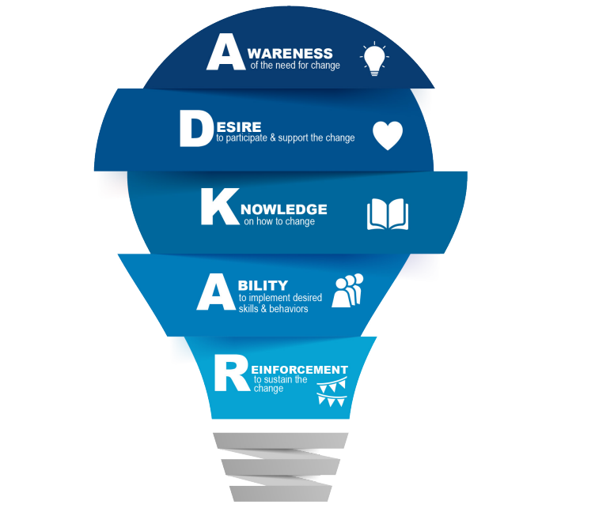
The Five Elements for Successful Change
Notes:
Allow me to introduce you to the Prosci ADKAR Model, which is the approved Change Management model for the VA.
The Prosci ADKAR Model shines a light on five elements, or stages, required for successful change.
This change model helps guide us through change while identifying and addressing roadblocks along the
Journey and is easily applied for changes at home or work, and on changes big and small.
For successful and sustainable change to occur in an organization, the stages of ADKAR should be followed in order beginning with Awareness.
However, we will focus on the second stage of ADKAR, Desire and why it’s so important for all change efforts, but certainly in situations where you find yourself leading without authority.
I would also suggest adding ‘barriers or speedbumps” with roadblocks as roadblock could be considered a stoppage. You mention journey, what journey are you speaking of? Maybe use the term earlier in the speaking section of the scenario. I would suggest removing ‘today’ maybe say, in this session. Also, I would repeat what the definition of leading without authority here. Were you also going to callout awareness here since you mention in the next slide and few slides down?

Slide 5

Building Desire
Desire represents the motivation and willingness to support and engage in a change.
Desire is the most difficult to achieve - it is ultimately a personal decision that is not under direct control.
Notes:
So let’s jump in!
Desire represents the motivation and willingness to support and engage in a change.
Something to consider is that more and more and more awareness or information does not result in desire.
At this stage, Desire explains:
WIIFM – this helps people determine whether the change is an opportunity or a threat – remember I mentioned how people are fearful of the unknown and threats – this directly impacts their desire
The organizational or environmental context for change (the assessment of the surroundings vary from person to person)
The individual’s personal situation (a person’s life situation, family, status, mobility, financial security, age, health, career aspirations, home and work relationships, education, upcoming, and environment)
What motivates them – those intrinsic motivators that are unique to the person (inherent attributes that make us individuals – do you desire respect, power, position?)
Desire is the most difficult to achieve because it is ultimately a personal decision that is not under our control. So how many of you have heard the phrase, “meet them where they are?” What does that mean to you? <PAUSE>
There’s certainly a range of responses to that question, but consider what stakeholders need to have buy-in? Some stakeholders are focused solely on the data, but we know, if we can connect a story and an emotion to the data – then we, as humans, are more likely to see a need for change. It’s these emotions that drive the initial behavior change and the emotions help evolve the change into long term habits.
Often, at the root of a lack of desire is fear and fear, as you may’ve guessed, is a demotivator. As fear diminishes, hope and motivation increase. Hope is a motivator and as motivation increases, harder changes can be made.

Slide 6

Building Desire
Share risks and benefits
Share data
Share success stories
Share personal stories
Incentivize
Friendly competition
Role model change
Create financial ties
Individualize per employee
Shared ownership
Make it exciting and fun
Notes:
Then how can we build desire by increasing motivation and reducing fear?
If you’re following the ADKAR model, then hopefully you have completed the Smart Change Toolkit’s “6-Essential Questions” as part of creating awareness. Part of what needs to be communicated to employees about change are the risks and the benefits to the change. To build desire, ensure the risks and benefits are clear to each stakeholder. Make the information relevant to that specific stakeholder and speak to their intrinsic and extrinsic motivators.
Next, share the data, success stories, and personal stories. Remember, stories help connect us as humans.
When possible, incentivize. This can seem challenging as government employees but get creative! Host a team potluck for small wins. Public recognition and gratitude to team members who contribute and complete work on time.
Friendly competition? Who doesn’t love a friendly competition?! This tactic is best used between teams rather than internal to teams due to inadvertent internal team conflict it can create.
We know as Servant Leaders, even if we are not formal leaders in our organizations, that we are watched and listened to so be sure you’re modeling the behaviors expected.
When possible, help others understand the Return on Investment – this his typically through financial ties, but could be a reduction in time spent on a specific task
Recognize people as individuals and connect with fellow employees. Understand their intrinsic motivators and guide the individual choice. When you are connected, it becomes easier to see the shared vision and work together to accomplish the change
Shared ownership helps people to feel that they are part of the solution. That Naysayer who doesn’t believe in change? Give them a seat and a voice at the table. When people feel included and are part of the solution, they become champion change agents!
Last, make it exciting and fun! Change doesn’t have to be hard. Encourage others to be innovative with solutions.
The first part of the second sentence does not apply to this session. Maybe provide some examples risks and benefits. Should we change servant leaders as some people do not know that term? Is there another term we could use for ‘formal’ leadership? Are you going to discuss how to ‘guide the individual choice’?

Slide 7
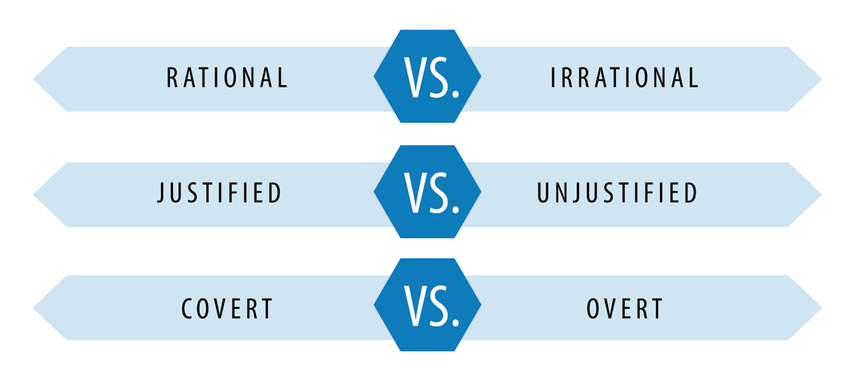
Managing Resistance – Reasons for Resistance
Notes:
Now that we know about building Desire, it’s important to understand how the stage is related to managing resistance. Before we learn about tactics to manage resistance, let’s first look at what the literature tells us about reasons for resistance.
To start, we have Rational or Irrational Resistance to Change. There is very little literature on irrational resistance, hence there is no agreed upon definition but we do know that irrational resistance is usually expressed in various behavioral forms (de Jager, 2001)
From rational resistance, we can then break out the Justified vs. Unjustified classifications.
Unjustified Rational Resistance is usually psychological in nature and may take the form of fear or threat. Remember, we briefly learned that fear is a demotivator and people can be afraid of
the unknown
Personal Failure
Labelled as Incompetent in a group of peers
Fear of Loss of Control over the situation – or perceived control
Threat to personal values, principles, or philosophy
Threat of possible change in the status, title, or power
Justified Rational Resistance happens when a real threat or fear exists, and the change is manifested in a negative form. In some situations, Justified Rational Resistance may have a positive effect on the organization because members of the organization correctly identify the threats and resist the change due to the threat of. It’s important to acknowledge that the resistance in this situation is to the adverse outcomes and not the change itself (de Jager, 2001; Atkinson, 2005; Dent and Goldberg, cited in Oreg, 2006 p. 76);
Potential adverse outcomes may include:
Increased workload
Lower job security – an example here is a new call center contract – call center employees would rationally and justifiably be concerned about their job security
Change may adversely affect the social networking of the employee that is crucial for the well-being of the employee
Resource availability for implementing the change is insufficient
Need for change is not considered urgent or important
From here, Rational Justified and Unjustified Resistance can be expressed as either Covert or Overt
Overt resistance is relatively easy to identify, and appropriate strategies can be used to mitigate its effects. Overt resistance may manifest in various forms but is usually expressed in the form of opposing vocally or physical agitation
Covert resistance on the other hand is very difficult to detect and may be expressed in the following ways (Recardo, 1995):
Reduction in the output
Withholding information – this is a tactic often used when people believe they have low job security. If they are the keeper of information, then they are not expendable.
Lingering on the topic by asking for unnecessary details and information. Of course, we encourage employees to ask questions so they have a systems perspective, but if employees feel they do not have sufficient information to make informed decisions, then reconsider the tactics and forums used to create awareness and ensure all risks and benefits are communicated clearly
Last, the development of or excessive use of complex governance structures. Sure, certain change efforts may need to route through governance channels before proceeding, but for true organizational change, we need to empower all staff to make decisions for their work areas!

Slide 8
Managing Resistance – Reasons for Resistance
Individual Resistance
Organizational Resistance
Fundamental Attribution Error
Notes:
Okay, so everything we just discussed can be applied to both individuals and organizations.
There are many ways the reasons for resistance to change impacts employees at the individual level. Let’s look at a few common challenges:
Fear. All of the components of fear that we discussed earlier – fear of unknown, personal, job, and financial security, and so on
Individuals consider how realistic the change effort is
They may say, “if it ain’t broke, don’t fix it”
How directly the change impacts them
Lack of acceptability or tolerance for the change:
We’ve all seen the change curve and know that we have Innovators, Early Adopters, Early Majority, Late Majority, and Traditionalists – understanding an individual’s tendency towards change can be helpful in addressing perceived resistance
We also experience change fatigue. Every single person. And this negatively impacts our motivation and desire to adopt more change
And last, a rigid belief that changes are inherently bad – this last one being relatively rare
Similarly, reasons for resistance to change can happen at the team level, Service level, or at the Organizational level. What does this look like?
To start, structural resistance is a defining feature of bureaucracies, which focus more on stability, control, set methodologies or routine. The very nature of bureaucracies creates an environment in which it is difficult to achieve sustainable change – but NOT impossible!
Next, when we do not account for all people, resources, and processes within the system, then the organizational change that is desired will not occur or will be slow to evolve
Organizations may resist change because just like individuals, organizations follow set behavioral patterns, norms, and cultures. Due to the change, the groups within the organization will likely need to change their existing ways of conducting business
And last, possible threats to power. Any kind of devolution of power or transfer of resources from some agency or group to some other agency or a group will lead to a feeling of fear towards the change
So why is all of this theory important? Well, it’s because, as humans, our natural tendency is to default to the “Fundamental Attribution Error.” Simply put, when we perceive someone as being resistant to change, we tend to label those people based on their personality and behaviors rather than situational explanations. Being mindful of our cognitive biases is important to addressing change in ourselves and others so remember to pause and consider all of the social, environmental, and organizational forces that influence us and those around us.
Toni’s suggestions: I think we need to bring the. comprehension level down a bit here “Fundamental attribution error – are you going to define this or can you change the wording to something all levels can understand?

Slide 9
Final Scenario
After several requests for Executive Leadership support, the assigned Executive Sponsor has not followed through on various items the team needs to move forward.
Notes:
Based on what we have covered, let’s look at another scenario:
Please share in the chat what tactical approaches you would take to lead without authority in this situation. What would be your next steps?
Is this covert resistance? Have we set up the Executive Sponsor for a successful change?

Slide 10

Build Desire and Manage Resistance – In Action
Emphasize communications
Hold meetings and obtain feedback
Provide materials, tools, and support
Engage and involve managers
Notes:
Based on what we’ve discussed today and sharing best practices from the literature, we should focus on
Emphasize communication:
Do you have clearly established communication channels? Create and carry out structured, targeted, and frequent communications about the change and ensure everyone is clear on what the communication channels are
Be clear about roles and what each stakeholder contributes to the change
Help to manage competing priorities and expectations – present the necessary and relevant information to the appropriate stakeholders
Hold meetings but do so in a way so that you’re not just delivering information but receiving it as well. When people feel included and have a voice, they feel empowered and motivated to drive change
Provide materials, tools, and support – as a Servant Leader and Change Agent in your organization, make it as easy as possible for those involved. Establish a singular platform to share information that is accessible to all participants, establish recurring meetings, block calendars, block rooms if you’re lucky enough to meet in person! In short, equip others to coach employees through change and empower them to be a change liaison with the project team to address barriers
Last, engage and involve managers and supervisors. Now, it is essential to have Subject Matter Experts as key stakeholders for successful change. What do I mean by Subject Matter Experts, that is to say, those people who do the work, who create the widgets, who see the patients – those people we expect to see behavior change from. They must be involved when identifying and testing solutions. But it is also important to engage their supervisors and managers for awareness. Why? Because employees need to know that they and the change are supported by their direct leadership. When the SMEs understand and believe this one piece of information, they are more likely to remain engaged through the duration of the change effort.

Slide 11

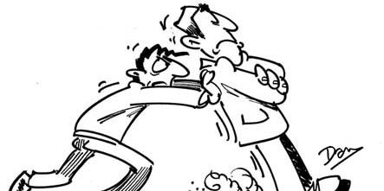
Key Takeaways
Notes:
What are our key takeaways?
First and foremost, remember that change does not start with Desire. Focus first on creating Awareness before moving towards building desire.
Remove fear and increase motivation by connecting the data and the need for change to a story
Lead by example, role model the expected behavior changes
Desire is ultimately about personal choice, influenced by the nature of the change, by an individual’s personal situation, as well as intrinsic motivators that are unique to each person.
Managing resistance, as we learned is connected to building desire and the resistance behaviors exhibited by employees are often due to personal, situational, environmental, and organizational factors.
It’s these situations and factors that lead employees to accept change over time.
Resistance to change should be expected but we should also expect excellence within our organizations so that we confidently deliver first-class services to Veterans, their families, and care givers.
Remember, as change agents in your organization the goal is to help others change!
When we set up ourselves, our change efforts, and other for success, we hopefully transition from this to this (use of images on slides) and see sustainable change on the macro level!
Toni’s suggestion: maybe change the first bullet. It is awkward given that the focus of this session is desire and resistance and not awareness. Again, I would not refer to the individuals as change agents in this session because we will have different levels of staff who may not know that terms. May champions of change??

Slide 12
How to Influence Change Without Authority
Building Desire and Managing Resistance
Notes:
Thank you for your time and I hope you’ve enjoyed the session on how to influence change without authority.

Slide 13


















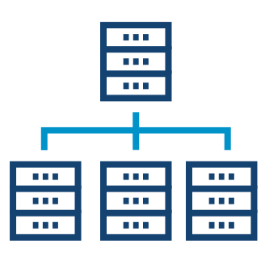




















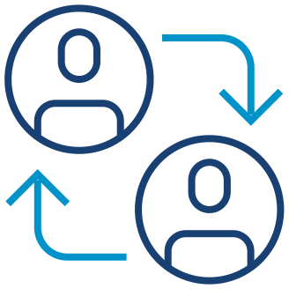



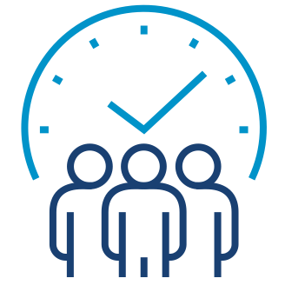




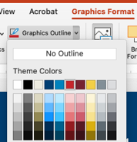













Thin Line Two-Color Icons
Academic Affiliations
App
(Mobile App)
Benefits/
Regional Office
Bright Spots
Caregiver
Communication
Community
Community Veteran Engagement Board
Data
Design
Digital Modernization
Discovery
Ease
Effectiveness
Email
Emotion
Employee
Employee Experience
Engagement
Enterprise Data Management
Faith Based Organizations
Family Member
Governance
Hospital
Improve
In-Person
Insights
LGBTQ
Men
Minority
Moments that Matter
Navigation
NCA
Office of the Secretary
Implement
Industry Best Practices
Pain Points
Patient Experience
Peer-to-Peer Networking
Performance Improvement
Phone
Respond
Service Recovery
Survivor
Technology
The Board
Tools
Partners
Trust
Veteran
Veterans Experience (VetXL)
Veterans Service Organizations
VHA
Virtual
Volunteers
Women
Training
VBA
*TIP: To change icon color, select “Graphics Format,” “Graphics Outline,” then select color of choice.

Slide 14


























































Full Color Icons
Academic Affiliations
App
(Mobile App)
Benefits/
Regional Office
Bright Spots
Caregiver
Communication
Community
Community Veteran Engagement Board
Data
Design
Digital Modernization
Discovery
Ease
Effectiveness
Email
Emotion
Employee
Employee Experience
Engagement
Enterprise Data Management
Faith Based Organizations
Family Member
Governance
Hospital
Implement
Improve
Industry Best Practices
In-Person
Insights
LGBTQ
Men
Minority
Moments that Matter
Navigation
NCA
Office of the Secretary
Pain Points
Patient Experience
Partners
Peer-to-Peer Networking
Performance Improvement
Phone
Respond
Service Recovery
Survivor
Technology
The Board
Tools
Training
Trust
VBA
Veteran
Veterans Experience (VetXL)
Veterans Service Organizations
VHA
Virtual
Volunteers
Women

