Slide 1
Welcome to Introduction to Customer Experience and
Human-Centered Design!
VA Customer Experience Institute
Notes:
Welcome to the Course: 1 minutes
I’m going to give you a little primer on our Customer Experience Institute courses where we focus on teaching a Human Centered Design way of thinking

Slide 2
Agenda
Customer Experience Overview
Applying CX at VA
Human-Centered Design
Notes:
Duration: 1 minute (1:05)
Facilitator Notes: For today’s lecture I’m going to cover these three areas:
Briefly review the session objectives:
Introduce customer experience (CX) and human-centered design (HCD) principles and terminology and
Connect CX mindsets to everyday work at VA.

Slide 3

Activity
Creativity is a crucial step in Human Centered Design, let's practice
Grab a writing utensil and piece of paper
Draw a vase
Now let's think about this differently...
How would you design a way to enjoy flowers
Drop in the chat, some of your most unique experiences enjoying flowers
Vase Exercise
Notes:
Duration: 3 mins (1:05-1:07) 3mins
Facilitator Notes:
Human Centered Design is about tapping into that creative part of our brain.
Let’s do a little exercise.
Pull out a piece of paper and a writing utensil.
You have 30 sec to draw a vase. Don’t’ worry about what it looks like, just draw a vase.
Now I’m going to give you 60 secs to think about and draw as many ways as you can think of for how to enjoy flowers.
Be creative, be unique. Answer this question, how would you like to enjoy flowers and draw that.
After 60 sec: Drop your most unique ways in the chat.
So Human Centered Design is a lot like this. It takes a common problem and asks you to think about things differently and from a unique perspective.
Like the variety of vases that I’m sure exist out there, there are probably twice or three times as many creative ideas about ways to enjoy flowers.

Slide 4
Customer Experience
Section 1
3
Notes:
Customer Experience Section Transition: 1 minutes (1:08)
Facilitator Notes:
Say: You may hear it referred to by other names, like Patient Experience or Veteran Experience.
At VA, we generalize customer to mean the person you serve, whether that is a patient, a Veteran or their family, or even a fellow VA staff member.

Slide 5
Customer Experience is…
The public’s perceptions of and overall satisfaction with interactions with an agency, product, or service.
Notes:
Customer Experience Definition: 1 minutes (1:09)
Facilitator Notes:
Say: In the US Government, Customer Experience is defined as “the public’s perceptions of and overall satisfaction with interactions with an agency, product or service.”
At VA, we provide many different services, products, and interactions.
While this is the official definition, it is a little wordy and technical. Let’s take a look at a few examples of what a customer experience might look like.
Transition to the next slide.

Slide 6
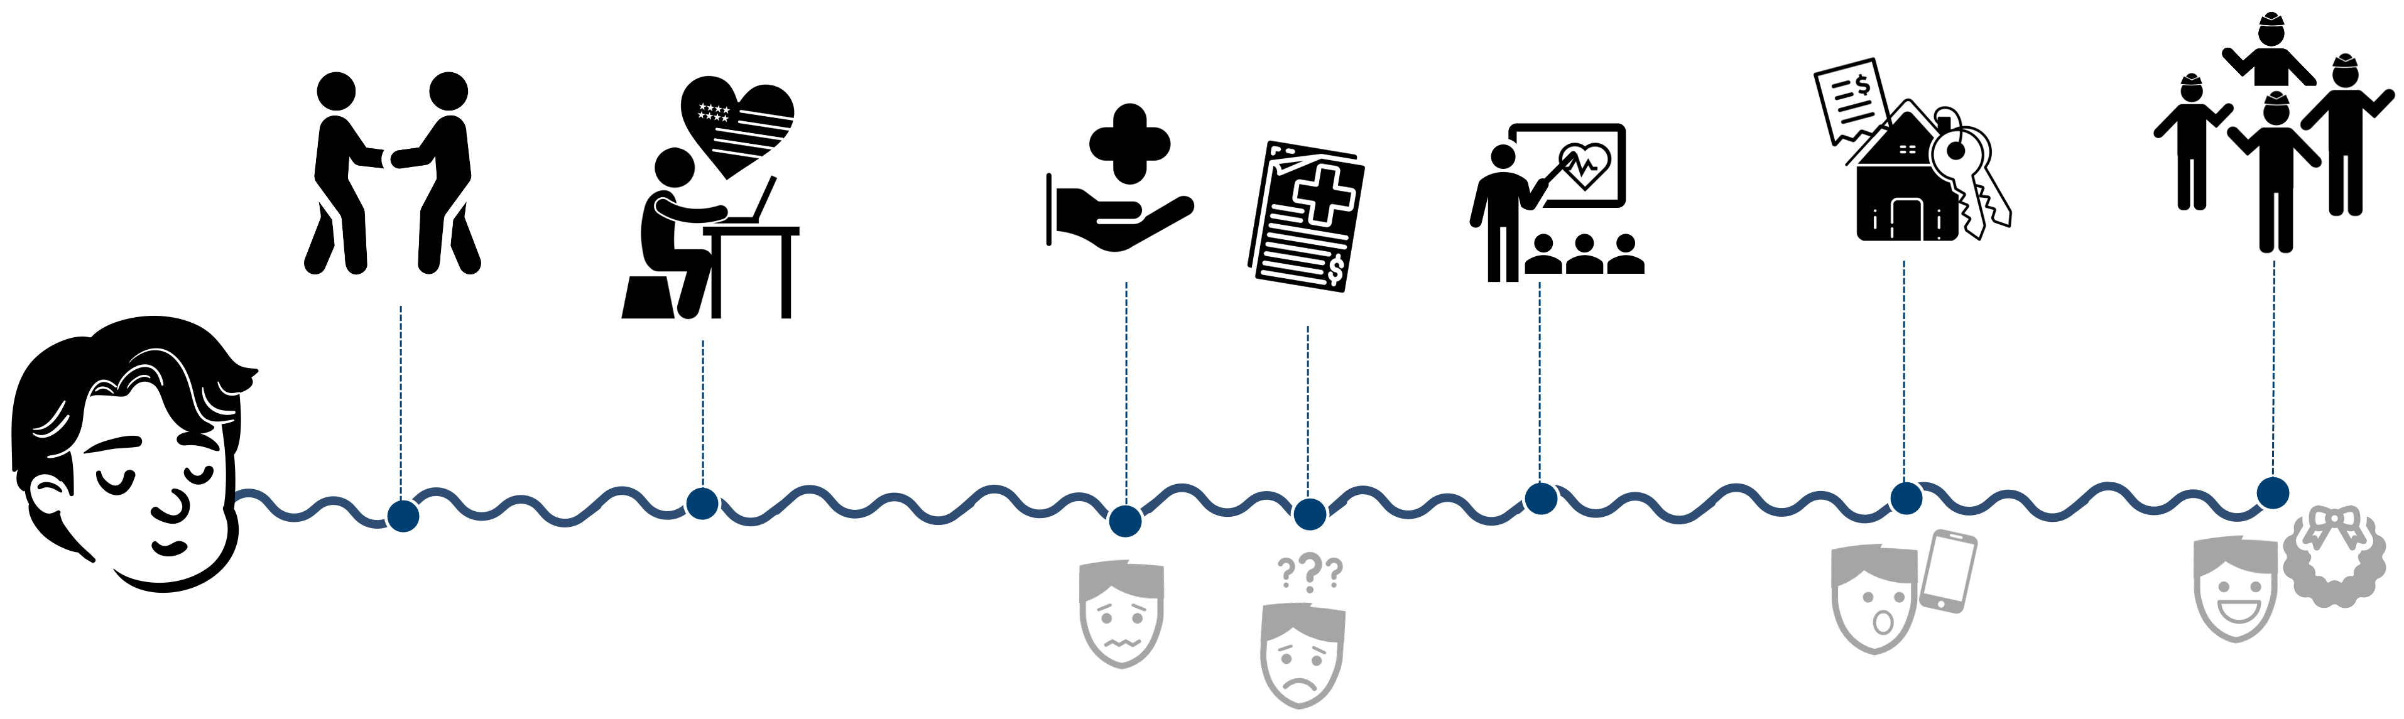

Meet Alex
Notes:
Customer Experience Story: 1:10-1:12) 2mins
Facilitator Notes:
Say: I’d like to introduce you to our fictional Veteran, Alex. We’re going to follow Alex’s story as they move through the journey of a Veteran.
Alex served for several years in the military before transitioning out of service.
After leaving service, Alex received an email, thanking them for participating in TAP (Transition Assistance Program), where they attended an online course that explained how they can access some of their benefits and what services were available to them.
Next, Alex decided to apply for benefits using VA’s website and My VA portal. Alex applied for several benefits, but was most interested in receiving education through the GI Bill
While continuing to live their life, Alex required medical assistance and was admitted to a VA hospital. Alex received medical service and was discharged a few days later.
Following their stay at the hospital, Alex was referred to an outside provider for continued service and received a bill. Alex submitted a medical claim to their insurance. Alex was unsure of the finer details of their coverage and decided to send an email to a general inquiry email they found on VA’s website.
Later, Alex receives information about a Whole Health seminar hosted by VA. After considering an in-person session, a virtual lesson, and a recorded session on a smartphone app, Alex decides to attend an in-person training with several other Veterans and a certified VA instructor.
Alex decides to apply for a VA Home Loan. Alex can’t find the answers they are looking for on the website, so they decide to give the VA help line a call to answer the question more quickly.
Alex’s new home is right by a Veterans Cemetery. Alex decides to volunteer for the annual National Wreaths Across America Day activities where they interact with other Veterans and several VA staff members.
Ask:
Think about what it would be like if:
1. If Alex’s interactions with VA are positive, what are the consequences for us as an agency?
If Alex’s interactions were negative, what are the consequences?

Slide 7
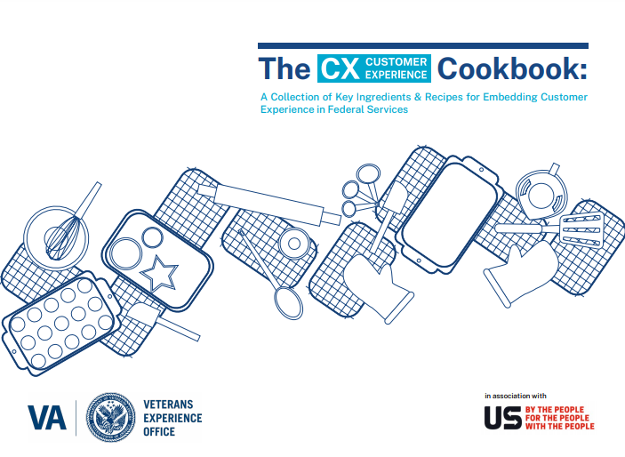





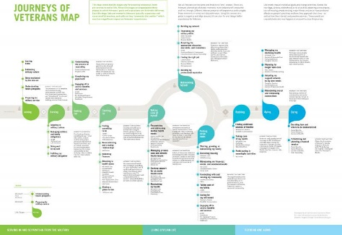





Our VA Customer Experience Journey
Through transformational leadership and dedicated employees, VA committed itself to core values, characteristics and principles that define the organization and how it serves Veterans, their families, caregivers, and survivors.
Employee Experience Journey Map published
VA Directive 0010
VA Customer Experience
Customer Experience
Prime Directive
38 C.F.R. amended to include ICARE Core Values and Characteristics
§§ 0.600-0.602 (7/13/2012)
VSignals Measurement Established
VA/VEO Leads PMA CAP Goal for Improving Customer Experience
Phoenix OIG Report released (8/2014)
VA Welcome Kit
published
2011
2012
2013
2014
2015
2016
2017
2018
2019
2020
2021
Human Centered Design Team Established in VEO
VETERANS
EXPERIENCE
OFFICE
VA CX Institute established
ICARE formally introduced
(6/20/2011)
MyVA Transformation to rebuild trust, VEO was established.
38 C.F.R. § 0.603 added to include CX Principles (5/20/2019)
ICARE Refresh
“The VA Way”
Veterans Journey Map published (11/2015))
Patient Experience Program launched
Notes:
Our VA Customer Experience Journey: 1 minutes (1:13pm)
Say: The experience of our customers is a critical component of achieving the VA mission.
A negative customer experience could have as big of an impact as outdated facilities, faulty equipment, or an incorrectly processed claim.
Say: VA has been on a journey for almost a decade of thinking about and working toward a better Customer Experience journey.
We still have a ways to go, the VA’s Customer Experience Institute are the latest effort to bring Customer Experience design to the forefront of VA’s priorities.
Our goal is to make it clear for you, the next generation of designers, that VA wants you to do this work and that you have the permission and support to do this work.
Transition to the next slide

Slide 8
Applying CX at VA
Section 2
7
Notes:
Applying CX Mindsets at VA Section Transition: 1 minutes (1:14pm)
Facilitator Notes:
Say: So, what does it mean to “do customer experience work” at VA?
We will talk about how we design for better customer experiences, but small changes in how we approach our daily work can have big impact.
We talk about those small changes as adopting customer experience “mindsets” or new ways of thinking about our work.
Let’s take a look at some of these mindsets.
Transition to the next slide.

Slide 9






Applying CX Every Day
What does a Customer Experience Mindset look like in your daily work?
Take your customer’s perspective
Empathize with your customer
Solve the right problem
Get feedback early and often
Embrace uncertainty
Notes:
Applying CX Every Day: 1 minutes (1:15pm)
Facilitator Notes:
Say: No matter what project you are on, you can consider these things to add a customer experience flavor to your work. Whether directly or indirectly – you are delivering services for Veterans. The CX mindsets are:
Take your customer’s perspective
Solve the right problem
Embrace Uncertainty
Get feedback early and often
Empathize with your customer
Rather than me telling you the importance of these mindsets, we want you to think about what these really mean and why they matter at VA. During our 7 course Customer Experience Institute, we go into more depth about taking each mindset and applying it to everyday work at the VA
Transition to the next slide.

Slide 10
Human-Centered Design
Section 3
9
Notes:
Human-Centered Design Section Transition: 1 minutes (1:15-1:16pm)
Facilitator Notes:
Say: Now that we understand what Customer Experience is, the obvious next question is “how do we improve our customer’s experience?”
At VA, you probably use many different methods when you want to make a change: Lean Six Sigma, systems redesign or maybe you have your own process.
When it comes to Customer Experience, the tool we suggest you use is called Human-Centered Design.
Transition to the next slide.

Slide 11
What is Human-Centered Design?
A multidisciplinary practice that puts human input at
the center of problem solving at every phase
of the design process.
Notes:
What is Human-Centered Design: 1 minutes (1:16pm)
Facilitator Notes:
Say: You know that old saying “the customer is always right?” In HCD, the customer’s input is always at the center of each decision we make.
We define Human-Centered Design (or HCD) as a multidisciplinary practice that puts human input at the center of problem solving at every phase of the design process.
This makes it uniquely positioned to solve customer experience problems compared to other methods.
Transition to the next slide.

Slide 12
Human-Centered Design Compared to Other Methods
Empathy based
Human-Centered Design
Innovation
Human-Centric, Problem Solving, Iterative
Hypothesis Driven
Lean Startup
Six Sigma
Business Model
Process
Quality & Process Driven
Notes:
HCD Compared to Other Methods: 1 minutes (1:17pm)
Facilitator Notes:
Ask: However, we know that Human-Centered Design is not the only problem-solving methodology out there. I’d like to see a show of hands (via Zoom) if you have heard of Lean Start-Up, Agile, or Six Sigma.
I’m sure many of you are familiar with other problem solving methods out there: Like Lean, Six Sigma, or Agile:
What this diagram illustrates is just like there are a variety of problem solving methods, they can work together to solve complex problems
Human Centered design is the approach we in VA use in order to ensure that our solutions are focused on the human who has the problem
if the problem you want to work on involves people, especially different groups of people. If this problem is complex in all the people and systems involved. If you’re seeking root cause of what you’re noticing (as in what you see as a problem might just be a symptom of a bigger problem or multiple problems), and if you’re looking to innovate instead of wanting incremental improvement, then human-centered design is the approach for you.

Slide 13
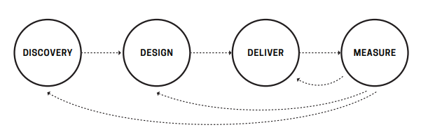
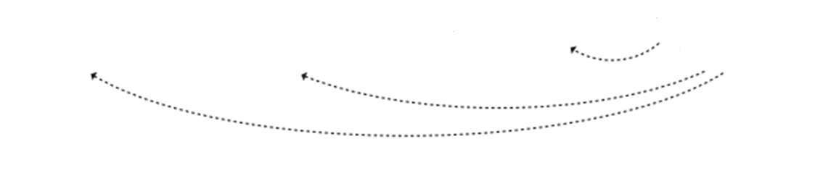
Human-Centered Design & VA
VA uses a four-phase process to improve products and services for our customers
DISCOVERY
DESIGN
DELIVER
MEASURE
Notes:
Human-Centered Design at VA: ( 1:17-1:19) 2mins
Facilitator Notes:
This slide has animations that cause the phase to be highlighted as it is being discussed. Progress the animation at each of the numbered bullets below.
Say: So how does HCD actually work? HCD involves a four phase process to create solutions
The process begins with Discovery, where we try to define a specific problem to address and build empathy for our customers by directly asking them about their experience. In this process we are discovering information that will help us solve the problem later.
Next, we Design our solution to the problem. This involves brainstorming many possible solutions and narrowing them down to the best options. We directly test different ideas with our customer, so we learn how we need to design our final solution.
Now that we know what our solution will look like, we Deliver it to our customers. This involves securing the resources to scale our solution up to reach a widespread audience. To fully realize the impact of our work, we must make sure our recommendations don’t just remain recommendations; we must actually deliver the solution we spent so much time creating.
Our final phase is Measure, in which we continue to collect feedback from our customers and refine our solution. However, recall that earlier we said human input is at the center of every one of these phases. So we don’t just measure at the beginning, we measure human input and customer feedback at every stage of this process.
Finally, while this framework may appear to flow in one direction, HCD is often a fluid process that involves revisiting past phases. Something learned in the design phase may require a return to discovery or an issue with delivery may mean more designing is required. So think of this framework as a loose guide of how HCD really happens.
PLAY VIDEO: https://www.youtube.com/watch?v=rmM0kRf8Dbk
Transition to the next slide.

Slide 14
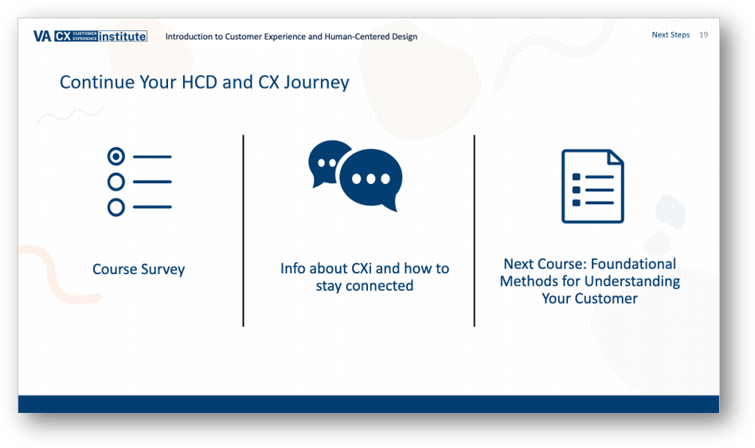
Human-Centered Design & VA
Mailbox: VACXi@va.gov
Website: VA Customer Experience Institute: Home
https://youtu.be/rmM0kRf8Dbk
Notes:
Duration: 1 min (1:19-1:22) allow 2:55 mins for video and wrap up by 1:23-1:25)
Facilitator Notes:
https://www.youtube.com/watch?v=rmM0kRf8Dbk
Say: IF all this sounds like something you would like to be a part of. Please check out our website listed above or in the chart. WE also have an email box. Our Customer Experience Institute is a 7 course session covering how to solve problems keeping the customer at the center.
Please sign up to receive information on our next set of offerings.
And reach out to me if you have any additional questions.
Do:
Thank everyone and end/close the virtual session.

