Slide 1
Data Inaccuracy: The ripple effect of emotional harm
Presented by: Nancy Walters

Slide 2
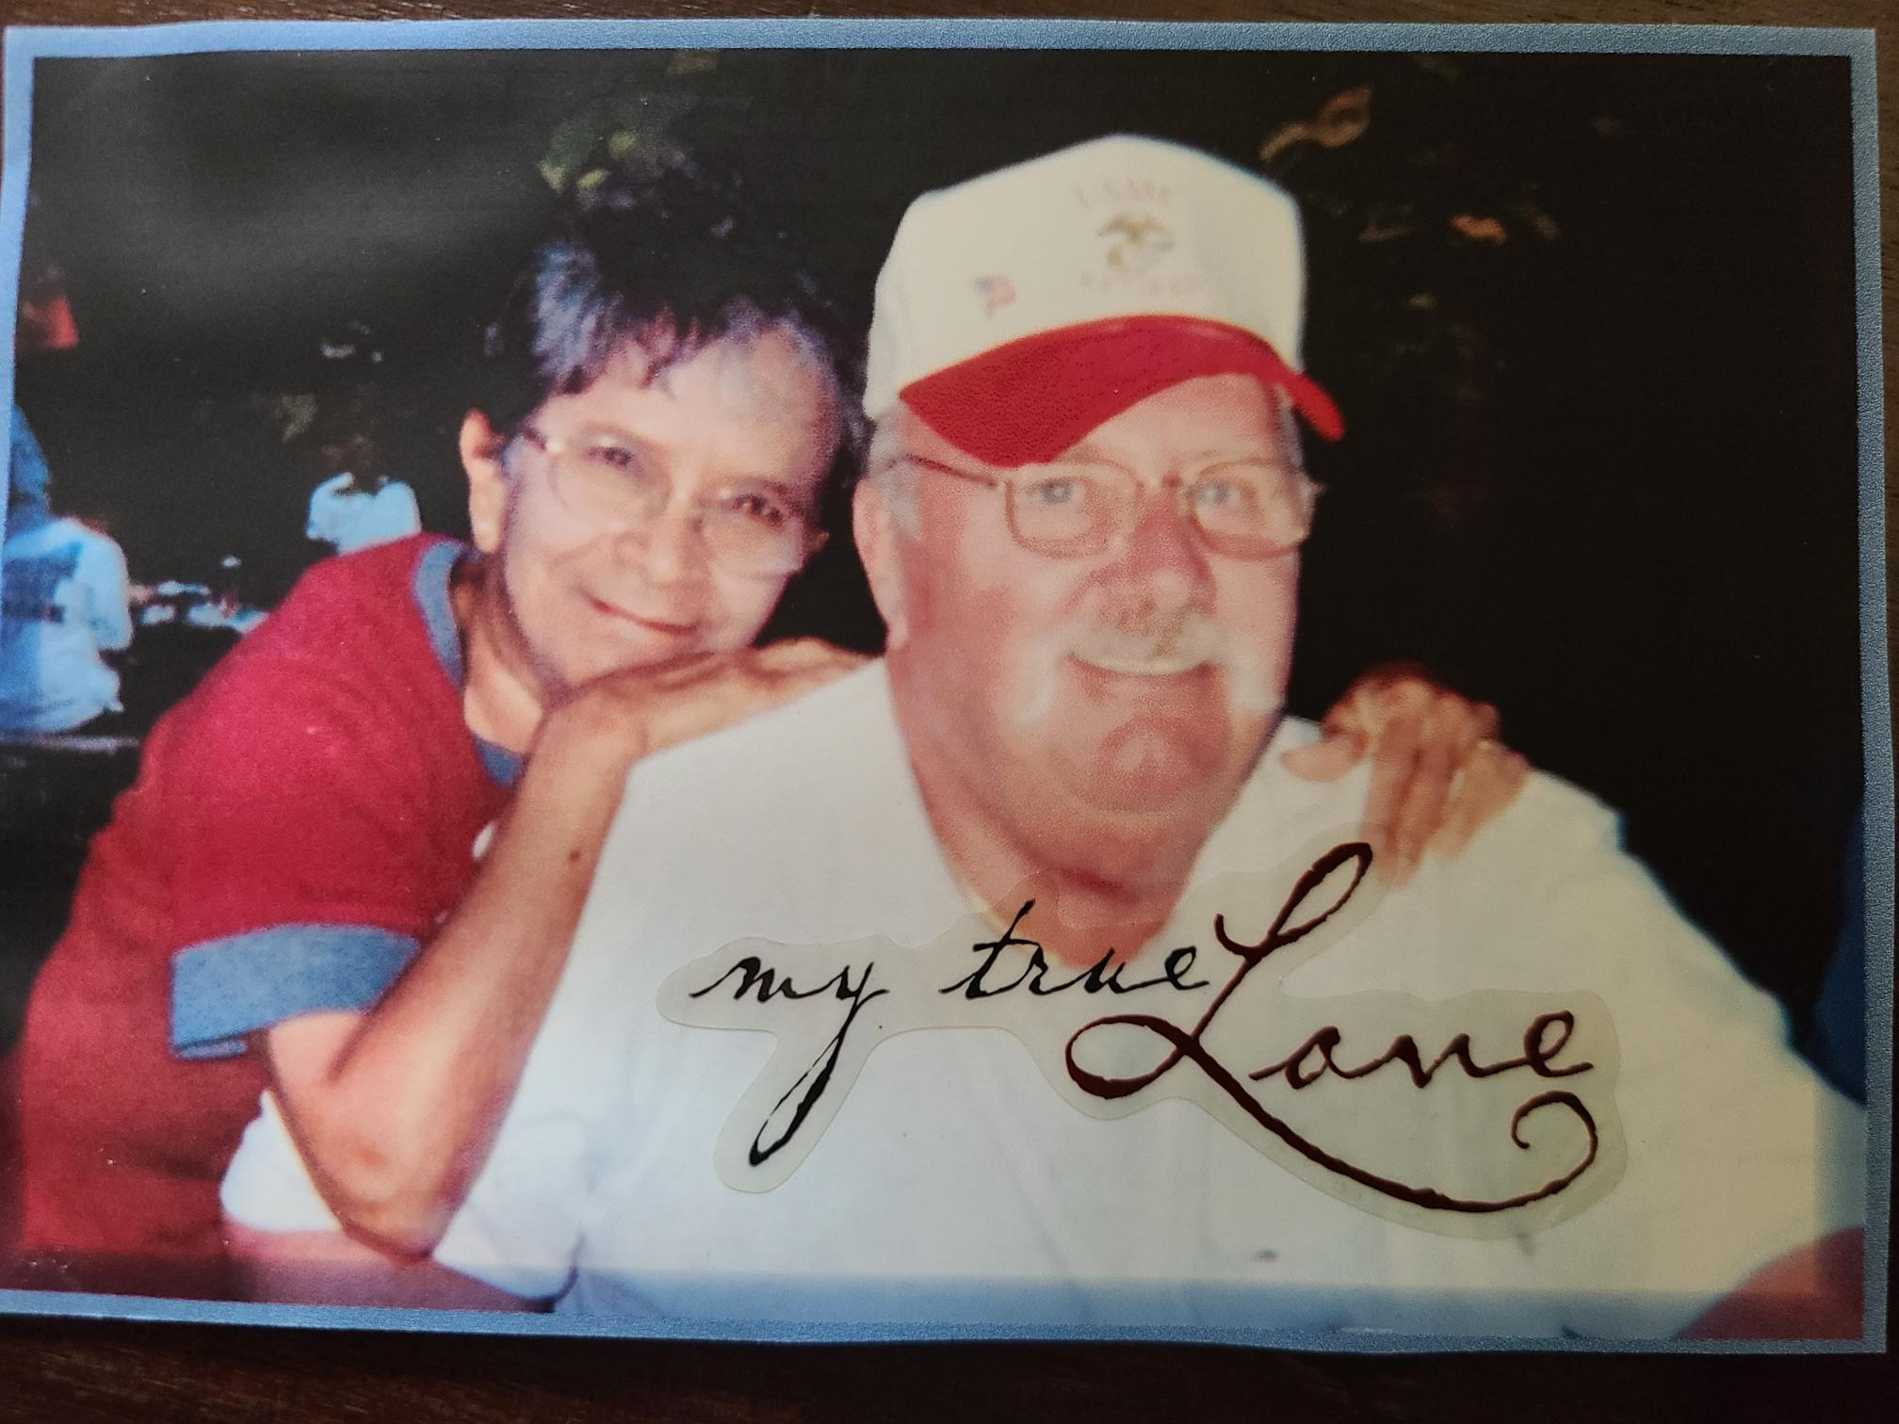

Slide 3
“Unofficial” Notice…
“Dear Next of Kin:”
“We have received an unofficial notice of the death for…”
“If correct accept our sincere condolences.”
“If incorrect, please have the member contact us immediately.”

Slide 4
Report of Existence
"I am not dead"
"I am alive"
"I exist"
"Please keep paying me"
30 days to review

Slide 5
Fast Start
"DEFINE F-A-S-T“
30 days to review

Slide 6
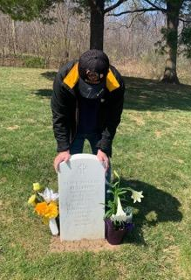
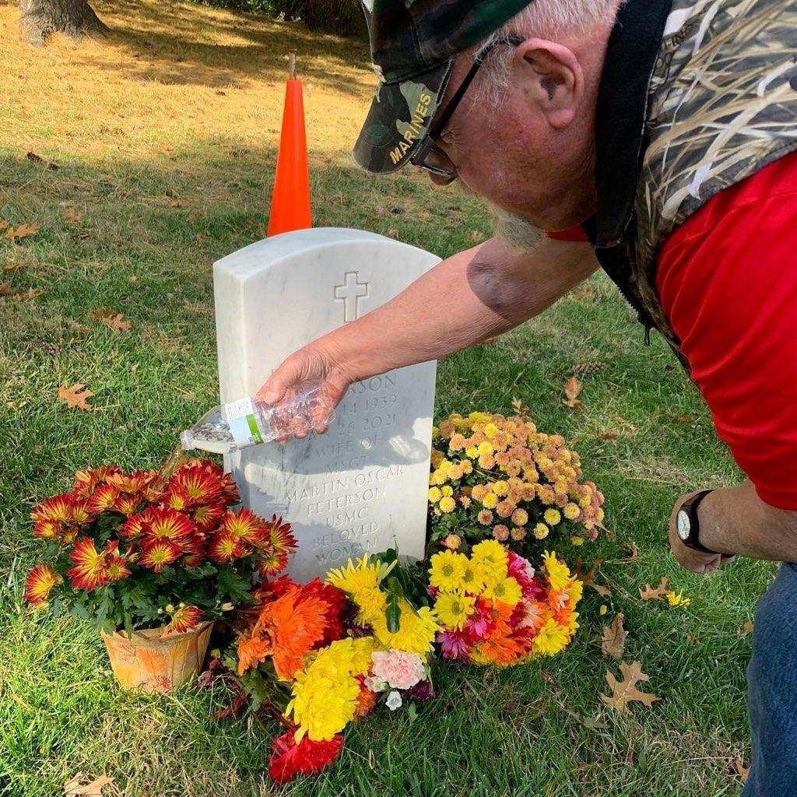
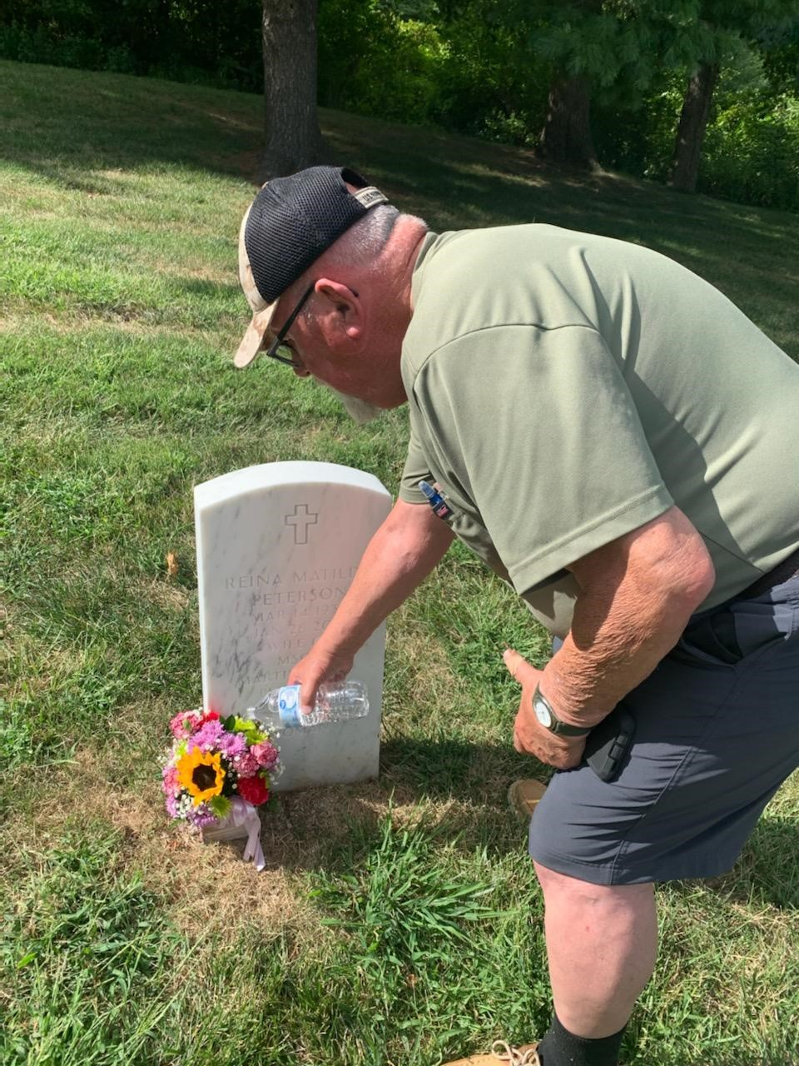

Slide 7
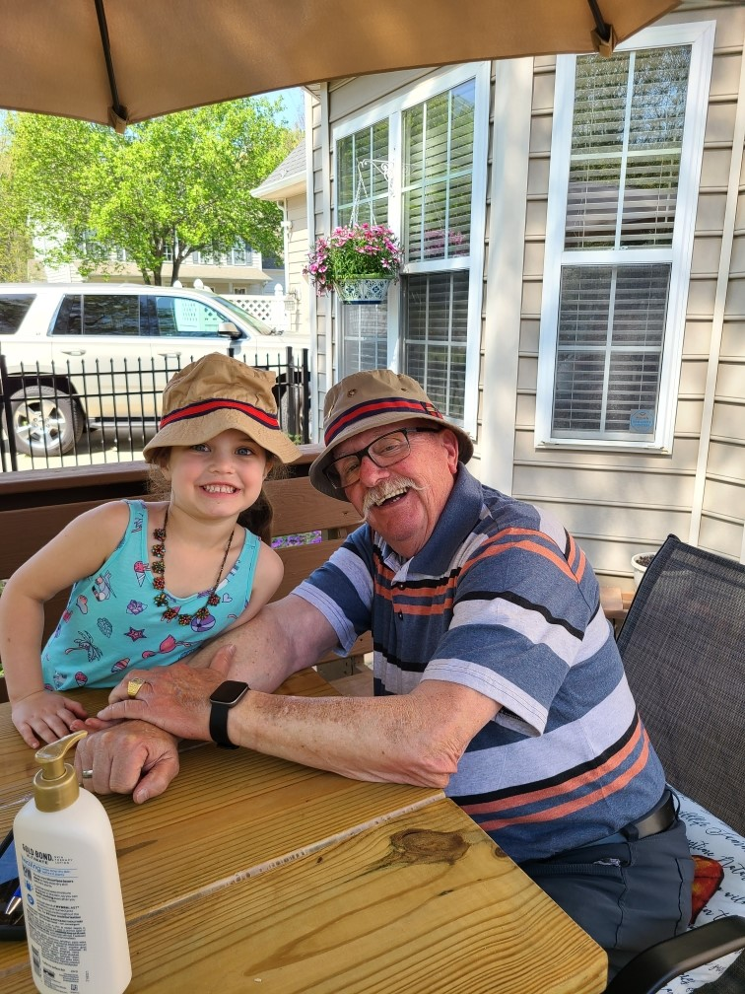
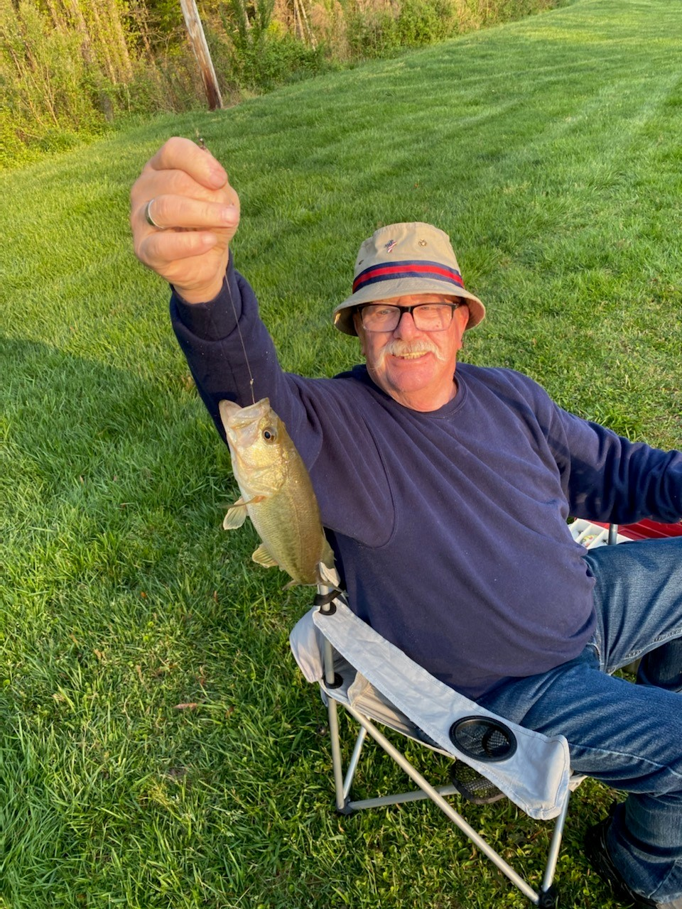

Slide 8
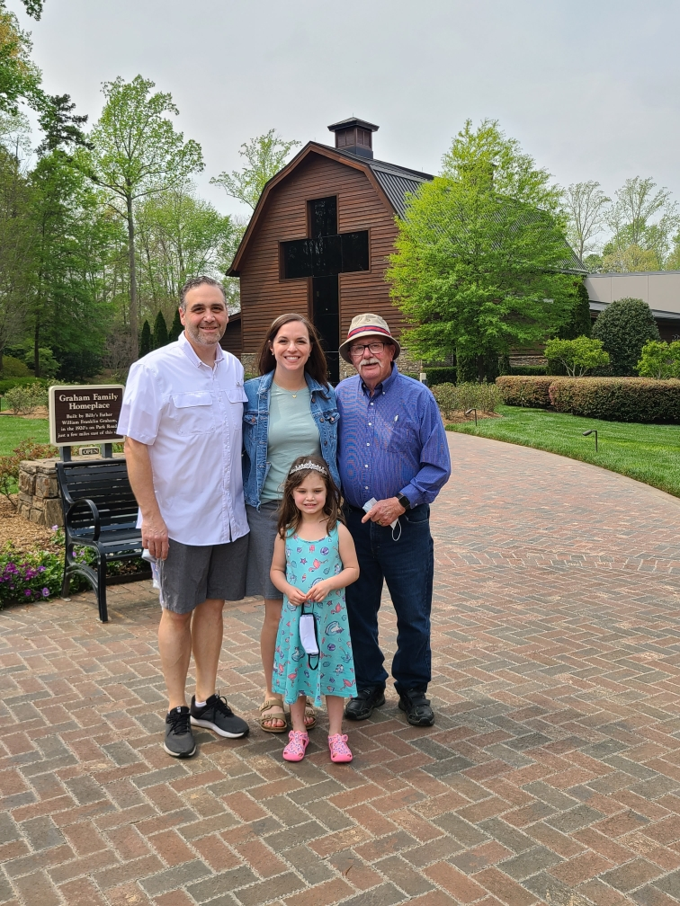

Slide 9

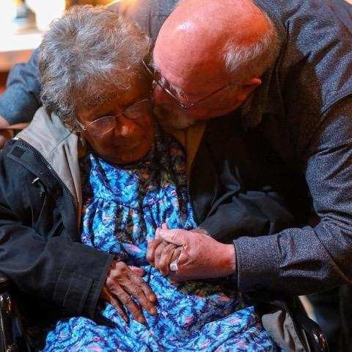
Always Faithful…

Slide 10
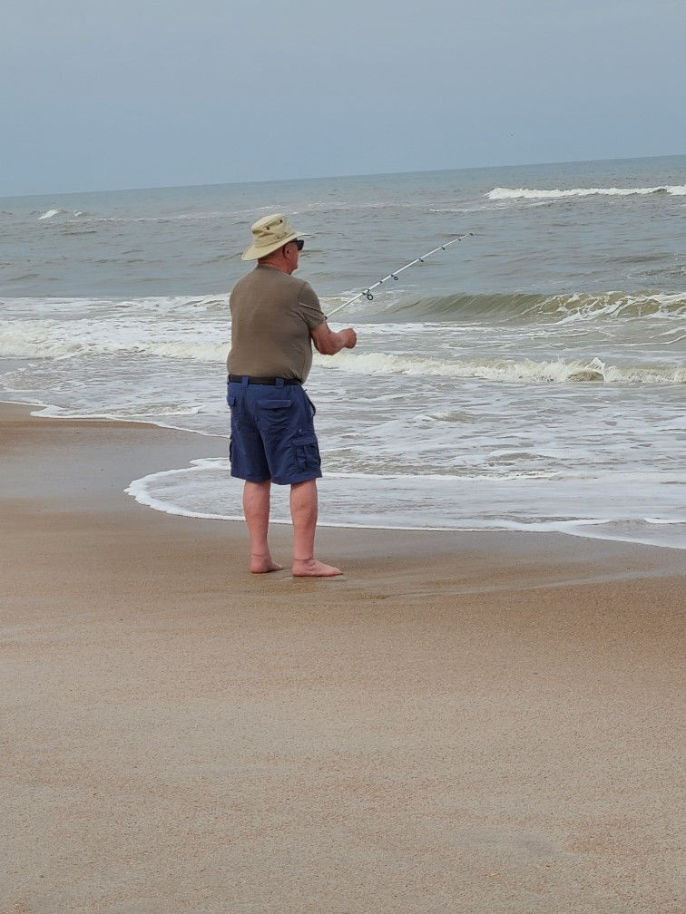
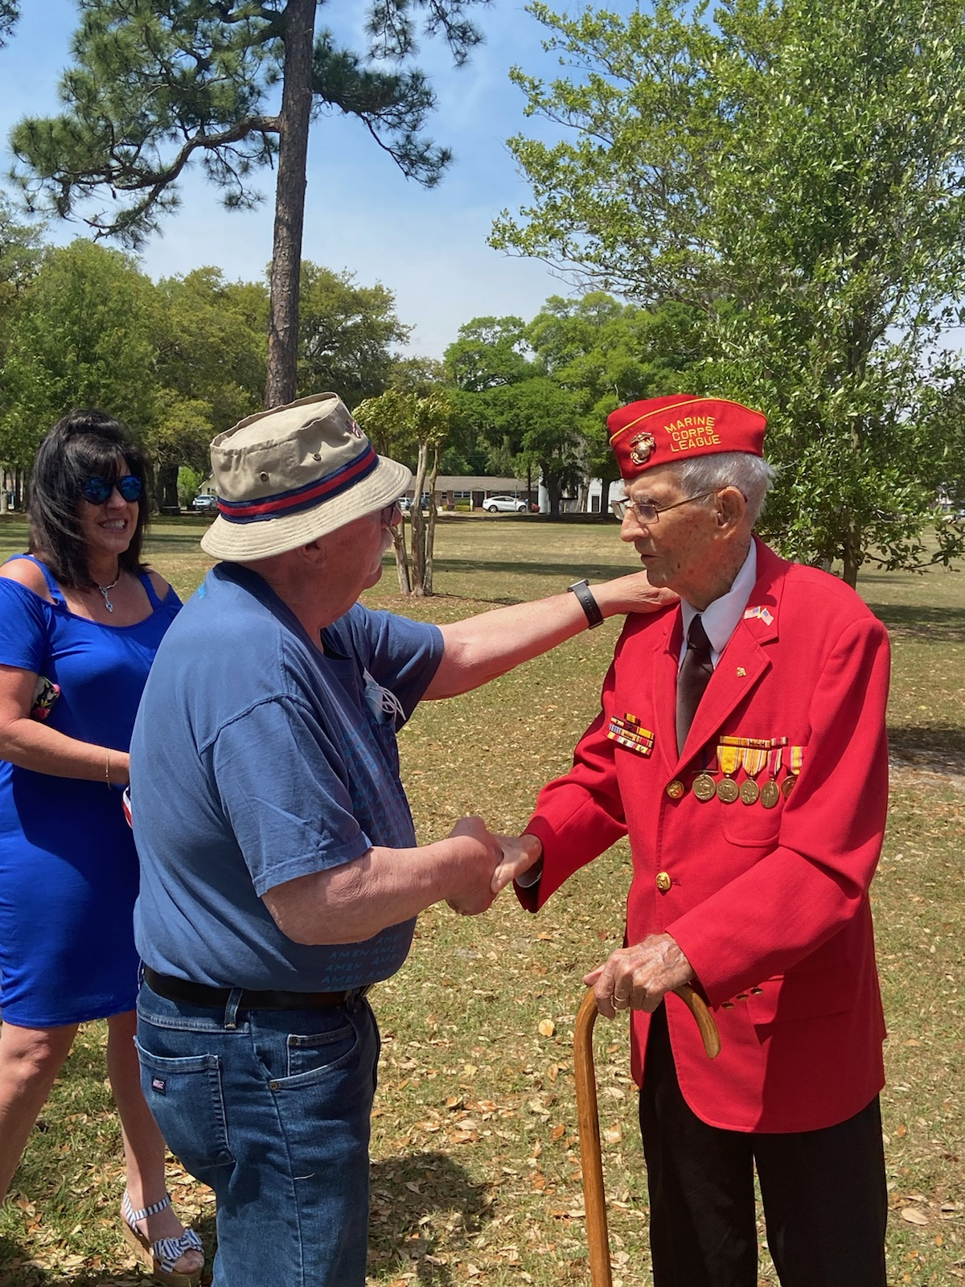

Slide 11
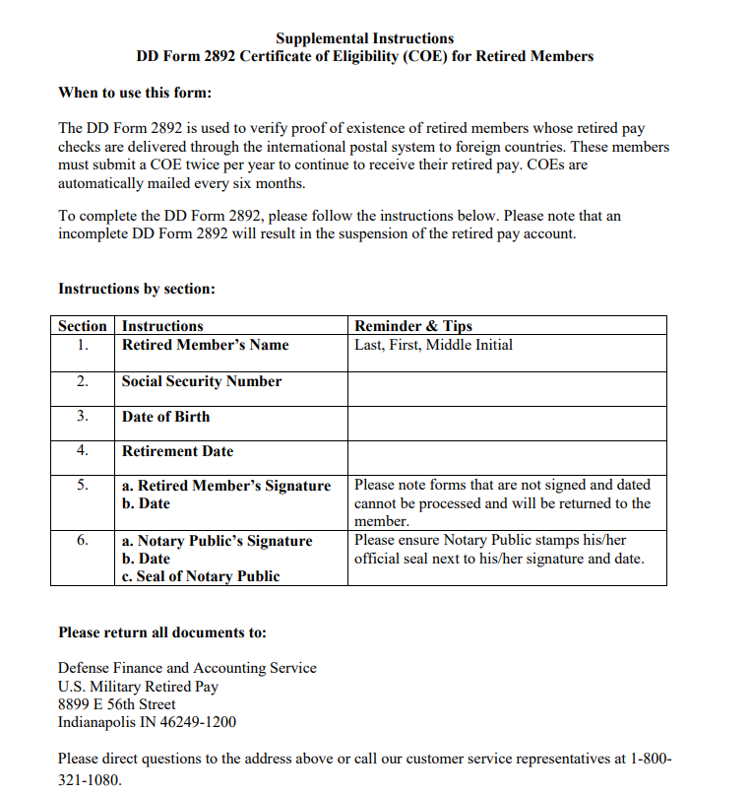
Certificate of Eligibility (COE)
21+ years in the Marine Corps
Vietnam Veteran
Filed original COE over 30 years ago
“Why is the guidance different every time we call?”
30 days to review

Slide 12
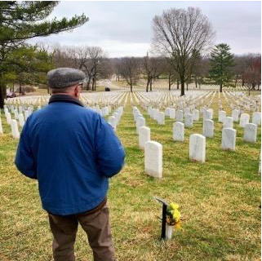
“My service in the Corps doesn’t matter to them”.

Slide 13

Semper Fidelis, Marine

