Slide 1
MEASURING CUSTOMER EXPERIENCE
Evan Albert, Director of Measurement and Data Analytics, Veterans Experience Office
Evan.Albert@va.gov

Slide 2
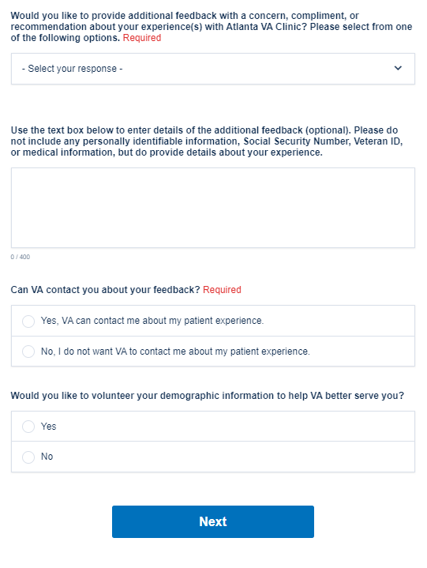
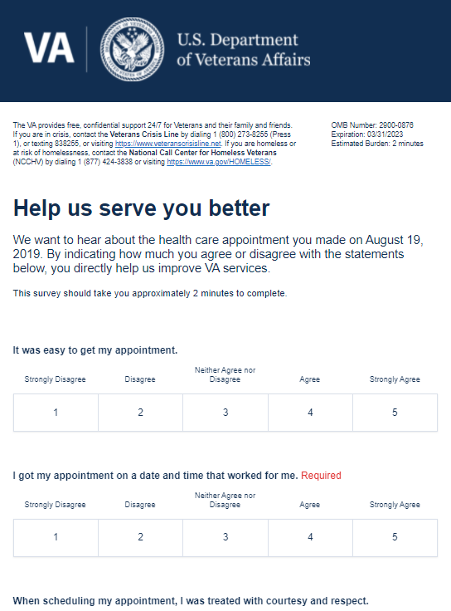
VSignals
A real-time digital survey platform providing descriptive, predictive, and prescriptive analysis of CX survey data.
Where do I find the VSignals platform?
Veterans Signals
How do I gain access to VSignals?
VSignals User Request Form
Where can I find promotional flyers?
VEO VSignals Info
Where can I find more info?
VEO VSignals SharePoint

Slide 3
Available VHA Surveys
Line of Business | Launch Date | Survey Names |  | Internal or External | Survey Format | Free-Text | Survey Frequency
1. Outpatient Services Surveys | 7/1/17 | 1. Visiting a Healthcare Provider 2. Scheduling an Appointment 3. Pharmacy Services Received By Mail | 4. Pharmacy Services Received In-Person 5. Labs/Imaging 6. Veterans Safety | External | Email | Yes | Twice a Week: Tuesday and Friday
2. Telehealth Services Surveys (Veterans) | 7/1/18 | 1. Scheduling a Telehealth Appointment 2. Telehealth at the Clinic 3. Telehealth at Home or Mobile 4. Telehealth Store & Forward at the Clinic | 5. Telehealth Store & Forward at Home or Mobile Appointment 6. Telehealth Store & Forward Result 7. Home Telehealth Continuing Patient | External | Email | No | Weekly: Friday
3. VHA Compensation and Pension Examination Surveys | 2/1/19 | 1. Scheduling a C&P Appointment 2. C&P Exam Visit |  | External | Email | No | Twice a Week: Tuesday and Friday
4. Telehealth Provider Surveys | 2/22/19 | 1. Non-Telehealth Provider Survey 2. Telehealth Providers Awareness Survey 3. Recent Telehealth Adoption for CVT 4. Recent Telehealth Adoption for HT | 5. Recent Telehealth Adoption for SFT 6. Continued Telehealth Exposure for CVT 7. Continued Telehealth Exposure for HT 8. Continued Telehealth Exposure for SFT | Internal (Providers) | Email | No | Monthly: 1st Business Day of the Month
5. Emergency Medicine | 6/26/20 | 1. Emergency Medicine 2. Telehealth Emergency Medicine (launched 7/23/21) |  | External | Email | Yes | Weekly: Friday
6. No-Show | 6/30/20 | 1. No-Show – Mental Health 2. No-Show – Imaging (launched 9/14/21) |  | External | Email | Yes | Weekly: Tuesday
7. ECCC – Clinical | 7/24/20 | 1. Contact Center Experience Survey 2. Provider Survey |  | External | Email | Yes | Twice a Week: Tuesday and Friday
8. ECCC – Member Services | 9/22/20 | 1. Contact Center Experience Survey |  | External | Email | No | Weekly: Tuesday
9. Office of Community Care | 9/8/20 | 1. Choosing VA CC 2. Scheduling VA CC 3. Attending VA CC 4. Prescription VA CC | 5. Financial Responsibility VA CC 6. Billing Questions VA CC 7. Community Emergency Care (launched 8/24/21) | External | Email | No | Twice a Week: Tuesday and Friday
This box should be used for call-out text or quotations. Text in this box is relevant to the bullet points on the right or overall topic of the slide, but needs to be set off, apart from the regular content of the slide. The text is 14 point.

Slide 4
Available VHA Surveys
Line of Business | Launch Date | Survey Names |  | Internal or External | Survey Format | Free-Text | Survey Frequency
10. Same Day Service Survey | 9/25/20 | 1. Phone or Online Request 2. In-Person Request 3. Provider Initiated |  | External | Email | No | Weekly: Friday
11. ECCC – Office of Community Care | 12/15/20 | 1. Community Care Contact Center (C4) |  | External | Email | No | Weekly: Tuesday
12. COVID-19 | 7/10/20 | 1. General COVID-19 Survey 2. Post In-Person COVID-19 Survey 3. Telehealth COVID-19 Survey | 4. Post-Vaccination Survey (launched 6/1/21) 5. Vaccine Acceptance Survey (launched 6/22/21) | External | Email | Yes
13. VA Liaison | 4/6/21 | 1. VA Liaison |  | External | Email | Yes | Weekly: Tuesday
14. Inpatient | 6/25/21 | 1. Inpatient |  | External | Email | Yes | Twice a Month: Friday
15. RCS Vet Centers | 7/16/21 | 1. Initial Engagement 2. Client Intake 3. Client Counselor Relationship/Client Growth | 4. Unengaged or Suspended Clients 5. Reengaged Clients | External | Email | Yes | Twice a Week: Tuesday and Friday
16. Geriatrics and Extended Care (GEC) | 8/3/21 | Veteran and Caregiver Home-Based Care Survey - VA Staff | Home-Based Care Survey -Homemaker/Home Health Aide | External | Email | Yes | Weekly
17. Telehealth ATLAS | 10/5/21 | Telehealth ATLAS |  | External | Kiosk | No | Continuous
18. ECCC - Caregivers | 1/18/22 | Caregivers Support Line |  | External | Phone | No | Post-Call
19. Digital Comment Card | 7/7/17 | 1. Digital Comment Card |  | External | Online Link | Yes | Continuous
20. Social Media Insights | 7/7/17 | Social media is captured from all official VA, VISN, and VAMC social media accounts |  | External | Social Media | Yes | Continuous
This box should be used for call-out text or quotations. Text in this box is relevant to the bullet points on the right or overall topic of the slide, but needs to be set off, apart from the regular content of the slide. The text is 14 point.

Slide 5
Available VHA Surveys
Total VHA Surveys Sent and Received
Total Free-Text Comments by Survey (10/1/19 – 7/26/22)
Fiscal Year | # of Surveys Sent | # of Surveys Received | Response Rate
FY 2020 | 7,914,882 | 1,380,247 | 17.4%
FY 2021 | 9,688,936 | 1,565,282 | 16.2%
FY 2022 | 9,603,063 | 1,516,363 | 15.8%
Total | 27,206,881 | 4,461,892 | 16.4%
Survey | # Free-Text Comments
Outpatient | 1,566,949
No-Show | 18,707
COVID-19 | 7,616
Emergency Medicine | 1,167
Inpatient | 6,162
Geriatrics and Extended Care | 4,790
VA Liaison | 250
RCS Vet Centers | 17,086
ECCC-Clinical | 5,532
Total | 1,628,259

Slide 6
VHA-Wide Outpatient Services Surveys Trust Over Time for Past 90 Days
I trust [Facility Name] for my health care needs.
% Trust, Compliments, Concerns, and Recommendations by VISN
VISN | Trust % | % Compliments | % Concerns | % Recs.
1 | 93.3% | 72.2% | 14.4% | 13.4%
4 | 93.1% | 73.5% | 14.4% | 12.1%
23 | 92.6% | 70.3% | 17.3% | 12.5%
12 | 92.5% | 70.5% | 16.4% | 13.1%
10 | 91.5% | 68.8% | 18.4% | 12.8%
2 | 91.4% | 70.4% | 16.3% | 13.4%
21 | 90.6% | 67.1% | 19.4% | 13.6%
15 | 90.5% | 67.4% | 19.4% | 13.2%
8 | 90.3% | 66.3% | 19.6% | 14.0%
9 | 90.2% | 70.8% | 16.7% | 12.5%
6 | 89.8% | 68.8% | 19.1% | 12.1%
5 | 88.8% | 66.7% | 19.8% | 13.5%
19 | 88.8% | 66.6% | 20.3% | 13.1%
22 | 88.4% | 65.4% | 21.3% | 13.3%
16 | 88.1% | 64.9% | 21.1% | 14.0%
17 | 87.9% | 64.4% | 21.8% | 13.8%
20 | 87.2% | 61.3% | 24.9% | 13.8%
7 | 86.3% | 63.4% | 23.1% | 13.5%
BLUF: In the past 90 days, VHA-wide trust has decreased 0.6%.

Slide 7
VHA-Wide Trust for Past 90 Days by Gender in Outpatient Services Surveys
% Trust by VISN for Male Veterans
% Trust by VISN for Female Veterans
VISN | Trust %
1 | 93.5%
4 | 93.3%
23 | 92.8%
12 | 92.8%
10 | 91.8%
2 | 91.6%
21 | 90.8%
15 | 90.7%
8 | 90.7%
9 | 90.4%
6 | 90.3%
5 | 89.7%
19 | 89.2%
22 | 88.7%
16 | 88.5%
17 | 88.3%
20 | 87.5%
7 | 87.0%
VISN | Trust %
4 | 90.6%
5 | 90.2%
1 | 90.2%
12 | 88.5%
15 | 88.3%
23 | 88.3%
21 | 87.9%
9 | 87.5%
19 | 87.5%
8 | 87.1%
17 | 85.9%
7 | 85.9%
10 | 84.8%
20 | 84.8%
16 | 84.8%
2 | 83.8%
6 | 83.5%
22 | 81.6%
BLUF: In the past 90 days in the VHA, males (90.3%) have shown greater trust in the VA than females (86.1%).

Slide 8
VHA-Wide Overview All Questions Past 90 Days in Outpatient Services Surveys
Lowest Performing Question by Survey (Past 90 Days)
% of Agree and Strongly Agree Responses
Visiting a Healthcare Provider | “I trust [Facility Name] for my health care needs.” | 91%
Pharmacy Services Received by Mail | "I knew when to expect my prescription(s)." | 78%
Pharmacy Services Received In-Person | "My wait time was reasonable." | 88%
Labs and Imaging | “I trust [Facility Name] for my health care needs.” | 93%
Scheduling an Appointment | "It was easy to get my appointment." | 84%
Highest Performing Question by Survey (Past 90 Days)
% of Agree and Strongly Agree Responses
Visiting a Healthcare Provider | "My provider explained things in a way that I could understand." | 95%
Pharmacy Services Received by Mail | "My prescription(s) arrived at my preferred address." | 98%
Pharmacy Services Received In-Person | "During my most recent VA health care experience, I felt respected and comfortable.." | 93%
Labs and Imaging | "When I got my tests done (blood draw, x-ray, MRI, CT scan, etc.), I was treated withcourtesy and respect." | 98%
Scheduling an Appointment | "When scheduling my appointment, I was treated with courtesy and respect." | 93%

Slide 9
Comment Breakdown in VHA for Past 90 Days in Outpatient Services Surveys
% Compliments | % Concerns | % Recommendations
65.5% | 22.9% | 11.6%
Percentage of Compliments, Concerns, and Recommendations for Past 90 Days:
BLUF: In the past 90 days, 65.5% of Veterans in the VHA that left a comment have left a compliment in their free-text Outpatient Services Survey comments.

Slide 10
Free-Text Responses: VHA-Wide Top Compliments and Concerns for Past 90 Days in Outpatient Services Surveys
Top Compliments and Concerns From Outpatient Services Surveys
 | Top Five Compliments |  | Top Five Concerns
 | Quality of Care |  | Appointment Cancellation by VA
 | Cleanliness of Facility |  | Cancellation of VA Prescriptions
 | Interactions with Staff |  | Scheduling an Appointment
 | Satisfaction with Specialty Care |  | Female Healthcare Services
 | Courtesy of Healthcare Providers |  | Prescriptions for Pain Management
Compliment/Concern Increased from Previous Month
Compliment/Concern Decreased from Previous Month
Compliment/Concern Remained the Same from Previous Month
New Top 5 Compliment/Concern for this Month

Slide 11
Free-Text Responses: VHA-Wide Top Compliments and Concerns by Gender for Past 90 Days in Outpatient Services Survey
Males
Females
1. Appointment Cancellation by VA | 1. Disability Benefits
2. Cancellation of VA Prescriptions | 2. Scheduling an Appointment
3. Prescriptions for Pain Management | 3. Appointment Cancellation by VA
4. Scheduling an Appointment | 4. Prosthetic Services
5. Accuracy of Mail Order Prescription Addresses | 5. Female Healthcare Services
Top Concerns
1. Quality of Care | 1. Quality of Care
2. Cleanliness of Facility | 2. Satisfaction with Specialty Care
3. Interactions with Staff | 3. Anesthesiology Services
4. Satisfaction with Specialty Care | 4. Interactions with Staff
5. Courtesy of Healthcare Providers | 5. Cleanliness of Facility
Top Compliments
BLUF: When leaving comments in the Outpatient Services Surveys, male Veterans in the VHA are most concerned with Appointment Cancellations by the VA; female Veterans are most concerned with Disability Benefits. Male Veterans are most complimentary about Quality of Care in the VHA; Female Veterans are also most complimentary about Quality of Care.

Slide 12
Free-Text Responses: VHA-Wide Top Concerns by Age Group for Past 90 Days in Outpatient Services Surveys
Top Concerns by Age from Outpatient Services Surveys (Past 90 Days):
< 40 | 40-49 | 50-59 | 60-69 | 70+
1. Appointment Cancellation by VA | 1. Disability Benefits | 1. Appointment Cancellation by VA | 1. Cancellation of VA Prescriptions | 1. Appointment Cancellation by VA
2. Scheduling an Appointment | 2. Appointment Cancellation by VA | 2. Scheduling an Appointment | 2. Appointment Cancellation by VA | 2. Cancellation of VA Prescriptions
3. Wait Time Over the Phone | 3. Scheduling an Appointment | 3. Concerns for Billing/Insurance | 3. Language Barriers | 3. Scheduling an Appointment for Specialty Care
4. Satisfaction with VA Providers | 4. Accuracy of Prescriptions | 4. Scheduling an Appointment for Specialty Care | 4. Disability Benefits | 4. Scheduling an Appointment
5. VA Choice Program/Community Care | 5. Satisfaction with VA Providers | 5. Language Barriers | 5. Scheduling an Appointment | 5. Accuracy of Mail Order Prescription Addresses

Slide 13
Free-Text Responses: VHA-Wide Top Compliments by Age Group for Past 90 Days in Outpatient Services Surveys
Top Compliments by Age from Outpatient Services Surveys (Past 90 Days):
< 40 | 40-49 | 50-59 | 60-69 | 70+
1. Cleanliness of Facility | 1. Quality of Care | 1. Quality of Care | 1. Quality of Care | 1. Quality of Care
2. Satisfaction with Specialty Care | 2. Cleanliness of Facility | 2. Cleanliness of Facility | 2. Cleanliness of Facility | 2. Cleanliness of Facility
3. Quality of Care | 3. Satisfaction with Specialty Care | 3. Interactions with Staff | 3. Interactions with Staff | 3. Interactions with Staff
 |  | 4. Satisfaction with Specialty Care | 4. Satisfaction with Specialty Care | 4. Satisfaction with Specialty Care
 |  |  | 5. Information about Available Benefits | 5. Women’s Primary Care Medicine Services

