Slide 1
My Data Says What? Board of Veterans’ Appeals
Marissa Caylor, Veterans Law Judge, Board of Veterans’ Appeals
Evan Albert, Director of Management and Data Analytics, Veterans Experience Office

Slide 2
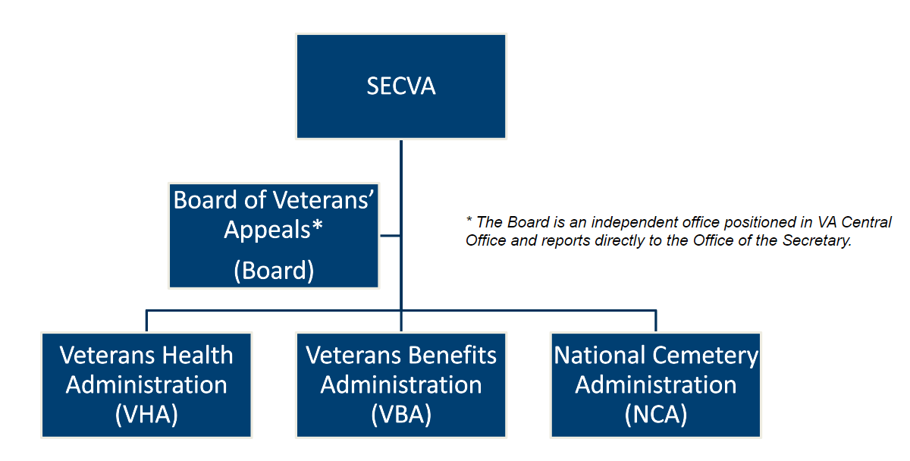

Overview of the Board

Slide 3
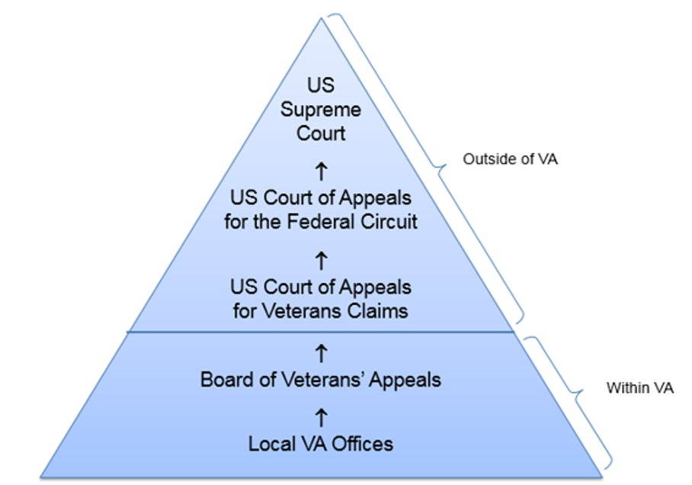
Overview of the Board
Mission
Conduct hearings and decide appeals properly before the Board in a timely manner. See 38 United States Code (U.S.C.) § 7101(a).​
Claims filed with the Secretary are subject to one review on appeal to the Secretary and are final. 38 U.S.C. § 7104(a).​

Slide 4



VetSignals Surveys
Notification Letters
Docketing letters – Legacy & AMA
Hearings
Notification, support from Hearing Coordinator, experience with Veterans Law Judge
Decisions
Include grant of benefits, denial of benefits, remand for additional development, or dismissal of appeal

Slide 5
The Appellate Process - Legacy
Claim
(Local VA Office)
Rating Decision (Local VA Office)
Veterans Law Judge Reviews Appeal
Board Issues Decision:
Grant,
Denial,
Remand
Dismissal
Notice of Disagreement (Local VA Office)
Statement of the Case (Local VA Office)
Substantive Appeal (Local VA Office)
Appeal Accepted at the Board (Docketing Letter)
(Optional) Hearing Scheduled & Held with Veterans Law Judge
Supplemental Statement of the Case (Local VA Office)
Local VA Office
Board
Survey:
Legacy Established Appeal
Survey:
Legacy Board Hearing
Survey:
Legacy Board Decision

Slide 6
The Appellate Process – Appeals Modernization Act
Rating Decision (Local VA Office)
(Optional)
Hearing Scheduled & Held with Veterans Law Judge
Veterans Law Judge Reviews Appeal
Board Issues Decision:
Grant,
Denial,
Remand
Dismissal
Claim (Local VA Office)
Notice of Disagreement
Appeal Accepted at the Board
(Docketing Letter Sent)
Local VA Office
Board
Survey:
AMA Established NOD
Survey:
AMA Board Hearing
Survey:
AMA Board Decision

Slide 7
What Does My Data Say?
Notification Letters
Docketing letters – Legacy & AMA
CX Challenges
Limited opportunity for face-to-face interactions prior to hearing
Appellant has already been denied
Two legal frameworks being used simultaneously
Difficulty identifying which part of VA owns each step in the process
CX Responses
Improved external website with brochures and information on how to file an appeal, track status, and contact RO
Clear communication in notification letters regarding next steps
Continuous improvement of written communication using CX data

Slide 8
Notification Letters
Clear, Accessible Communication
Ease and Effectiveness
Highest % of Agree/Strongly Agree
Ease/Simplicity
Legacy – I clearly understood how to file an appeal to the Board
AMA – I clearly understood how to file my Notice of Disagreement (NOD)
Confidence/Trust
AMA – I felt confident that I selected the best review for my situation
Compliments
“The letters received are very understandable and this is good for submitting appeals!” – 65-yr-old male respondent
“[The Board’s] communication and procedures are very simple to understand.” – 66-yr-old male respondent
7

Slide 9
Key CX TouchPoints
Hearings
Notification, support from Hearing Coordinator, experience with Veterans Law Judge
Ease & Accessibility
Videoconference at a VBA Regional Office
In-person Travel Board at a VBA Regional Office
In-person Board of Veterans’ Appeals Central Office Hearings
Virtual Hearing
Support & Connection
Hearing Coordinator
Pre-Hearing Conference
Veterans Law Judge
Representative
*RO coordinator, if at VBA Regional Office

Slide 10
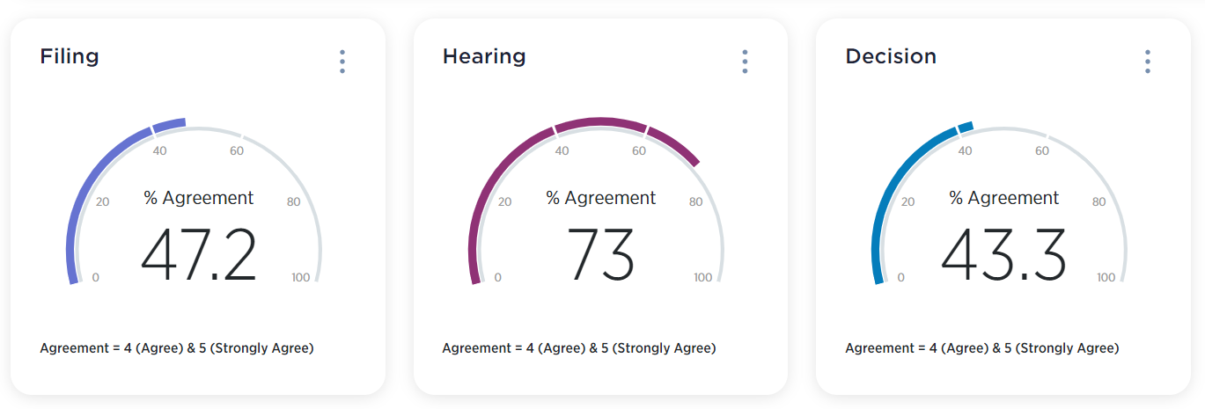
Key CX Touchpoints
Appeal Accepted at the Board
(Docketing Letter Sent)
(Optional)
Hearing Scheduled & Held with Veterans Law Judge
Veterans Law Judge Reviews Appeal
Board Issues Decision:
Grant,
Denial,
Remand
Dismissal

Slide 11
Key CX TouchPoints

Slide 12
Key CX TouchPoints
Hearings
Notification, support from Hearing Coordinator, experience with Veterans Law Judge
CX Challenges
CX data that Veterans did not feel prepared for their hearing experience
Veterans who live hours from a VBA RO
Pandemic closure of VBA Regional Offices and travel restrictions
Mail delay impact on hearing notification
CX Responses
Updated external website to feature video and fact sheets on Board hearings
Expansion of Virtual Hearing Pilot Program for use in all Board hearings
Notice to all appellants with pending in-person hearing requests of the option to have a virtual hearing instead
Hearing Coordinators increased frequency of and methods of touchpoints

Slide 13
Relationship Between Hearings & Trust Scores
Trust score increases with number of hearings held
Free-Text Comments
Appellants Consistently Agree/Strongly Agree
The Veterans Law Judge who held the hearing listened to me
The Veterans Law Judge explained things to me in a way that was easy to understand
I understood what I needed to do to prepare for my hearing
“The Veterans Law Judge was very professional and thorough. I was very impressed with the way my case was handled. My representative was also top notch.” – 71-yr-old male respondent
“[The Hearing Coordinator] was very helpful and I had no idea that she would be there to help me. She was a ray of sunshine on this dark and lonely path to my appeal hearing. I truly appreciate her and the time she spent with me.” – 57-yr-old male respondent
12

Slide 14
Hearings & Service Recovery
Turning around a negative experience with Connection
Examples
“The hearing made me feel like my concerns were actually being addressed. They are real and should have been addressed years ago.” – 71-yr-old respondent
The “hearing is where I finally was able to say something where my voice was heard.” – 63-yr-old male respondent
Perceived negative experiences with VA
Compensation & Pension examiner
VAMC care or VA provider care
Apportionment or overpayment issues
Representation
Historic experiences with VA
Appellants Consistently Agree/Strongly Agree
The Veterans Law Judge who held the hearing listened to me
13

Slide 15
Key CX TouchPoints
Decisions
Include grant of benefits, denial of benefits, remand for additional development, or dismissal of appeal
Types
Grant
Denial
Remand
Dismissal
Disposition Impacts Satisfaction
Grant
Denial – Tend to be more dissatisfied
Remand – Tend to be more dissatisfied
Dismissal

Slide 16
Key CX TouchPoints
Decisions
Include grant of benefits, denial of benefits, remand for additional development, or dismissal of appeal
CX Challenges
Reports that Board decisions are difficult to understand
Legal authorities, including statutes and regulations, use confusing language
CX Reponses
Cultural focus on writing for the Veteran
Interactive Decision Template (IDT)
Bottom Line Up Front (Order); Readability Score
Customer Service & Organizational Support Performance Element
Training Focus on:
Validating contentions
Respectful language regarding credibility
Use of plain language

Slide 17
Decisions
Quality of Veterans Law Judge
Compliments
Highest Trust Agreement
Combining all appeals, both hearing and non-hearing, the highest Trust scores related to:
Quality of Judge
Communication with Judge
“Until the board review of my case I felt I was just beating my head against the wall. I was. pleased at how the board considered my input in the decision.” – 69 yr-old male respondent
“I was surprised by the decision and the depth of information they reviewed.” – 77 yr-old male respondent
“I appreciate the way appeals [are] handled by the Board of Appeals – I have found the Board’s common-sense approach to be fair and accurate regardless if the decision is favorable or unfavorable.” – 67-yr-old male respondent
16

Slide 18
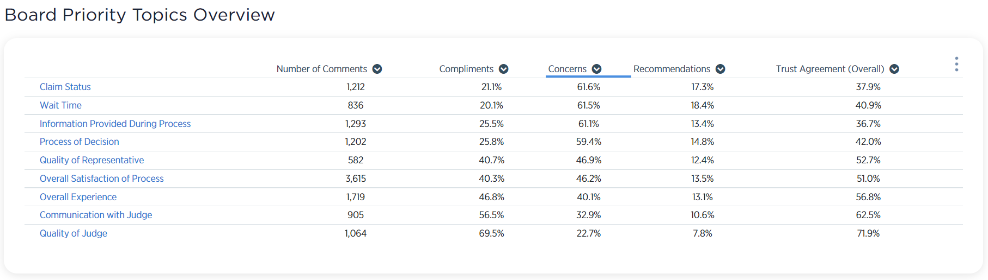
VSignals Board Priority Topics Overview
Topics are sorted by % Concerns (descending)
Claims Status and Wait Times are the two topics with the highest share of concerns in the Board Surveys free text comments

Slide 19
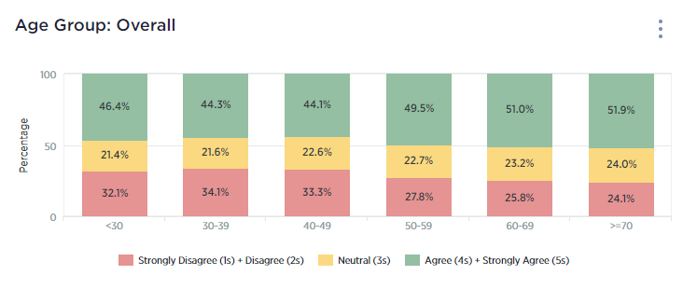
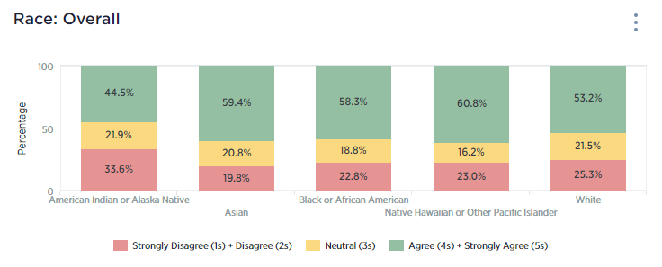
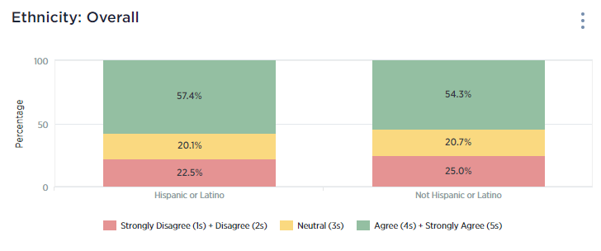
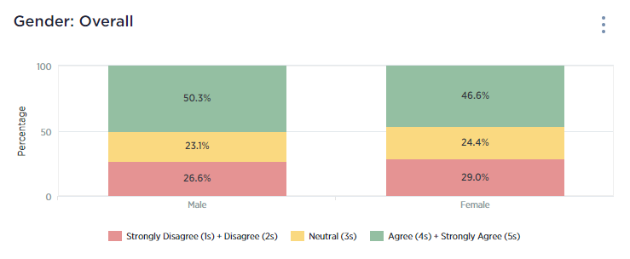
Board Results by Demographic

