Slide 1
My PX Data Says What? CX Symposium 2022
Veterans Experience Office (VEO)

Slide 2
My PX Data Says What?
Mr. Evan Albert, Director of Measurement and Data Analytics, Office of Enterprise Measurement and Design (EMD), Veterans Experience Office (VEO)
Ms. Jennifer Chapin, Patient Experience Coach, Tools & Implementation (T&I), Veterans Experience Office (VEO)
Notes:
JEN: Brief intro
Evan Albert
Director of Measurement and Data Analytics, Veterans Experience Office (VEO), Enterprise Measurement and Design Directorate
Evan Albert serves as Director of Measurement and Data Analytics for VA’s Veterans Experience Office (VEO) Enterprise Measurement and Design Directorate where he leads VEO’s efforts related to Customer Experience data and measurement capabilities, including VA’s V-Signals survey platform. Evan has over 20 years of governmental Project Management and Data Analysis-focused experience. Evan previously served in Federal program and planning positions in the Department of Interior’s Budget, Planning, and Execution Office and DHS’s Sector Outreach and Programs Division and managed the Detroit regional office for the Federal agency that operates AmeriCorps and other national and community service programs.
Jennifer Chapin
Patient Experience Coach, Patient Experience Directorate, Veteran Experience Office
Jennifer Chapin is a PX Coach for the Patient Experience Implementation branch, in the Patient Experience directorate of the Veterans Experience Office. Jen joined the PX team in 2020 and prior to that, spent 14 years at the Iowa City VA Healthcare System. She has a background in acute care, case management, utilization management, and quality improvement. Jen is Black Belt trained and holds a Masters of Science in Nursing. She lives in Eastern Iowa with her husband and two children.

Slide 3
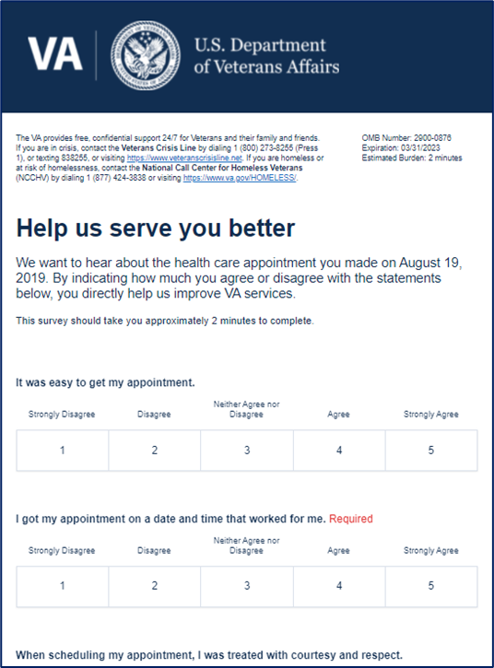
Patient Satisfaction & Patient Experience
Patient satisfaction and patient experience refer to measuring healthcare quality and survey instruments. These terms are not synonymous.
Patient Satisfaction – Leading indicator measured by VSignals.
i.e., Did we meet your expectations with this one interaction?
Patient Experience – Lagging indicator measured by SHEP.
i.e., How would you rate your overall experience at this hospital?
Notes:
JEN: Before we jump into the presentation today, I wanted to take the opportunity to make one distinction.
Often, we hear the terms patient satisfaction and patient experience used interchangeably.
In fact, Patient Satisfaction and Patient Experience are not the same thing, and here at VA, we measure both of these.
Patient Satisfaction means, “Did we meet your expectations in this one interaction?” We are measuring patient satisfaction at VA via VSignals.
Patient Experience means, “Thinking about the last 6 months of encounters, how would you rate your overall experience with VA?” We are measuring patient experience at VA via SHEP.
One great thing about VSignals is that, since we receive the feedback so rapidly from Veterans, it allows us to perform service recovery prior to the patient receiving any other survey. Thus, improving the overall patient experience.
We know from research that performing service recovery after a bad experience actually improves the patient’s perception of the care they received, even higher than if nothing bad had happened at all.

Slide 4
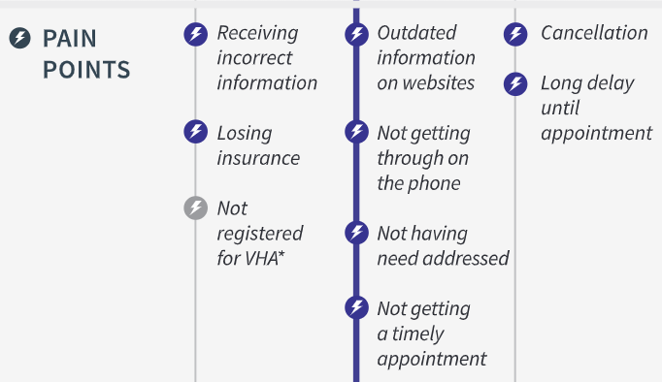
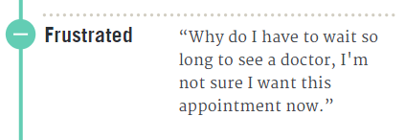
Access to Care: Moments that Matter
Notes:
JEN: In today’s presentation, we are going to review some of the access satisfaction data that is available in VSignals.
Vsignals questions are not arbitrary – they are derived from Human Centered Design research which determine the pain points and moments that matter to Veterans along their healthcare journey.
On this slide, you can see a few of the moments that matter for Veterans in accessing outpatient care and navigating care in the community. In accessing primary care, we heard Veterans say “READ SLIDE”
In accessing other outpatient care, pain points for Veterans were *READ SLIDE*

Slide 5
Available VHA Surveys
Line of Business | Launch Date | Survey Names |  |  |  | Internal or External | Survey Format | Free-Text | Survey Frequency
1. Outpatient Services Surveys | 7/1/17 | Visiting a Healthcare Provider Scheduling an Appointment Pharmacy Services Received By Mail |  | (4) Pharmacy Services Received In-Person (5) Labs/Imaging |  | External | Email | Yes | Twice a Week: Tuesday and Friday
2. Telehealth Services Surveys (Veterans) | 7/1/18 | Scheduling a Telehealth Appointment Telehealth at the Clinic Telehealth at Home or Mobile Telehealth Store & Forward at the Clinic |  | (5) Telehealth Store & Forward at Home or Mobile Appointment Telehealth Store & Forward Result Home Telehealth Continuing Patient |  | External | Email | No | Weekly: Friday
3. VHA Compensation and Pension Examination Surveys | 2/1/19 | Scheduling a C&P Appointment C&P Exam Visit |  |  |  | External | Email | No | Twice a Week: Tuesday and Friday
4. Telehealth Provider Surveys | 2/22/19 | Non-Telehealth Provider Survey Telehealth Providers Awareness Survey Recent Telehealth Adoption for CVT Recent Telehealth Adoption for HT |  | (5) Recent Telehealth Adoption for SFT Continued Telehealth Exposure for CVT Continued Telehealth Exposure for HT Continued Telehealth Exposure for SFT |  | Internal (Providers) | Email | No | Monthly: 1st Business Day of the Month
5. Emergency Medicine | 6/26/20 | Emergency Medicine |  |  |  | External | Email | Yes | Weekly: Friday
6. No-Show | 6/30/20 | Mental Health Radiology and Nuclear Medicine |  |  |  | External | Email | Yes | Weekly: Tuesday
7. COVID-19 | 7/10/20 | General COVID-19 Survey Post In-Person COVID-19 Survey Telehealth COVID-19 Survey |  |  |  | External | Email | Yes | Weekly: Tuesday
8. Office of Community Care | 9/8/20 | Choosing VA CC Scheduling VA CC Attending VA CC | (4) Prescription VA CC (5) Financial Responsibility VA CC (6) Billing Questions VA CC |  |  | External | Email | No | Twice a Week: Tuesday and Friday
Notes:
EVAN: Talk about all of the available VHA surveys and which surveys have questions that relate to access (highlighted).
Bring awareness to all survey types available for VHA facilities – not just inpatient/outpatient.

Slide 6
Available VHA Surveys
Line of Business | Launch Date | Survey Names |  | Internal or External | Survey Format | Free-Text | Survey Frequency
9. Same Day Service Survey | 9/25/20 | Phone or Online Request In-Person Request Provider Initiated |  | External | Email | No | Weekly: Friday
10. COVID-19 Post Vaccination | 6/1/2021 | COVID-19 Post Vaccination |  | External | Email | No | Weekly: Friday
11. COVID-19 Vaccine Acceptance | 6/22/21 | COVID-19 Vaccine Acceptance |  | External | Email | No | Continuous
12. Inpatient | 6/25/21 | Inpatient |  | External | Email | Yes | Weekly: Friday
13. RCS Vet Centers | 7/16/21 | Reengaged Clients Unengaged or Suspended Clients Counselor-Client Relationship Client Intake Initial Engagement |  | External | Email | Yes | Weekly: Friday
14. Emergency Medicine | 7/23/21 | Telehealth Emergency Medicine |  | External | Email | No | Weekly: Friday
15. Geriatrics & Extended Care | 8/3/21 | Veteran and Caregiver Home-based Care: Homemaker/ Home Health Home-based Care: VA Staff |  | External | Email | Yes | Weekly: Tuesday
16. Office of Community Care | 8/24/21 | Community Emergency Care |  | External | Email | Yes | Twice a Week: Tuesday and Friday
17. Telehealth ATLAS | 10/5/21 | Telehealth Atlas |  | External | Email | No | Continuous
Notes:
EVAN: Talk about all of the available VHA surveys and which surveys have questions that relate to access (highlighted).
Bring awareness to all survey types available for VHA facilities – not just inpatient/outpatient.

Slide 7
Access to Care Veteran Experience Comparison (10/01/2021 – 07/15/2022)
Veteran Experience Analysis demonstrates Direct Care, Community Care and Telehealth are key to maintaining access to care and sustaining Veteran trust in VA care delivery
VA Direct Care (10/1/2021 - 7/15/2022)
 | # of Surveys Sent | # of Surveys Received | % (4-5) Agreement
VISN 23 | 258,028 | 50,545 | 92.7%
VHA-Wide | 6,784,569 | 1,129,372 | 90.0%
VA Direct and VA Community Care Comparison Outpatient Scheduling:
Veterans trust the VA to provide equal or better care than in the community
Veterans are satisfied with the care they receive in VA
VA Community Care (10/1/2021 - 7/15/2022)
 | # of Surveys Sent | # of Surveys Received | % (4-5) Agreement
VISN 23 | 17,539 | 2,586 | 92.7%
VHA-Wide | 360,436 | 50,117 | 76.4%
Telehealth Summary:
Veterans trust telehealth and the modalities of telehealth service delivery VA offers
Veterans are satisfied with telehealth as a component of overall care
Telehealth (10/1/2021 - 7/15/2022):
 | # of Surveys Sent | # of Surveys Received | % (4-5) Agreement
VISN 23 | 34,880 | 5,155 | 88.6%
VHA-Wide | 1,126,222 | 139,290 | 84.8%
VSignals Access Experience:
VSignals (10/1/2021 - 7/15/2022):
Veterans would rather see a VA clinician at a VA facility
Veterans are satisfied with service delivered within the community, VA, and via telehealth
VSignals Survey Question: | % Agreed to Question
I am satisfied with the care I received from the community care provider | 92.1%
I am satisfied with the service I received from VA Outpatient facility appointment | 88.2%
I am satisfied with the VA telehealth video visit | 87.7%
Notes:
EVAN: This is a representative sample about access. There are so many different modalities of care you can explore. Identify themes and trends.

Slide 8
VSignals Access Experience Defined By 2 Questions (10/01/2021 – 07/15/2022)
Vsignals Question Date Range- 10/1/21 -7/15/22 | Outpatient Survey N-163,741 | Telehealth N-69,008 | Community Care N-9,731
“I got my appt on a date and time that worked for me?” | VHA Average 87% VISN 23 90% (R: 83%-91%) | VHA Average 87% VISN 23 92% (R:84%-92%) | N/A
“It was easy to get my appointment?” | VHA Average 85% VISN 23 88% (R: 79%-90%) | N/A | VHA Average 76% VISN 23 77% (R: 70%-83%)
What we know from Veterans through VSignals:
The first introduction to telehealth is the critical moment that matters to Veterans.
Connected Care has developed extensive training for providers and staff to introduce telehealth to Veterans.
When given a choice between a provider in person or telehealth, Veterans choose in person.
For community care survey respondents when asked the question: “Given the option, I would have chosen to get my care from a VA clinician using telehealth” only 15% answered “agree or strongly agree.”
Veterans are worried about receiving a bill and would prefer to go to a VA Emergency Department if given a choice.
Notes:
EVAN

Slide 9
VSignals Summary (10/01/2021 – 07/15/2022)
Veterans provide high scores ( >80% Agreement) for all direct care surveys and for attending VA community care surveys across A-11 Drivers,* indicating positive experience with VA direct care and with the actual visit to community care.
Community care surveys show lower trust scores than similar Outpatient surveys.
Veterans provide lower scores for surveys related to choosing, scheduling, and paying for community care.
Coordinating and getting answers to billing questions related to community care seems to be an area of frustration.
When asked about preference for telehealth instead of community care, only 15% of Veterans using community care indicated they would have preferred a telehealth appointment.
When asked about preference for telehealth instead of outpatient services, only 9% of Veterans using outpatient services indicated they would have preferred a telehealth appointment.
Notes:
EVAN

Slide 10
Facility Case Study – Next Steps
Review No-Show survey results for facility (Mental Health and Radiology).
Pay special attention to any free-text comments regarding barriers to accessing appointments.
Any scheduling issues?
Review Community Care survey results for facility.
What barriers are Veterans having in accessing community care?
What improvements can be made in how the VAMC is coordinating community care for the Veteran?
Review Outpatient survey results for facility.
Are patients able to obtain appointments at a time/date that works for them?
Is the scheduling process easy?
Analyze free text comments containing “appointment”, “access”, and “clinic”.
Review Telehealth survey results for facility.
Were patients given a choice between telehealth and in-person appointments?
Does telehealth reduce the need to travel long distances?
Overall satisfaction with telehealth?
Notes:
JEN: Review how facilities can analyze VSignals data step by step to obtain a picture of access at their facility.

Slide 11
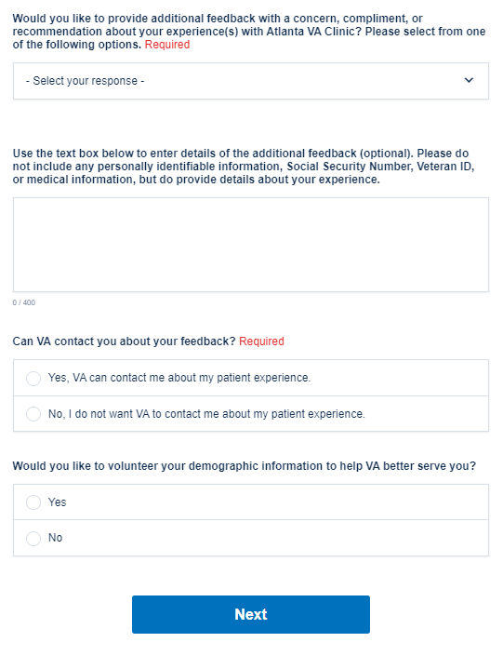
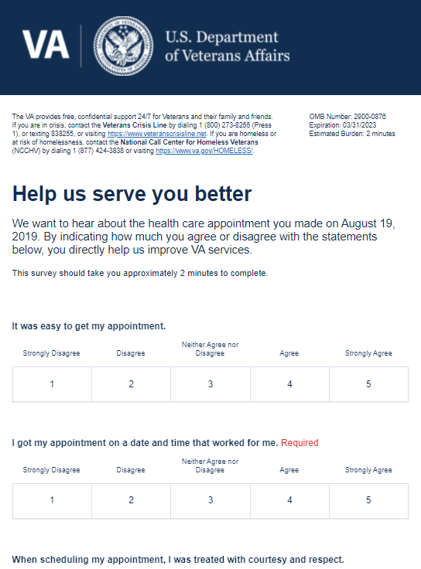
For More Information on VSignals
Where do I find the VSignals platform?
Veterans Signals
How do I gain access to VSignals?
VSignals User Request Form
Where can I find promotional flyers?
VEO VSignals Info
Where can I find more info?
VEO VSignals SharePoint

Slide 12
Thin Line Two-Color Icons
Academic Affiliations
App (Mobile App)
Benefits/ Regional Office
Bright Spots
Caregiver
Communication
Community
Community Veteran Engagement Board
Data
Design
Digital Modernization
Discovery
Ease
Effectiveness
Email
Emotion
Employee
Employee Experience
Engagement
Enterprise Data Management
Faith Based Organizations
Family Member
Governance
Hospital
Improve
In-Person
Insights
LGBTQ
Men
Minority
Moments that Matter
Navigation
NCA
Office of the Secretary
Implement
Industry Best Practices
Pain Points
Patient Experience
Peer-to-Peer Networking
Performance Improvement
Phone
Respond
Service Recovery
Survivor
Technology
The Board
Tools
Partners
Trust
Veteran
Veterans Experience (VetXL)
Veterans Service Organizations
VHA
Virtual
Volunteers
Women
Training
VBA
*TIP: To change icon color, select “Graphics Format,” “Graphics Outline,” then select color of choice.

Slide 13
Full Color Icons
Academic Affiliations
App (Mobile App)
Benefits/ Regional Office
Bright Spots
Caregiver
Communication
Community
Community Veteran Engagement Board
Data
Design
Digital Modernization
Discovery
Ease
Effectiveness
Email
Emotion
Employee
Employee Experience
Engagement
Enterprise Data Management
Faith Based Organizations
Family Member
Governance
Hospital
Implement
Improve
Industry Best Practices
In-Person
Insights
LGBTQ
Men
Minority
Moments that Matter
Navigation
NCA
Office of the Secretary
Pain Points
Patient Experience
Partners
Peer-to-Peer Networking
Performance Improvement
Phone
Respond
Service Recovery
Survivor
Technology
The Board
Tools
Training
Trust
VBA
Veteran
Veterans Experience (VetXL)
Veterans Service Organizations
VHA
Virtual
Volunteers
Women

