Slide 1
New to Customer Experience (CX)
Getting Started: Learning the Basics
Notes:
Welcome to the Course: 1 minutes
I’m going to give you a little primer on our Customer Experience Institute courses where we focus on teaching a Human Centered Design way of thinking

Slide 2
Objectives
The purpose of this presentation is to support staff new to the Customer Experience role by providing concise information for all agencies.
Our goal is to build confidence in understanding your CX role by raising awareness and navigation to key components of a strong CX foundation. We will walk through the first year in a CX role.

Slide 3



Understand Customer Experience
&
Build CX Structure
“Be a student before you become a teacher.”
Align and Execute CX Strategy
&
Measure and Analyze
"Be the change you wish to see in the world.”
Recognize, Sustain, and Evolve CX
“The Road to Success is Always Under Construction.”
Awareness & Desire
Knowledge & Ability
Reinforcement

Slide 4
Awareness & Desire
Understand my role as it relates to the mission
Review directives and policies
Gain access to data sources
Education and training
Listen, observe, and learn
Familiarize yourself with VEO resources
Understand Customer Experience
&
Build CX Structure
“Be a student before you become a teacher.”
Awareness & Desire

Slide 5

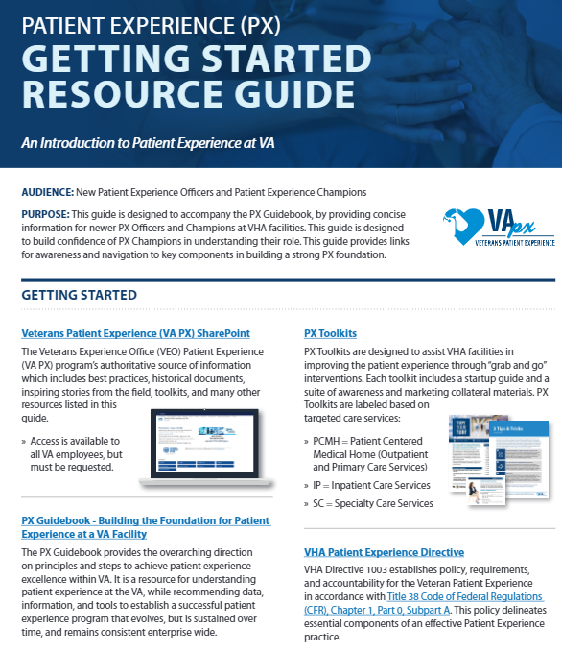

Awareness & Desire
Directives/Policies
Membership Provides Access To:
Agency Understanding and Government Understanding
Familiarize yourself with Directives, Facility Memorandums (MCM), Facility SOPs
The President's Management Agenda | The White House
VA Directive 0010: VA Customer Experience
VHA Patient Experience Directive
Title 38 Code of Federal Regulations-Ch1, Part0, SubpartAz.
Visit the Veteran Experience Office (VEO) SharePoint Site
Review CX cookbook
Gain Access to data sources and SharePoint that you need to do your work (example: PATS-R, VSignals, SHEP, SharePoint etc.)
VBA CX SharePoint site ​
VBA CX Playbook (includes templates and worksheets)​
2021 VBA CX Gallery Walk​
Message CXVC.VBACO@va.gov for information on CXC Monthly Meetings, CX Roundtables, and CXC Brown Bags​
PX Getting Started Guide​
PX Guidebook - Building the Foundation for Patient Experience at a VA Facility​
Veterans Patient Experience (VA PX) SharePoint site​

Slide 6

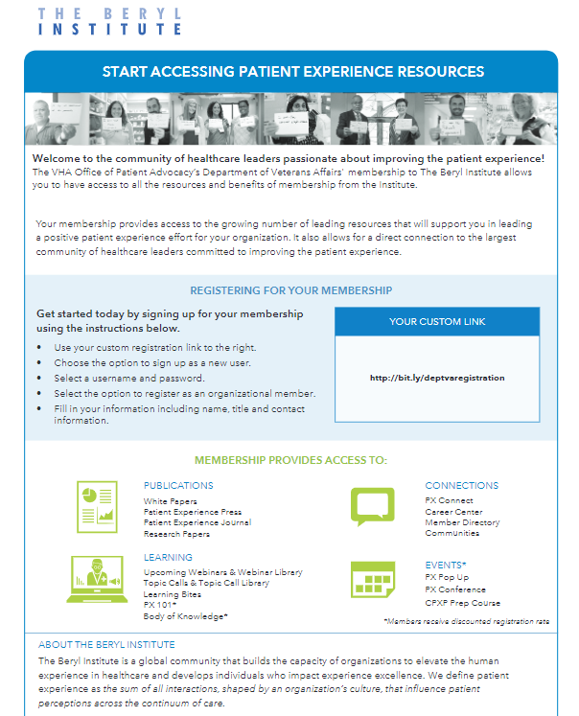


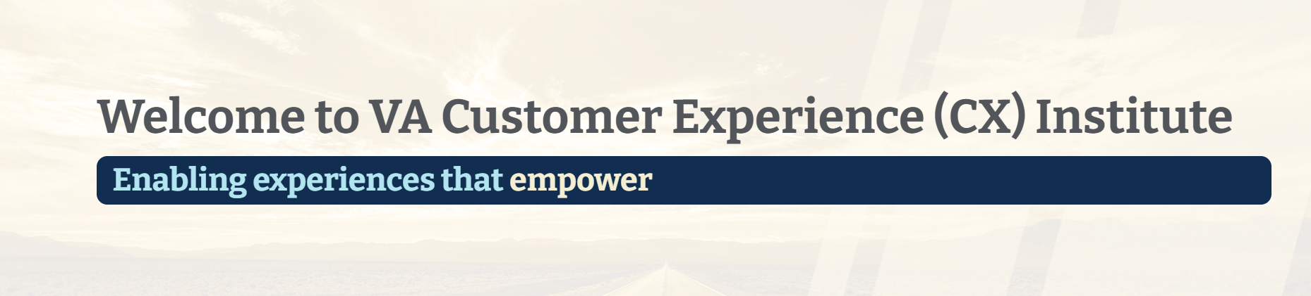
Education and Training
Recommended Training:
TMS (VA 3901227) - VA Core Values Training (I CARE Recommitment)
TMS (VA 43530) - Own the Moment / Self-Paced eLearning (1.25 CEUs available)
TMS (VA 43530) - Patient Experience (PX) Toolkits to Improve the Inpatient Experience
TMS VA 37667 - HRO 101
VACXi
Experience Data Set Training
Patient Experience University
Beryl Institute Learning
Journey Maps & Human Centered Design (HCD)

Slide 7
Knowledge & Ability
Networking & Meet with Key Stakeholders
Establish Relationships & Build Trust
Review current CX data
CX Strategic Planning
Set Priorities and Action Plan
Set SMART Goals
Communicate CX updates
Align and Execute CX Strategy
&
Measure and Analyze
"Be the change you wish to see in the world.”
Knowledge & Ability

Slide 8
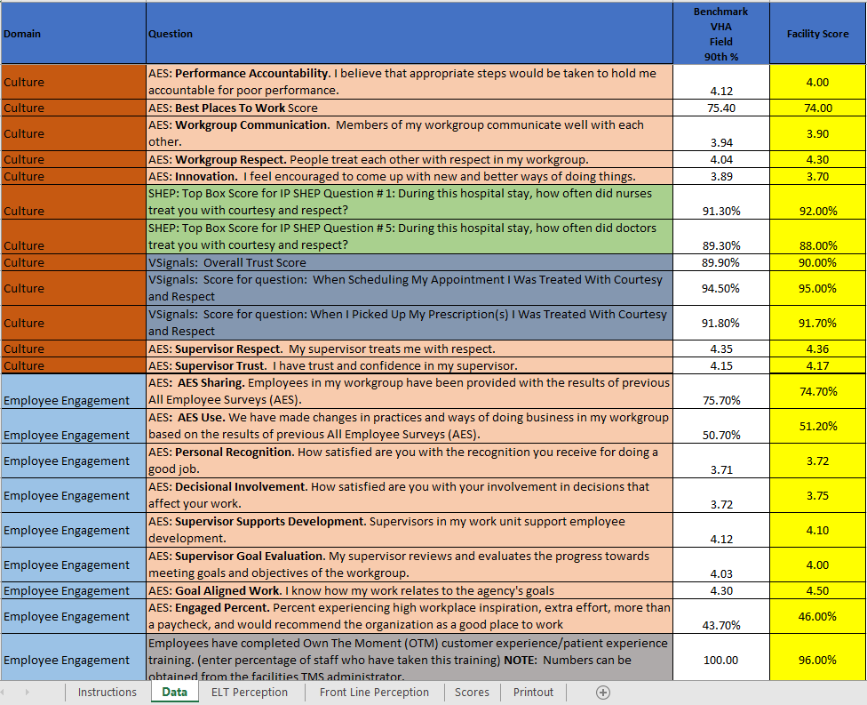

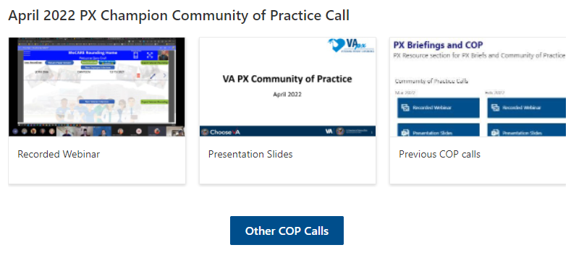
Knowledge & Ability
Reporting & Data
Getting leadership Buy-in
Make sure CX data is presented in Committees.
Be a member of other committees (Voice of the Veteran)
Update reports to match what your sites focus areas are
Ask leaders what is important to them
Know how to visually display data that makes sense and is easy to understand
Know how to speak comfortably about the data displayed
Know where to find your data,
Get comfortable telling Data stories
Trend and find improvement opportunities
Work with Stakeholders – Quality department, Systems Redesign, etc.
Experience Data Set Training
PX Environmental Scan
Earn a seat at the Table!
Establish a relationship with an Executive Sponsor
Present at Executive Leadership Team meetings and participate in discussions
PX Self-Assessment: ADKAR
Set Goals with SMART Criteria
Establish CX as the culture, not flavor of the month

Slide 9
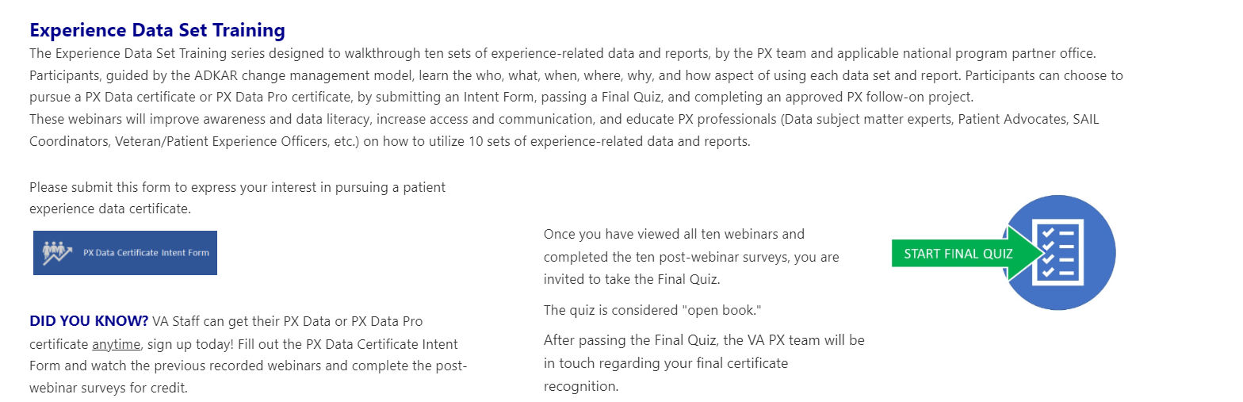

Knowledge & Ability
Networking and Engagement
Getting leadership Buy-in
Connection is key!
Develop relationships with department leaders, executives, other colleagues within your VISN who hold the same role (example: VPAC/VPXO)
Find your champions
Create your elevator pitch
Understand strengths and weaknesses
Consider Strategic Planning and Action Planning
Set SMART goals and priorities
Visit huddles and meetings
Attend outreach events
Meet your Veteran Service Organization reps
Engage in the PX Community of Practice and VBA CX Round tables
Share Best Practices
Participate in the CX Symposium
Earn a seat at the Table!
Establish a relationship with an Executive Sponsor
Present at Executive Leadership Team meetings and participate in discussions
PX Self-Assessment: ADKAR
Set Goals with SMART Criteria
Establish CX as the culture, not flavor of the month

Slide 10
Reinforcement
Reflect, Review and Analyze Feedback Systems and CX Data
Identify opportunities for Continuous Process Improvement
Provide support, guidance and assistance
Capture and Provide Feedback / Recognition
Recognize, Sustain, and Evolve CX
“The Road to Success is Always Under Construction.”
Reinforcement

Slide 11
Understand Customer Experience
&
Build CX Structure
“Be a student before you become a teacher.”
Align and Execute CX Strategy
&
Measure and Analyze
"Be the change you wish to see in the world.”
Recognize, Sustain, and Evolve CX
“The Road to Success is Always Under Construction.”
Awareness & Desire
Knowledge & Ability
Reinforcement

