Slide 1
Assessment Tool, Guidebook & Support
Notes:
Hi everyone! We are excited you have joined us today.
Today we will discuss:
-Assessment Tool
-Guidebook
-Support we can provide
Transition: We want to first start with the assessment tool.

Slide 2
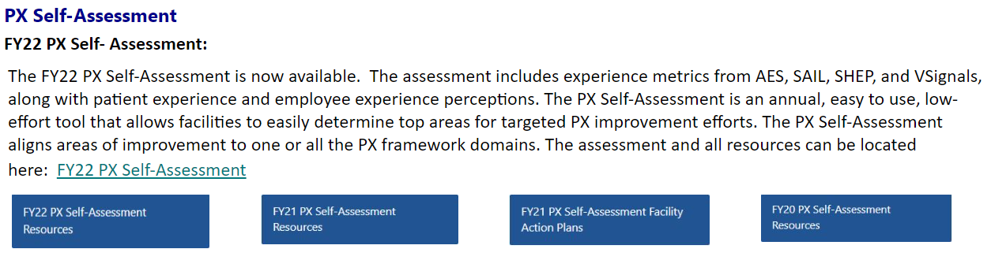
Assessment – What is it & Why use it?
Patient Experience Self-Assessment: Easy to use, low effort tool that assesses the current maturity level of Patient Experience at the individual facility level and aligns with the seven experience domains (Leadership, Culture, Patient Communication, Employee Engagement, Environment, Voice of the Veteran, Measurement & Improvement). The assessment allows facilities to zero in on certain areas to focus efforts.
Notes:
-Read Slide (overview)
-There are two versions – Outpatient only and Inpatient/Outpatient combined.​
-This assessment is for internal use only. There is no requirement to report your assessment results to the Veterans Experience Office. ​
​
-The assessment is a great tool to use in order to identify areas of improvement.
Transition: The PX Self-Assessment includes different tabs for information gathering.

Slide 3
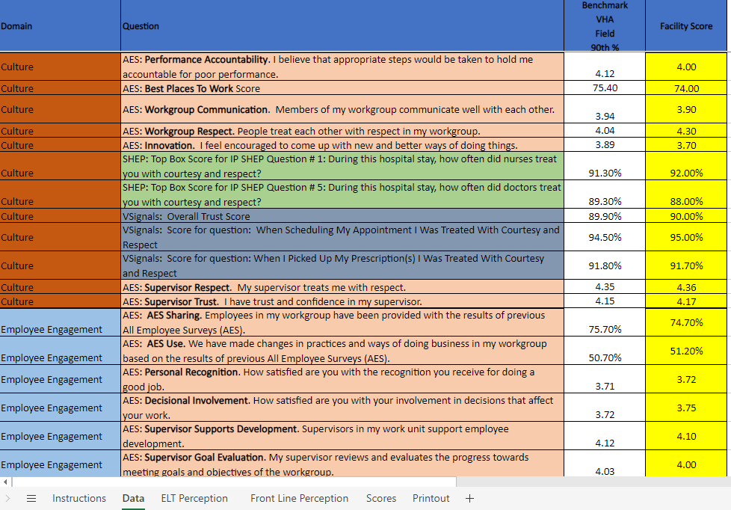
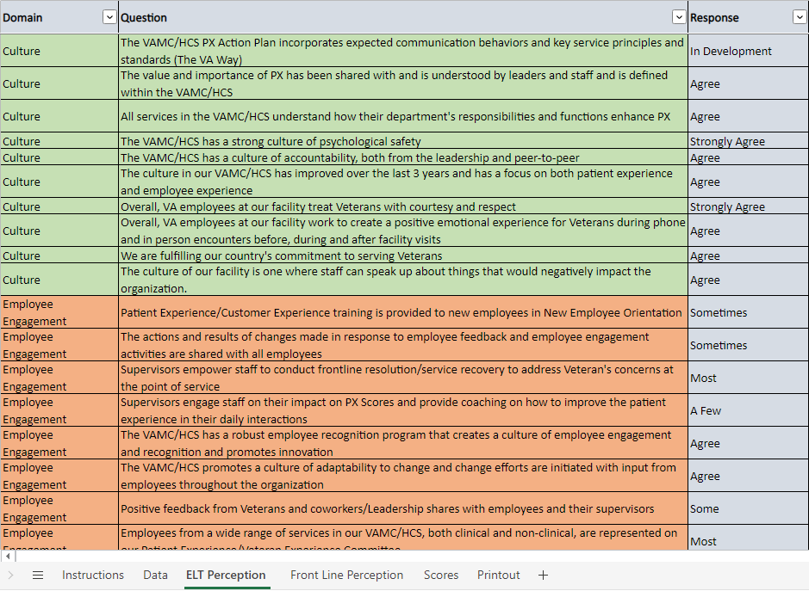
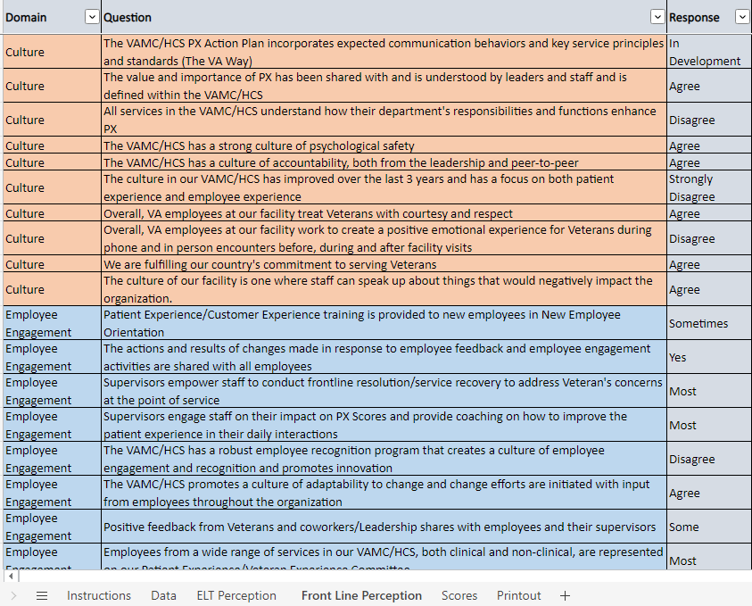
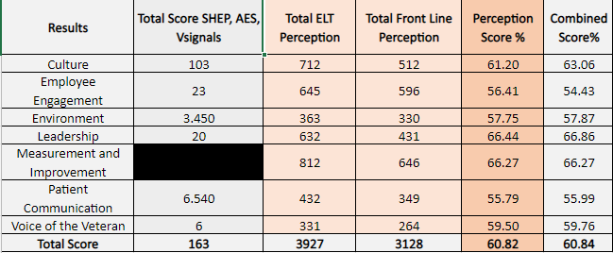
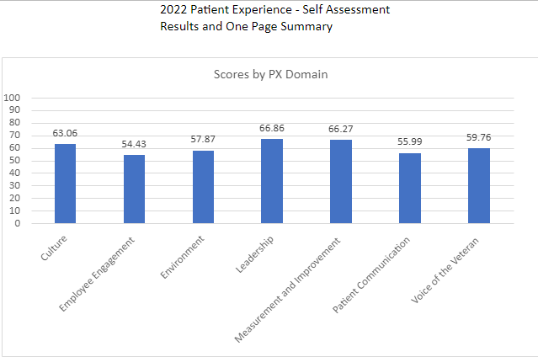
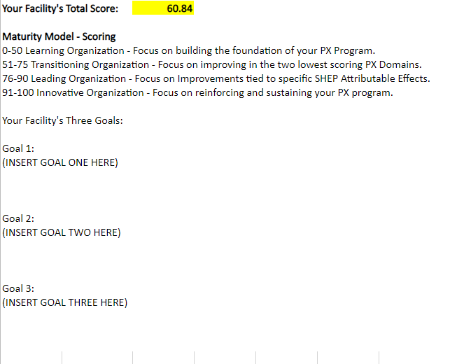
Assessment – What is it & Why use it?
Assessment has a data tab: Assessment has perceptions tab for both executive leaders
& front-line staff:
Assessment has a score tab and a printout tab for easy use/sharing:
Notes:
First is the Data Tab: This tab includes experience metrics from AES, SAIL, SHEP, and VSignals. Questions from each are included in the assessment. A data analyst can assist in pulling information for this area of the assessment.
-In addition to the data, there are two perceptions tab. One for the executive leadership team and one for the front-line staff. These tabs identifies perceived areas of improvement. It can also help identify gaps in perception between leadership and front line allowing different communication channels and improvements as needed.
-Lastly there are tabs for the final overall facility score and a printout tab that can be used for sharing information easily, posting information on huddle and informational boards for employee viewing.
Transition: Once you have completed the assessment, you will probably ask yourself “Now what?” – We are going to walk you through what to do with your results.

Slide 4
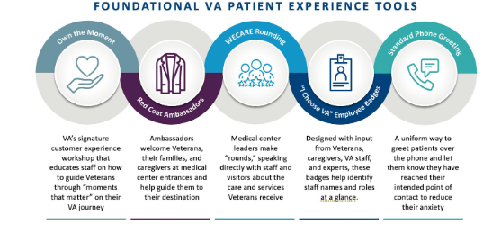
Assessment Results – What Next?
Maturity Model - Scoring ​
Less than 50, focus on building the Foundation of your PX Program. Utilize the PX Guidebook to assist in building the Foundation.​
Facilities should begin with a robust implementation of the five foundational tools designed to improve outpatient experiences.
Notes:
If your score is less than 50 - Read slide
The five foundational toolkits were developed to address the five outpatient moments that matter most to our Veterans.
The 5 MTM are:
I got the appointment when I needed it (EASE)​
It was easy to find where to go for my appointment (EASE)​
I felt heard and cared for (EMOTION)​
It was easy to get my prescriptions filled (EFFECTIVENESS)​
I understand what I needed to do next to manage my Whole Health (EFFECTIVENESS)​
Walk through the foundational toolkits, tie some into the actual MTMs.
The five foundational toolkits include:
I Choose VA/PX Badges
Own the Moment Veterans Customer Experience
Red Coat Ambassador program
Standard Phone Greeting
WECARE Leadership Rounding program
Transition: If you score between 51 and 75…

Slide 5
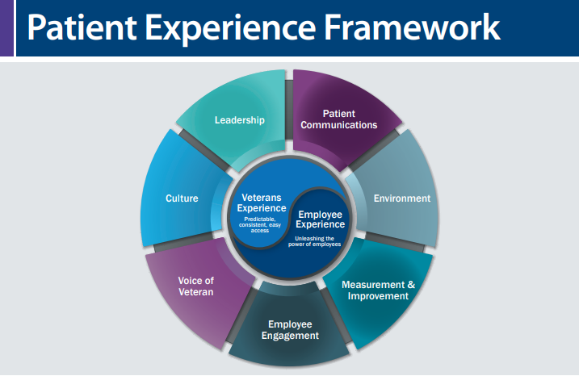
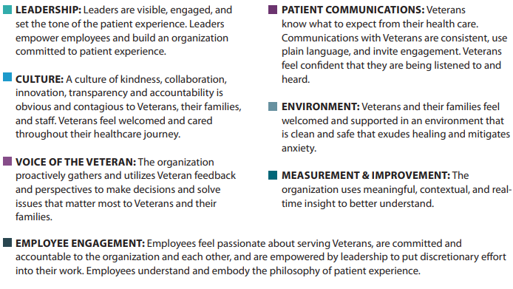
Assessment Results – What Next?
Between 51 and 75, focus on improvement in your two lowest scoring PX Domains.
Between 76-90, focus on specific improvements in your SHEP Attributable Effects​
Patient Centered Medical Home (PCMH) - Outpatient
Overall Rating of Provider | Q32 | The Overall Rating of the Primary Care Provider is a direct driver in the PCMH survey. The question asks the rating from zero to ten. The top box response is a score of a "9 or "10" in this rating.
Care Coordination Composite | Q23, 27, 34 | The Care Coordination composite questions are measured on a scale from: Never, Sometimes, Usually, and Always. The top box response is "Always" for these questions. The question responses are calculated as the average of the site's scores on the three questions.
Stress Discussed | Q46 | The Stress Discussed question on the outpatient survey is a direct driver in the PCMH survey. The question is measured on a yes or no response scale. The top box response is "yes".
Inpatient (IP)
Overall Rating of the Hospital | Q18 | The Overall Rating of the Hospital is a direct driver in the Inpatient Survey. The question asks for a rating from zero to ten. The top box response is a score of "9" or "10" in this rating.
Care Transition Composite | Q20, 21, 22 | The Care Transition Composite questions are measured on a scale: Strongly Disagree, Disagree, Agree, and Strongly Agree. The top box response is "Strongly Agree" for these three questions. The question responses are calculated as the average of the site's scores.
Specialty Care (SC)
Overall Rating of the Specialty Care Provider | Q21 | The Overall Rating of the Specialty Care Provider is a direct driver in the SC Survey. The question asks for a rating from zero to ten. The top box response is a score of "9" or "10" in this rating.
Communication Composite | Q12, 13, 17, 18 | The Communication composite questions are measured on a scale from: Never, Sometimes, Usually, and Always. The top box response is "Always" for these questions. The question responses are calculated as the average of the site's scores on the three questions.
Notes:
Focus on improvement in your two lowest scoring PX domains.
List the domains, then give examples – for instance, if you score low in culture, review the PX guidebook for potential solutions to improve culture at your facility such as Change Management and Own The Moment Workshops. The guidebook is set up to easily find solutions by clicking on the area of focus on the table of contents.
If you score between 76-90, focus on specific improvements within your SHEP attributable effects – walk through some of the questions on the slide with option for improvement. For example, if you are scoring low on Q46, stress discussed, consider using the Pre-Visit Checklist and/or Messages for the Moment. The pre-visit checklist has an actual scripted question about Stress and Messages for the moment will allow staff to come with with key words/phrases to use when asking about stress.
Transition: Lastly, if you score between 90-100

Slide 6




Assessment Results – What Next?
Between 90-100, focus on reinforcing and sustaining your PX program. As facilities pursue patient experience excellence, ensure the desired changes remain in place:
Celebrate Success through:
Town Halls
Employee Celebrations
WECARE Leadership Rounding
Communicate & Reinforce through:
Staff Meetings/Huddles
Communication Templates
Governance Structure
Hold Voice of the Veteran Listening Sessions
Share Best Practices through PX Community of practice calls
Reassess Data through improvement teams, staff meetings, committees, governance structure
Retake the PX Self-Assessment Annually
Utilize PX Guidebook for improvement efforts (also aligned with the seven PX domains).​
​
​
Notes:
Read Slide.
Transition: Earlier we referenced the PX guidebook, we want to take a few minutes to talk about what it is and why it is helpful to use it.

Slide 7
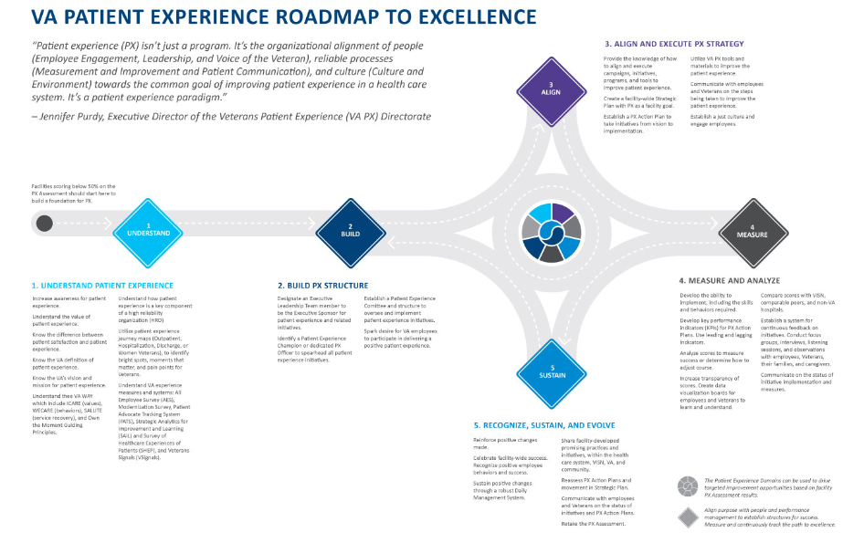
Guidebook - What is it & Why use it?
Patient Experience Guidebook:
This guidebook provides the overarching direction on principles and steps to achieve patient experience excellence within VA. This guidebook is a resource for understanding patient experience at the VA, while recommending data, information, and tools to establish a successful patient experience program that is sustained, evolves, and consistent enterprise-wide. It aligns with the VA Roadmap to Excellence 2.0.
Notes:
Read Slide.
Transition: In addition…

Slide 8
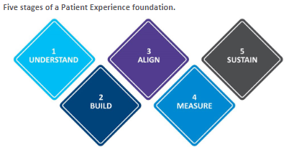
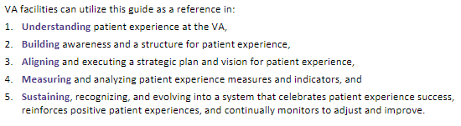
Guidebook - What is it & Why use it?
Patient Experience Guidebook:
The guide navigates through the five stages of a foundational patient experience program. The stages align to process improvement and change management models.
This guide can also be used as a reference for PX Self-Assessment results and utilize targeted PX Domain chapters to recognize why each domain is an important factor in patient experience, what strong patient experience initiatives and programs targeting that domain look like and receive overall tips on how to improve in that domain.
Notes:
Read first bullet of slide:
Walk through the five stages – give examples in each category.
Understand – This is where you learn the difference between patient satisfaction and patient experience, increase awareness of patient experience at a facility and understand how patient experience is a key component of a high reliability organization.
Build – This is where you designate an Executive member to be your PX sponsor, identify your PX Champions, identify your dedicated PX officer, build your committee and start sparking desire for VA employees to participate in delivering exceptional experiences.
Align – This is where you create a facility wide strategic plan with PX as a facility goal, provide knowledge of how to align and execute initiatives and where you communicate with staff about steps being taken to improve PX.
Measure – This is where you develop the ability to implement including the skills and behaviors required, create key performance indicators, analyze scores to measure success, and communicate status of initiatives.
Sustain – this is where you recognize and celebrate successes, reinforce positive changes, and sustain through daily communication channels.
Remind them by reading second bullet on slide.
Transition: Remember, our team always stands ready to assist!
Transition -

Slide 9
Support
PX Data Deep Dive (Virtual; 2-3 hours): An interactive crosswalk for leaders and employees to understand bright spots and pain points pertaining to facility and clinic-level experience scores, covering Access to Care, VA’s All Employee Survey, CMS Hospital Compare, Strategic Analytics for Improvement and Learning (SAIL), the Survey of Healthcare Experience of Patients (SHEP), and Veterans Signals.
PX Consultation (On-Site; 2-3 days): An on-site consultation, encompassing a PX Data Dee of Dive, and a catered agenda for the facility that could include a traditional on-site consultation, a Program Review, Strategic Planning and/or Action Planning with focus groups, and interviews to gather the observations of employees and Veterans.
PX Coaching (1 Day Shadow/1-Hr Ongoing, Virtual & In Person): A Virtual or On- site visit with a catered agenda that could include options for 1:1 coaching, PX Self-Assessment Support, Experience Data Set Training and VISN VEC Support coaching.
Implementation (On-Site; 2-3 days): On-site and virtual implementation coaching and utilization of all Patient Experience Toolkits. Implementation also includes solutions derived from the Human-Centered Design (HCD) journey maps, addressing the moments that matter, development of new evidence-based new toolkits, and implementation support of opportunities identified through PX Consultation. ​
Notes:
Walk through support options on slide.
End: We want to once again thank you for joining our breakout session today and we are open to any questions you may have now or feel free to outreach us at anytime at vapx@va.gov.

