Slide 1
Survey of Healthcare Experiences of Patients- SHEP 101
Jim Schaefer- Director of Surveys
SHEP Program
Quality & Patient Safety- Analytics & Performance Integration
August-2022

Slide 2




AGENDA
Getting Started
SHEP Program Overview
Data Navigation
Know where to find SHEP Patient Experience data and what it means
Data Activation
Turn data into action: How to narrow the focus
Case Study
Learn how a VHA Facility Journeyed to the 90th Percentile!
Notes:
Agenda

Slide 3
PURPOSE
Purpose
Assess Veterans’ experience within VHA through the administration of Inpatient , Patient-Centered Medical Home (PCMH), Specialty Care, and Community Care surveys
Support transparency for VHA’s initiative to publicly report data
Identify opportunities for improvement
Provide customer-centric data, tools, and reports that strengthen facility and system-level performance, quality of care, efficiency, resilience and enhance Veteran experience
2
Notes:
What is the SHEP Program? The purpose is to:
Collects Veterans’ feedback through the administration of Inpatient , Patient-Centered Medical Home (PCMH), Specialty Care and Community Care to assess patient experience within VHA. Later we will share more about the SHEP family of surveys.
We support transparency for VHA’s initiative to publicly report data. On the next slide, we will share more about the internal and external SHEP reporting practices.
We measure Improvements in patient experience- Our surveys and data results are used to identify opportunities for improvement. We also work very closely with other program offices such as Center for Improvement Coordination (CIC) and VA PX to improve patient experience.
We identify opportunities for improvement- This is one of the goals on today’s session to share what data sources and reports to use to identify key priority areas.
And finally we provide customer-centric data, tools and reports that strengthen facility and system-level performance, quality of care, efficiency, resilience and enhance Veteran experience

Slide 4
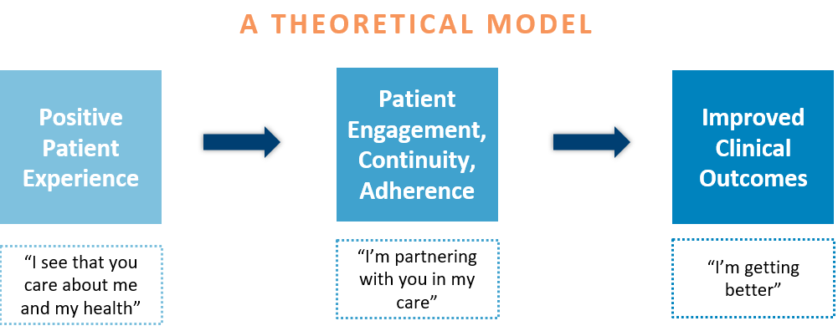
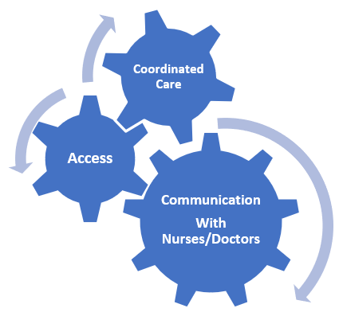
WHAT IS SHEP?
What is Patient Experience
The sum of all interactions, shaped by the organization’s culture, that influence Veterans’ and their families’ perceptions along their healthcare journey.
Why Patient Experience Matters
SHEP Surveys
Measuring experience of care in different settings
Inpatient
Primary Care
Specialty Care
Community Care
Mail only
Mail & Online
Mail & Online
Mail & Online
SHEP FAMILY OF SURVEYS
3
Notes:
What is SHEP?
What is known today as the Survey of Healthcare Experiences of Patients (SHEP) program was established in 1995 in response to Executive Order 12862 – Setting Customer Service Standards.
For over 20 years, the SHEP program has assessed Veterans’ healthcare experience in the service of improving the quality of that care.
The program is responsible for measuring VHA’s performance on Veteran Healthcare Service Standards and benchmarking VHA’s performance against comparable non-VHA populations.
The SHEP team works to advance the creation of a coordinated national system within the VHA for assessing patient experience, to support a culture of patient-centered care, to meet the changing measurement needs of the field, and to construct opportunities for improving the healthcare experience of Veterans.
The SHEP team offers expertise in survey development, analysis and performance measurement. Data-driven analyses is utilized to inform decision-making aimed at improving patients’ healthcare experiences and quality of care. The team supports transparency through external benchmarking and public reporting.
In line with API’s vision of “purpose-driven analytics”, over the past few years the SHEP program has grown to provide advanced analytic tools and consultative services to promote understanding survey results and facilitate improvement in patient experience and clinical care.
Why Patient Experience Matters?
Measuring is not simple. Perception is everything… And patient experience factors into how patients see your services, your team, and everything in between. The answers are in their ratings.
The experience begins at arrival and parking, entry into the facility, the look and feel of the reception area.
Did they find their way to the appointment quickly and easily? How were they greeted and treated by the front desk staff? Was the reception area amenities satisfactory?
This journey is different for every patient.
As you can see it’s the sum of all interactions. Every interaction with your facilities and staff reveals how in-tune you are with your patient’s needs regardless of their age/gender/race/ethnicity etc. The goal is to put them at ease and elevate the value of your services for their health. The patient experience you provide reveals that you understand what it’s like to walk-in-their shoes.
SHEP Surveys:
As you can see there are 4 core SHEP Surveys in SHEP family of surveys. Each survey is different and is based on the Consumer Assessment of Healthcare Providers and Systems (CAHPS) standard questionnaires. On the next 2 slides we will share details about each survey including the mode, total number mailed each year and the response rate of each survey.

Slide 5



WHAT IS CAHPS?
The content of SHEP surveys is based on the industry-standard
Consumer Assessment of Healthcare Providers and Systems surveys (CAHPS).
SHEP/CAHPS surveys ask questions based on what has been proven to be most important to patients such as access, care coordination, and communication.
Private sector hospitals also use CAHPS surveys, which provides a basis of comparison of patient experience between VA and the private sector.
Mail only
Mail & Online
Mail & Online
Mail & Online
4
Notes:
The SHEP team administers surveys using industry-standard Consumer Assessment of Healthcare Providers and Systems (CAHPS) family of survey questionnaires to collect feedback from Veterans regarding their patient experiences. CAHPS surveys are the gold standard for patient experience measurement. These surveys measure patient experience of care in different settings.
Private sector hospitals also use CAHPS surveys, which provides a basis of comparison of patient experience between VA and the private sector hospitals.
SHEP surveys ask questions based on what has been proven to be most important to patients.
The surveys cover a broad array of important healthcare experiences, including patients’ access to timely appointments, how clearly their providers communicated with them, whether they got the support they needed from office staff, and their overall care experience.
The Centers for Medicare and Medicaid Services (CMS) summarizes Hospital Performance in CAHPS (HCAHPS) using a 5-star rating system.
Star Ratings make it easier for consumers to use the information and spotlight excellence in healthcare quality. There are a total of 10 publicly reported inpatient measures plus the summary star rating.
CMS Care compare releases HCAHPS Star ratings each quarter. Recently the Jan. 2022 data was released and when compared to FY18 data there were 28% of VA hospitals that had increased to 4-5 star hospitals.
On a composite basis there are even more noteworthy improvements. Please see the Feb. 2022 SHEP Users call for a presentation on the HCAHPS Summary Star ratings. (https://vaww.qps.med.va.gov/divisions/api/pm/shep/shepUsersCalls.aspx)
Here is more:
“About CAHPS”: https://www.ahrq.gov/cahps/about-cahps/index.html
CMS Care Compare: https://www.medicare.gov/care-compare/
CMS Care Compare data- VA HCAHPS- https://vaww.qps.med.va.gov/filedownload.ashx?fid=57891
If you’d like to learn more or want a quick hit video that’s less than 5 minutes, please check out the “Introduction to SHEP Video”: https://www.youtube.com/watch?v=udeuLW7TpMM&feature=youtu.be
This video is intended to provide both seasoned and new staff a brief yet comprehensive overview of the SHEP Program.

Slide 6
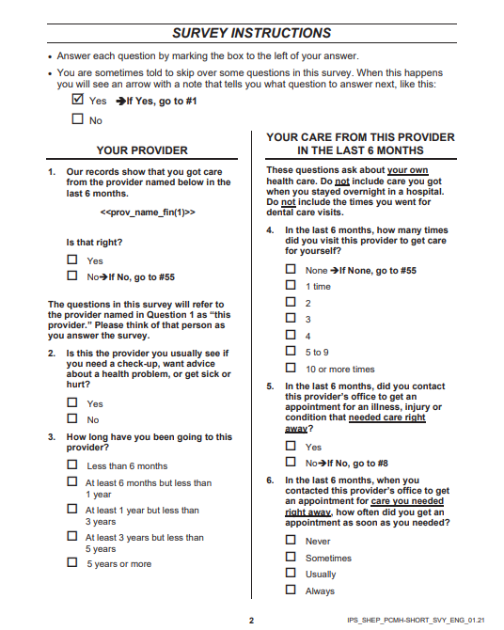
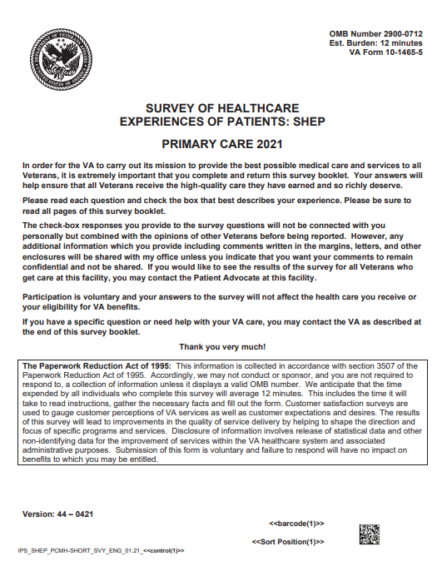




SHEP SURVEY ADMINISTRATION
Inpatient
Mail only (HCAHPS protocol)
14,500 surveys/month
Specialty Care
Community Care
Patient-Centered Medical Home (PCMH)
33.5% Response Rate (FY21)
60,000 surveys/month
33.2% Response Rate (FY21)
Internet & Mail
Internet & Mail
54,000 surveys/month
33.2% Response Rate (FY21)
Internet & Mail
10,000 surveys/month
30.3% Response Rate (FY21)
Mail only
Mail & Online
Mail & Online
Mail & Online
ALL SHEP SURVEYS ARE LOCATED HERE:
SHEP Questionnaires (va.gov)
5
Notes:
SHEP is not a single survey, but a survey program designed to obtain feedback from Veterans regarding their experiences with those aspects of the healthcare process that matter most to patients.
Combined, the SHEP program contacts approximately 150,000 Veteran users of VA healthcare a month. That equates to contacting 1.8 million Veterans each year. The SHEP Response rate at national level is much higher than the industry. SHEP also adjusts for non-responders making the results more representative of the population. Do other surveys adjust in this way?
In terms of content, SHEP uses surveys from the Consumer Assessment of Healthcare Providers and Systems (CAHPS) program. CAHPS surveys are regarded as the “gold standard” for the assessment of patient experience and widely used in the private sector.
Some FACTS about SHEP:
SHEP as mail only prior to FY16
What modes does SHEP include? Mail, Email/web
Inpatient is Mail Only
SHEP contacts 1.8 million Veteran each year
If you’d like to learn more or want a quick hit video that’s less than 5 minutes, please check out the “Journey of the Survey Video”: https://www.youtube.com/watch?v=7NZq4WnDnV8&feature=youtu.be. This video is intended to provide both seasoned and new staff a brief yet comprehensive of the survey administration process.

Slide 7
SHEP SURVEYS: Dimensions of Patient Experience Assessed
All SHEP surveys
Access: Getting Timely Appointments, Care, and Information.
Communication: How Well Providers Communicate With Patients.
Coordination: Providers' Use of Information to Coordinate Patient Care.
Office Staff: Helpful/Responsive, Courteous, and Respectful Staff.
Patients’ Overall Rating of Provider (PCMH, SC) or Hospital (Inpatient)
Satisfaction with Care (except Inpatient)
In addition, for the Inpatient Survey
Cleanliness of Hospital
Quietness of Hospital
Shared Decision Making
Discharge Information
Care Transition
In addition, for Community Care Survey
Eligibility Determination
First Appointmentt Access
Billing
Mail only
Mail & Online
Mail & Online
Mail & Online
6
Notes:
What are we measuring in SHEP Patient Experience Surveys?
All SHEP Surveys:
Access: Getting Timely Appointments, Care, and Information.
Communication: How Well Providers Communicate With Patients.
Coordination: Providers' Use of Information to Coordinate Patient Care.
Office Staff: Helpful/Responsive, Courteous, and Respectful Staff.
Patients’ Overall Rating of Provider (PCMH, SC) or Hospital (Inpatient)
Satisfaction with Care (except Inpatient)
There are some additional items assess in Inpatient:
Cleanliness of Hospital
Quietness of Hospital
Shared Decision Making
Discharge Information
Care Transition
And some additional items in Community Care:
Eligibility Determination
First Appointmentt Access
Billing

Slide 8

SCORING LOGIC- “TOP BOX” SCORING
Provider Listened Carefully
Never
Sometimes
Usually
Always
Strongly Disagree
Disagree
Agree
Strongly Agree
Staff took my preferences into account
Overall Rating
(0-10)
0-6
7-8
9
10
TOP 2 BOX
TOP BOX
TOP BOX
Mail only
Mail & Online
Mail & Online
Mail & Online
7
Notes:
It’s important to understand the scoring concept known as “Top Box” scoring. This refers to the fact that, for many items, the best way to score is to look at the percentage of patients giving the highest possible response, for example “Strongly Agree” with the question that asks if staff took my preference into account, or that Doctors “Always” listened carefully. On the Overall Rating of Care, which the patient is asked to rate on a scale of 0 to 10, where 10 is the BEST CARE IMAGINABLE, the scoring is based on the percentage hitting the top 2 categories, “9” or “10”.​
​
This approach is based on good scientific evidence. For instance:​
​
We know this type of scoring is better able to discriminate HIGH from LOW performers, even if the percentage seems low for all. AND​
We also know that when we EXCEED the patient’s expectations, they really notice, and that generates a stronger partnership with their treating team.​
​ There is only ONE CAUTION here. This principle works AS DESIGNED only if you do not create a “response bias” in the patient. They need to react to the question ON THERE OWN. So, PLEASE, no “10” Posters or Lapel Buttons. ​

Slide 9

DATA NAVIGATION Know your data: Where to find it and what it means?
Mail only
Mail & Online
Mail & Online
Mail & Online
8
Notes:
This section is called “Data Navigation”- Where to find the data you need.

Slide 10
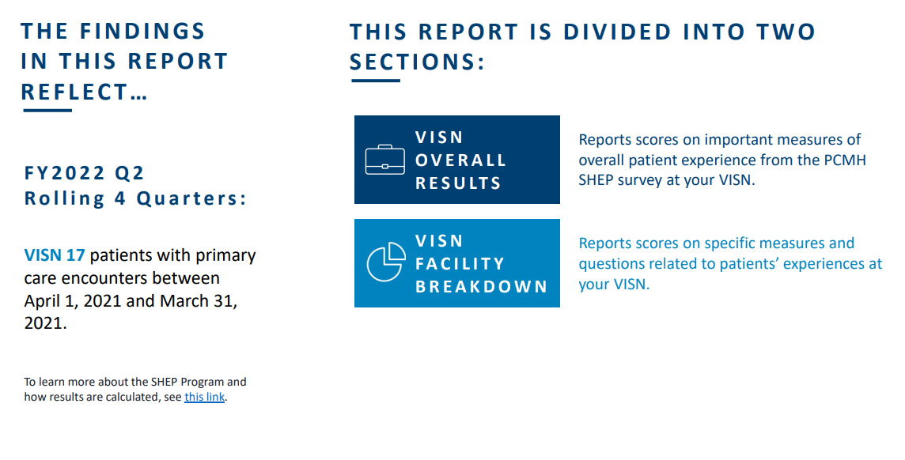
VISN Level Infographics Report
Mail only
Mail & Online
Mail & Online
Mail & Online
9
Notes:
The SHEP VISN & Facility Level Infographics report is great pre-made report with the latest SHEP data.
We understand compiling data in a meaningful and visually appealing way takes time.
One-Stop-Shop SHEP data report for Inpatient and PCMH
Report can be easily shared with all levels within the organization
Facility level reports organized into sections for leadership, clinicians, office staff etc.
Report shows facility scores, trends over time, questions, response level, top drivers and attributable effects results.
Reports are located on the SHEP website: https://vaww.qps.med.va.gov/divisions/api/pm/shep/shepVISNLevelInfoGraphic.aspx

Slide 11
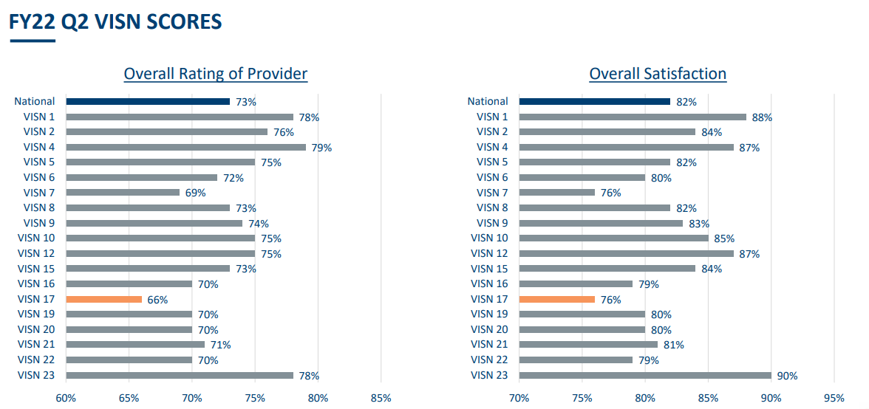
VISN Level Infographics Report- Comparison
Mail only
Mail & Online
Mail & Online
Mail & Online
10
Notes:
What to know how your VISN compares to other VISNs in Overall Rating of Provider and Overall Satisfaction measures?

Slide 12
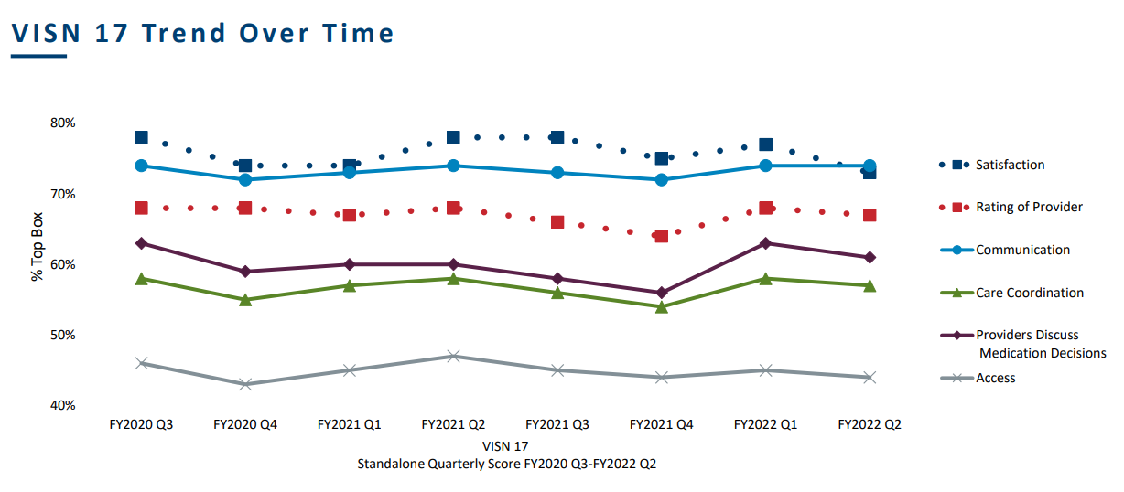
VISN level Infographics Report- Trending
Mail only
Mail & Online
Mail & Online
Mail & Online
11
Notes:
Looking at trends over time helps in understanding how measures have performed.

Slide 13
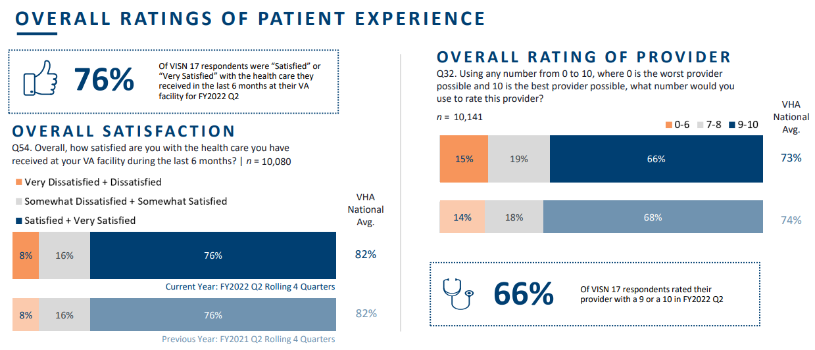

VISN level Infographics Report- Response Level Drilldown
Mail only
Mail & Online
Mail & Online
Mail & Online
12
Notes:
The VISN Level dimensions breakdown slides showcase each measure/composite and other helpful information such as:
Measure/Composite (Overall rating/ Access/Care coordination etc.)
Current state score (Rolling 4 Quarters)
N’s
Response level breakdowns (Always, usually + sometimes etc.)
VHA National Average
Previous year’s scores for comparison

Slide 14
DATA ACTIVATION Turning data into action and narrowing the focus
Mail only
Mail & Online
Mail & Online
Mail & Online
13
Notes:
Data Activation Section

Slide 15
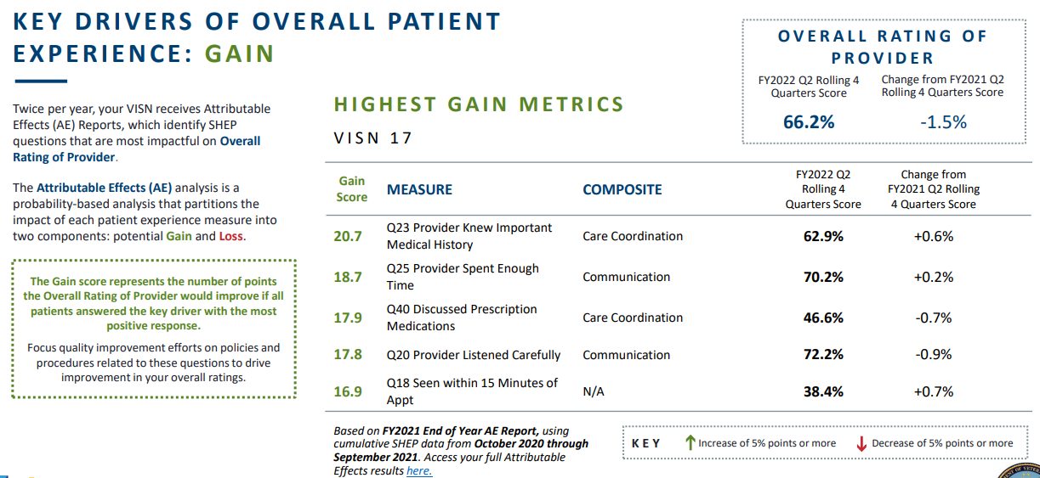
IDENTIFY DRIVERS- Using Attributable Effects Reports
Mail only
Mail & Online
Mail & Online
Mail & Online
14
Notes:
The Attributable Effects Reports aka AE report help you understand how changes in Veterans’ responses to each individual SHEP question might impact the outcome measure (Overall Rating Patient)
You can look at AE reports for each care setting to identify top drivers (or top questions) that impact the overall rating.
By focusing on the question with the highest gain scores. You will have the most impact on or the greatest chance to improve overall rating.
Results of the AE are displayed as Gain or Loss scores for each measure.
Question: What are some aspects of care my facility should focus on for high-impact quality improvement?
On this slide we can identify questions such as (Care Coordination questions Q23 and 40) and (Communication Q25)- if we focus on these aspects of care and Veteran's respond favorably w. top box scores, we can see an improvement of over 10 percent increase in the Overall Rating of provider score.
Here’s the link to the SHEP Reporting website: https://vaww.qps.med.va.gov/divisions/api/pm/shep/shepReporting.aspx
Go to AE Reports on the right-hand side and select the AE report you’d like (PCMH/IP/SC/CC) then VISN.
Check out the Communication and Care Coordination toolkits on the SHEP toolkits webpage: https://vaww.qps.med.va.gov/divisions/api/pm/shep/shepEnvScanAndToolkits.aspx
And the VAPX toolkits that can help improve scores in these areas: https://dvagov.sharepoint.com/sites/vha-patient-experience/PX_Toolkits
These toolkits gives the basics about the measure, recommendations, implementation examples and resources for improvement.

Slide 16
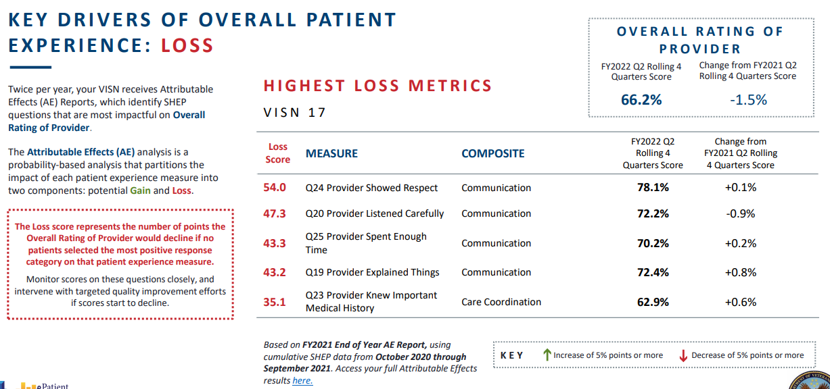
IDENTIFY DRIVERS- Using Attributable Effects Reports
Mail only
Mail & Online
Mail & Online
Mail & Online
15
Notes:
Question: What are some aspects of care my facility should focus on for high-impact quality improvement?
On this slide we can identify questions such as Communication and Care Coordination questions- if we focus on these aspects of care and Veteran's respond favorably w. top box scores, we can see an improvement of over 10 percent increase in the Overall Rating of provider score.
Here’s the link to the SHEP Reporting website: https://vaww.qps.med.va.gov/divisions/api/pm/shep/shepReporting.aspx
Go to AE Reports on the right-hand side and select the AE report you’d like (PCMH/IP/SC/CC) then VISN.
Check out the Communication and Care Coordination toolkits on the SHEP toolkits webpage: https://vaww.qps.med.va.gov/divisions/api/pm/shep/shepEnvScanAndToolkits.aspx
And the VAPX toolkits that can help improve scores in these areas: https://dvagov.sharepoint.com/sites/vha-patient-experience/PX_Toolkits
These toolkits gives the basics about the measure, recommendations, implementation examples and resources for improvement.

Slide 17
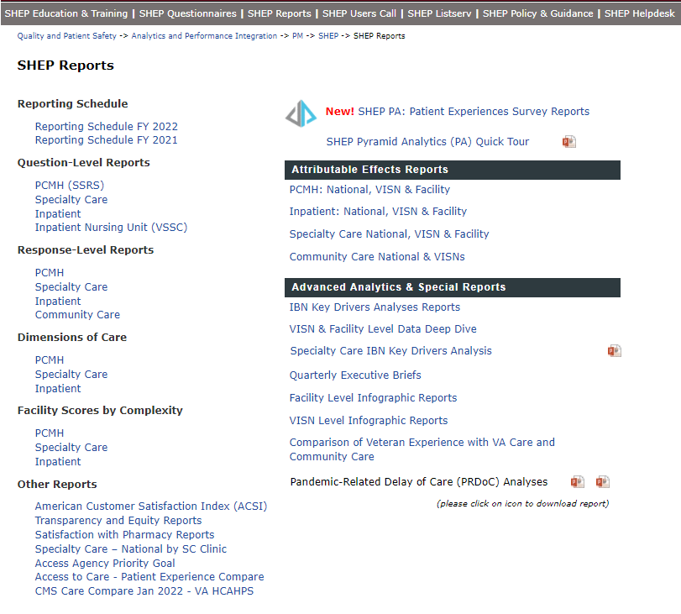
WHERE TO FIND SHEP ATTRIBUTABLE EFFECTS REPORTS?
Mail only
Mail & Online
Mail & Online
Mail & Online
16
Notes:
You can access the SHEP Attributable Effects report from the SHEP reports website. Here is the link: https://vaww.qps.med.va.gov/divisions/api/pm/shep/shepReporting.aspx
Go to AE Reports on the right-hand side and select the AE report you’d like (PCMH/IP/SC/CC) then VISN.
AE reports are produced twice per year

Slide 18

INFOGRAPHICS – Facility Breakdown
COMPOSITES INCLUDED IN THIS SECTION
Overall Satisfaction
Overall Rating of Provider
Communication
Care Coordination
Self- Management Support
Comprehensiveness
Providers Discussed Medication Decisions
Access
Office Staff
Mail only
Mail & Online
Mail & Online
Mail & Online
17
Notes:
You can find the VISN Level Infographic Report here: https://vaww.qps.med.va.gov/divisions/api/pm/shep/shepVISNLevelInfoGraphic.aspx

Slide 19
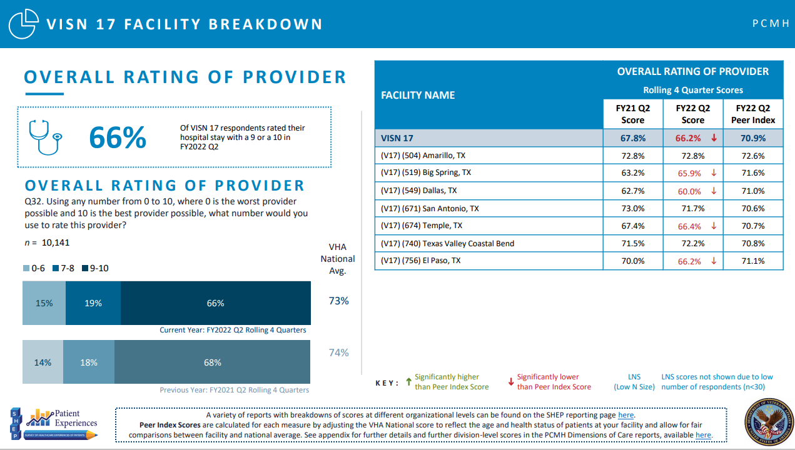

FACILITY BREAKDOWN
SAIL
Mail only
Mail & Online
Mail & Online
Mail & Online
18
Notes:
The VISN Level dimensions slides showcase each measure/composite as well as a VISN facility breakdown. There are other helpful information such as:
Measure/Composite (Overall rating/ Access/Care coordination etc.)
Current state score (Rolling 4 Quarters)
N’s
Response level breakdowns (Always, usually + sometimes etc.)
VHA National Average
Previous year’s scores for comparison
On the right-hand side there is the Facility level breakdown showcasing:
VISN and Facility names
Previous years scores
Current years scores
Comparison to the peer index (used for benchmarking)
Peer Index adjusts the national score to reflect the facility demographics for fair comparisons between the facility and the national average. It can be used as a benchmark.

Slide 20
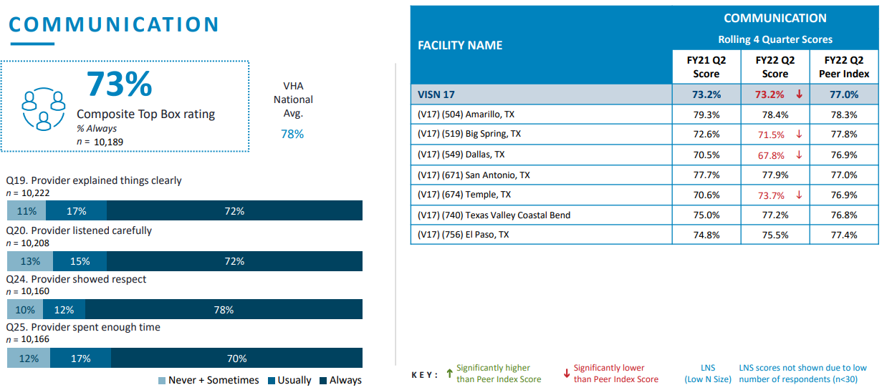
FACILITY BREAKDOWN
Mail only
Mail & Online
Mail & Online
Mail & Online
19
Notes:
Communication is highlighted here because it was identified as a key driver in the Attributable Effects report. Please note all composite slides are available in the report.
The VISN Level dimensions slides showcase each measure/composite as well as a VISN facility breakdown. There are other helpful information such as:
Measure/Composite (Overall rating/ Access/Care coordination etc.)
Current state score (Rolling 4 Quarters)
N’s
Response level breakdowns (Always, usually + sometimes etc.)
VHA National Average
Previous year’s scores for comparison
On the right-hand side there is the Facility level breakdown showcasing:
VISN and Facility names
Previous years scores
Current years scores
Comparison to the peer index (used for benchmarking)
Peer Index adjusts the national score to reflect the facility demographics for fair comparisons between the facility and the national average. It can be used as a benchmark.

Slide 21
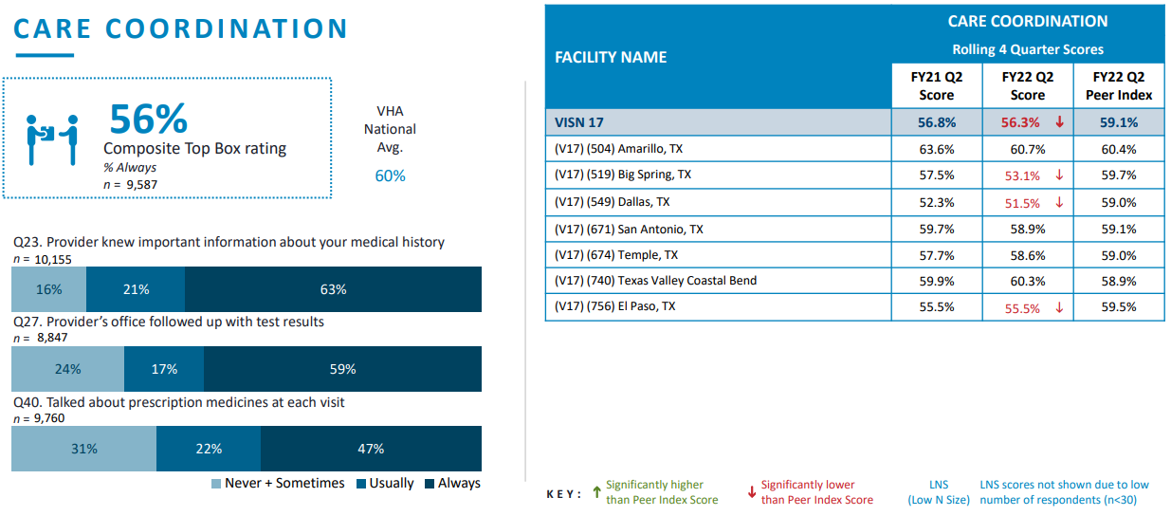
FACILITY BREAKDOWN
SAIL
Mail only
Mail & Online
Mail & Online
Mail & Online
20
Notes:
Care Coordination is highlighted here because it was identified as a key driver in the Attributable Effects report. Please note all composite slides are available in the report.
The VISN Level dimensions slides showcase each measure/composite as well as a VISN facility breakdown. There are other helpful information such as:
Measure/Composite (Overall rating/ Access/Care coordination etc.)
Current state score (Rolling 4 Quarters)
N’s
Response level breakdowns (Always, usually + sometimes etc.)
VHA National Average
Previous year’s scores for comparison
On the right-hand side there is the Facility level breakdown showcasing:
VISN and Facility names
Previous years scores
Current years scores
Comparison to the peer index (used for benchmarking)
Peer Index adjusts the national score to reflect the facility demographics for fair comparisons between the facility and the national average. It can be used as a benchmark.

Slide 22
CASE STUDY Learn how a VHA Facility Journeyed to the 90th Percentile!
Mail only
Mail & Online
Mail & Online
Mail & Online
21
Notes:
What to learn what other facilities are doing to improve patient experience? Here’s a case study used in Nebraska Western-Iowa HCS.

Slide 23

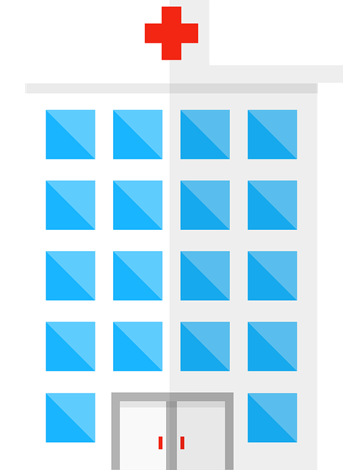
CASE STUDY: JOURNEY TO 90th PERCENTILE!
Want to know how a facility used patient feedback to Improve their CAHPS Scores and their journey to the 90th Percentile?
Nebraska-Western Iowa Healthcare System
Improvement in Specialty Care SHEP Scores!
Examine how Patient Experience and Quality Management teams partnered to improve CAHPS domains of Overall Rating of SC Provider, Communication & Care Coordination.
Takeaways include targeted strategies such as focusing on the “Why”, defining Attributable Effects, applying evidence-based tactics and using real time patient feedback to validate impact of interventions on patient care services.
Click below for Archived Recording and Presentation!
Recording
Presentation
Mail only
Mail & Online
Mail & Online
Mail & Online
Nebraska-Western Iowa Healthcare System
SHEP Website SHEP Users Call SHEP LISTSERV SHEP Helpdesk
22
Notes:
Want to know how a facility used patient feedback to Improve their CAHPS Scores and their journey to the 90th Percentile?
Nebraska-Western Iowa Healthcare System- Improvement in Specialty Care SHEP Scores!
Recording: https://vaww.qps.med.va.gov/divisions/api/pm/shep/media/SHEPUserGroup05-22.mp4
PPTX: https://vaww.qps.med.va.gov/filedownload.ashx?fid=59307
SHEP Users Call Website: https://vaww.qps.med.va.gov/divisions/api/pm/shep/shepUsersCalls.aspx
NWIHCS presented in Sept. 2021 and May 2022

Slide 24
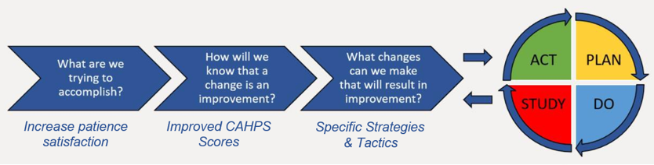
CASE STUDY: PDSA Process
Mail only
Mail & Online
Mail & Online
Mail & Online
23
Notes:
PDSA Process

Slide 25


CASE STUDY: Leadership & Employee Buy-in
What are we trying to
accomplish?
Build Buy In
Mail only
Mail & Online
Mail & Online
Mail & Online
24
Notes:
Leadership & Employee Buy In

Slide 26
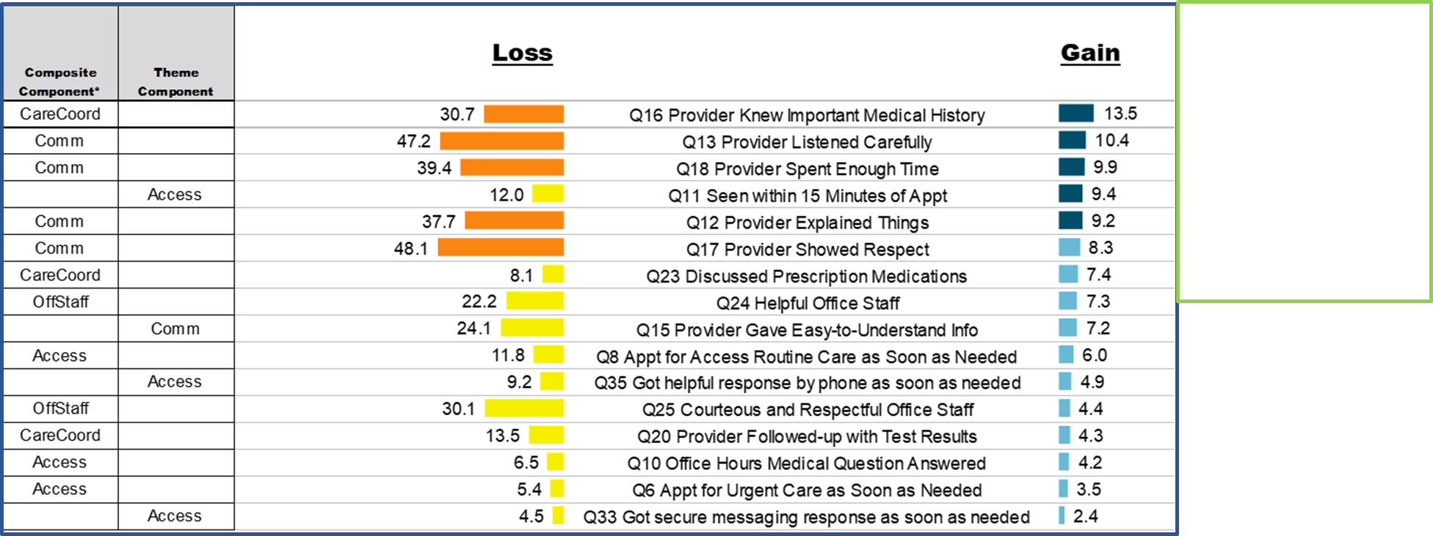
CASE STUDY: Identify Tactics using Data
What changes can we make that will result in improvements?
Specialty Care: Overall Rating of Provider – (V23) (636) Nebraska-W Iowa HCS
Sorted highest to lowest, 5 with highest gain score Dark Blue
5 questions with the highest loss score Orange
Mail only
Mail & Online
Mail & Online
Mail & Online
USING SHEP DRIVER ANALYSIS REPORT: ATTRIBUTABLE EFFECTS FOR SC
25
Notes:
After looking at baseline scores or current state- find out which questions impact the Overall Rating of the Provider score the most. The Attributable effects report uses a powerful advance analytics to tease out which questions have the greatest impact and can move the needle.

Slide 27

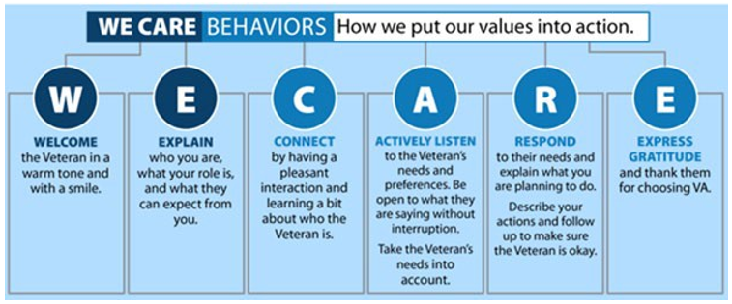
CASE STUDY: Identifying Tactics
What changes can we make that will result in improvements?
Identify Tactics
Mail only
Mail & Online
Mail & Online
Mail & Online
26
Notes:
Now it’s time to Identify tactics- NWI HCS chose We Care behaviors as one of their tactic.

Slide 28
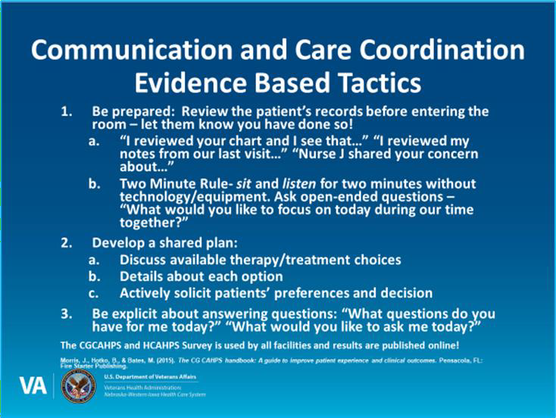
CASE STUDY: Develop and Deploy Tactics
TACTIC CHOSEN & IMPLEMENTED BY NWI
LEADERSHIP
Mail only
Mail & Online
Mail & Online
Mail & Online
27
Notes:
Next, leadership and staff agree that Communication and Care Coordination should be the focus. Here is a tactic they developed and implemented.

Slide 29
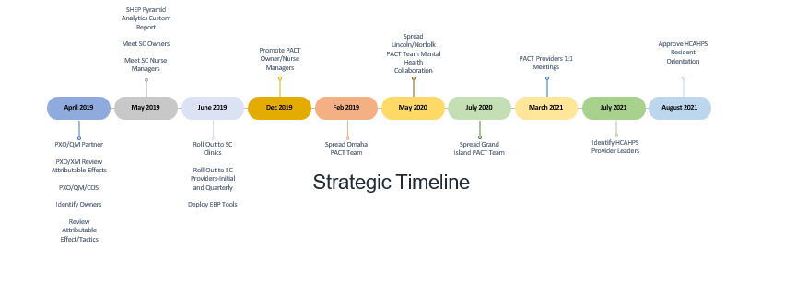
CASE STUDY: Strategic Timeline
What changes can we make that will result in improvements?
IMPLEMENT STRATEGY
Mail only
Mail & Online
Mail & Online
Mail & Online
28
Notes:
“Rome wasn’t built in a day but they were laying bricks every hour”- James Clear

Slide 30
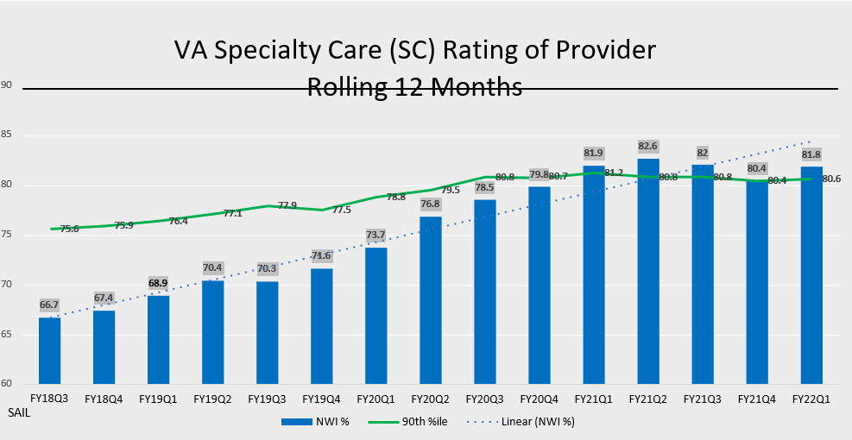
Measure, Forecast & Distribute
CASE STUDY: Measure, Forecast & Share Data
How will we know that a change is an improvement?
Mail only
Mail & Online
Mail & Online
Mail & Online
29
Notes:
Hello 90th Percentile! The results are worth it!

Slide 31

CASE STUDY: Review Results and Sustain
RESULTS
How will we know that a change is an improvement?
Sustain
Overall Rating of the Provider
Specialty Care top 10% for five quarters
Primary Care improved 11.5% in four quarters
Primary Care top 10%
Improved Clinic Leadership Engagement
Real-time feedback on specific tactics
Employee Recognition
Patient comments shared weekly
Huddles, newsletters, emails, committees, notes, and awards
4. No Shortcuts
The only real shortcut is to realize there is no “secret sauce” and no shortcuts to provide excellent Patient Experiences
Mail only
Mail & Online
Mail & Online
Mail & Online
30
Notes:
Let’s break it down…
Overall Rating of provider score improved!
Clinic Leadership Engagement improved!
Employee satisfaction through recognition improved!
Reached the 90th percentile in Overall Rating of Specialty care provider!
Everyone working together and no shortcuts- Priceless!

Slide 32




CASE STUDY: Lesson’s Learned
Leadership and employee engagement is key
Foundational goal of the organization
Patient experience baked into the organization’s culture
Understand what is important to patients
Human centered design
Journey maps of key touchpoints (Moments that Matter)
Turning data into action
Key drivers help to narrow the focus
Understand patient/staff interactions, processes, and key touchpoints
Develop and deploy toolkits for quality/process improvement and standardization across the enterprise
Celebrate successes!!!
Mail only
Mail & Online
Mail & Online
Mail & Online
31
Notes:
No regrets just Lessons learned!

Slide 33

SHEP RESOURCES
SHEP Handbook: https://vaww.qps.med.va.gov/filedownload.ashx?fid=51799
SHEP Users Call Catalog: https://vaww.qps.med.va.gov/divisions/api/pm/shep/shepUsersCalls.aspx
SHEP Awareness & Educational Materials:
https://vaww.qps.med.va.gov/divisions/api/pm/shep/shepAwareEdMaterial.aspx
The Patient Experience Connection: https://vaww.qps.med.va.gov/filedownload.ashx?fid=57237
Environmental Scan & SHEP Toolkits: https://vaww.qps.med.va.gov/divisions/api/pm/shep/shepEnvScanAndToolkits.aspx
Understanding SHEP & Vsignals: https://vaww.qps.med.va.gov/divisions/api/pm/shep/shepvsignals.aspx
SHEP VISN & Facility Level Data Deep Dive: https://vaww.qps.med.va.gov/divisions/api/pm/shep/shepVISNLevelDataDeepDive.aspx
Infographic Reports: VISN Level Facility Level
SHEP Frequently Asked Questions: https://vaww.qps.med.va.gov/divisions/api/pm/shep/shepFAQs.aspx
SHEP Videos: https://www.youtube.com/playlist?list=PL3AQ_JVoBEyxwGW7T0RuPR7BXBFjS8DHk
32
Notes:
Additional SHEP Resources

Slide 34





STAY CONNECTED
SHEP Users Call
2nd Thursday of every month
@2pm Eastern
Link: Join the Meeting
Platform: SHEP Users Call MS Team Channel
Phone: 347-566-4838
Conf. ID: 945966471#
SHEP Listserv subscription is open to everyone who wishes to receive SHEP Users Call reminder emails and SHEP program updates.
Join the SHEP Users Call *Public* MS Team. Click here!
For questions, contact the SHEP Helpdesk
Can’t attend a SHEP Users Call? All MS Team Videos are posted on the SHEP Users Call Stream Channel!
33
Notes:
Here’s how to stay connected with the SHEP team! Please don’t be shy we love hearing from you and our team is happy to help.
Please give me a thumbs up if you are a subscriber of the SHEP Listserv email notification list?
Please give me a thumbs up if you regularly attend our SHEP Users call? If not, please join us. Our SHEP Users Calls are held on the 2nd Thurs of every month. Our next call is on March 10th.
Please give me a thumbs up if you are a member of the “SHEP Users Call Channel”. We have over 1400 members of the PM Office Public MS team and over 700 are SHEP Users Channel members.
Here’s the link, don’t miss out and please share with your staff. https://teams.microsoft.com/l/channel/19%3ab726c16490e8456eb18358d4c7860bde%40thread.tacv2/SHEP%2520Users%2520Call?groupId=2a113dd8-2d44-44c6-9d26-ec0034433b9f&tenantId=e95f1b23-abaf-45ee-821d-b7ab251ab3bf

Slide 35
DON’T FORGET
Patient experience is the sum of all interactions, shaped by the organization’s culture, that influence Veterans’ and their families’ perceptions along their healthcare journey.
34
Notes:
What is Patient Experience?
As defined by The Beryl Institute and adapted for the VA: The sum of all interactions, shaped by the organization’s culture, that influence Veterans’ and their families’ perceptions along their healthcare journey.

Slide 36

CONTACT US
Jim Schaefer- james.schaefer@va.gov
SHEP HELPDESK
35

