Slide 1
Systems Thinking

Slide 2
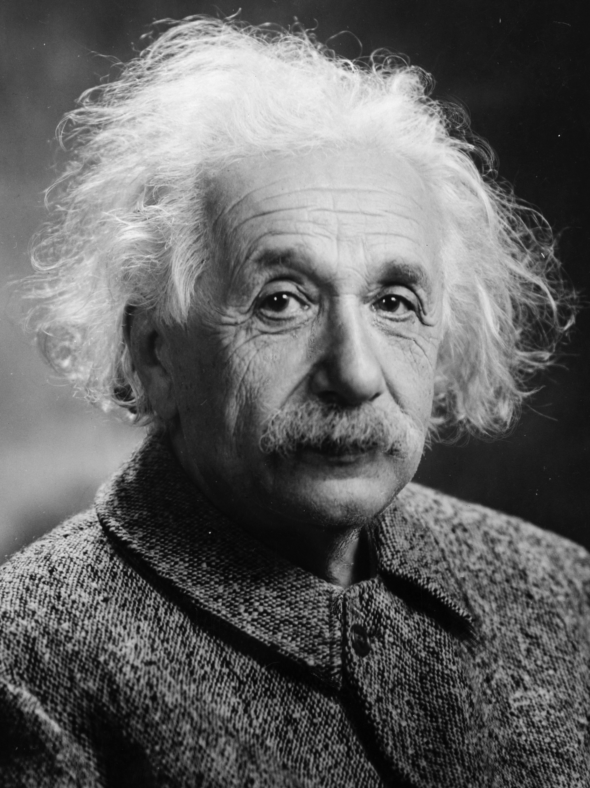
“The significant problems we face today cannot be solved at the same level of thinking at which they were created.”
ALBERT EINSTEIN
Notes:
Who better to quote than Albert Einstein? Read quote
One of the things said at a lot of facilities to exec leadership teams and service chiefs is that the data is telling you exactly what the system you've created is designed to do. So you may know people, especially the patient advocates, who want to deny that the problem doesn't exist or want to pretend that data is wrong. There no value in that. Part of systems thinking is accepting the data and the outcomes are a result of the inputs of the system we currently have. Not always a negative thing. We talked early about the issues that Women Veterans face, and that's because it was built for men; that's who the system was designed for. And we're now working to be more inclusive in healthcare delivery. Doesn’t mean it was wrong for the time. Just accept the way things are, no finger pointing, not helpful.

Slide 3

Learning Objectives
Define System(s)
Identify principles of Systems Thinking
Describe tools of a System Thinker
Notes:
Review learning objectives

Slide 4
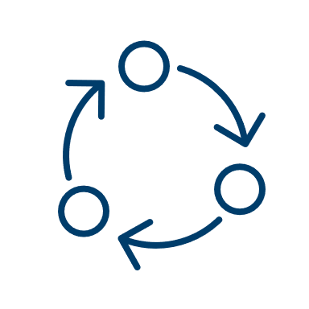
”System” Defined
Meadows defined a system as
“an interconnected set of elements that is coherently organized in a way that achieves something.”
This definition points to the fact that systems achieve some intended purpose – which is why they are often stable and so difficult to change.
Notes:
Stroh, D. P. (2015). Systems Thinking For Social Change: A Practical Guide to Solving Complex Problems, Avoiding Unintended Consequences, and Achieving Lasting Results. (P. 16)
Meadows she is a leading scholar around Systems Theory, she's the leading academic.
What’s unique about her definition is that achieves “something.” The system is neutral, it doesn’t care, but there is some intended purpose
When talk about Change Management, it’s hard because the system that we built is doing what we designed it to do, whether that’s good bad or indifferent.
Think about this as we think through CM this week.
Transition:

Slide 5
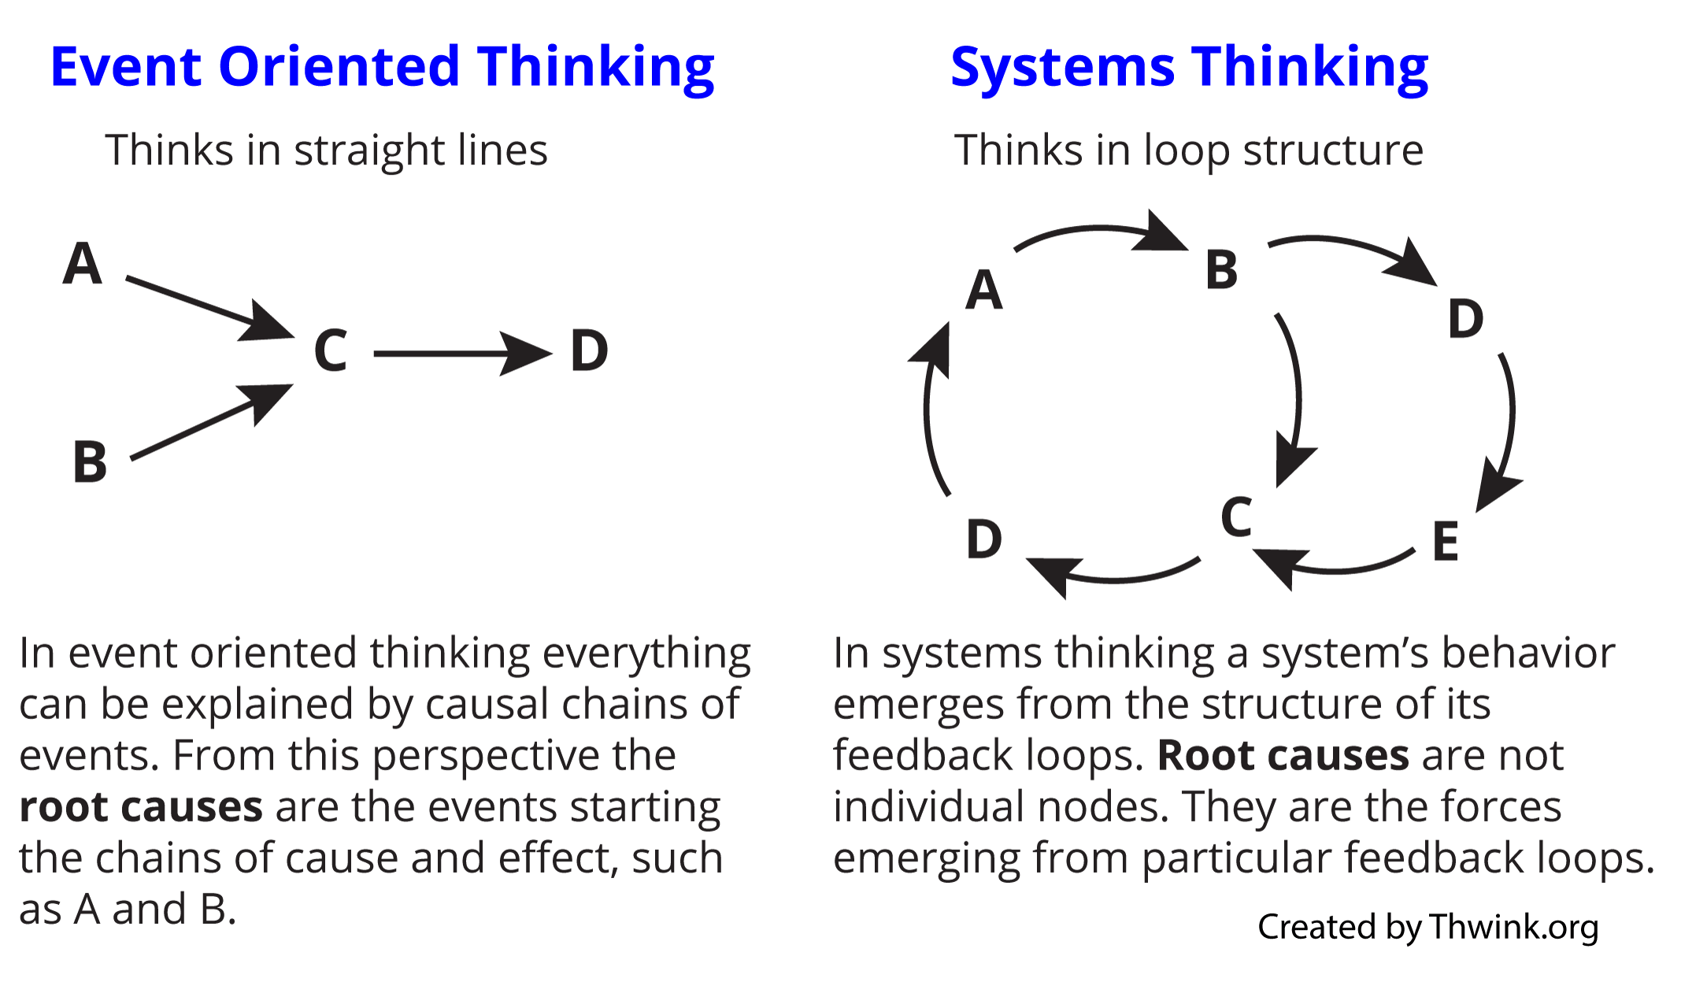
Ways of Thinking
Notes:
A couple of ways of looking at this: the video referenced the linear way of thinking cause and effect (event oriented). You started smoking, so you got lung cancer. Gained weight, etc.
What video highlights is there are a variety of inputs that go into place that effect it: so now that you ate poorly, you gained weight? Why did you eat poorly? Maybe low access to quality food, food deserts, maybe didn’t have access to routine health care, which makes you less likely to take preventive measures.
So looking at the whole system, its’ easy to watch a video or think in such a way as to say are we removing all responsibility from all the individual actors or in this case, the individual who is obese. Idea is not to say that all individual parts in the system are not responsible, but they are all interconnected in way that they often lose how they are responsible for the outcome.
This will make more sense when we start to look at the tools.
Transition:

Slide 6
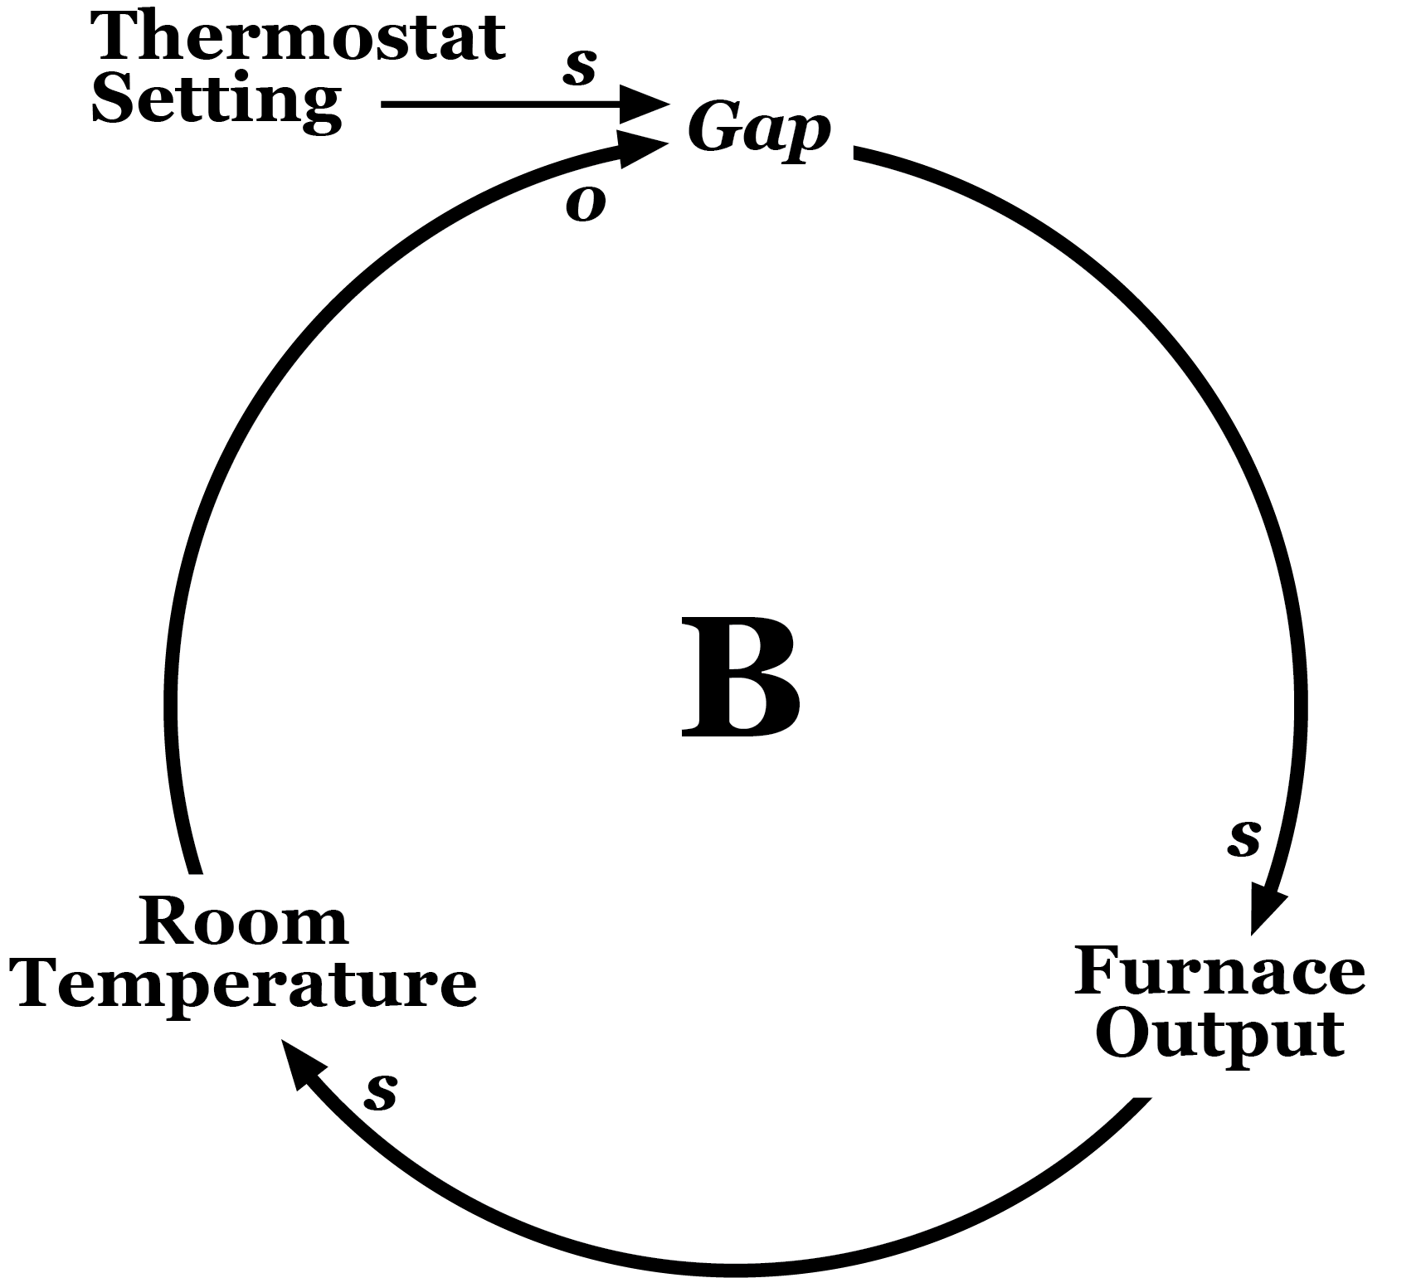
Examples of Systems
Notes:
This is an easier way to view in terms of why you may not sleep much.
Pretty common example.
Transition: let’s look at another

Slide 7
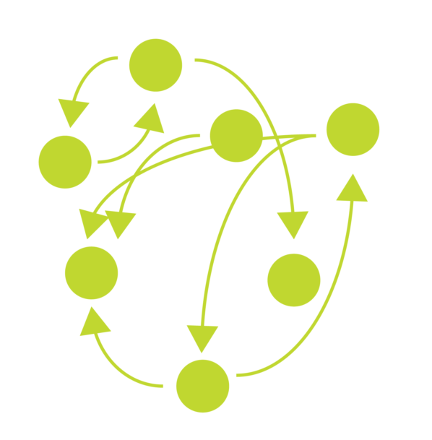
Examples of Complex Systems
Climate
Education
Human body
Eligibility
Appeals Modernization
Compensation and Pension
Educational Benefits
Home Loans
Notes:
SO what are some examples of complex systems (just a transition slide)
Justice, education, digestive system, human body, are all common examples.

Slide 8

Systems Thinking in Healthcare
The Checklist Manifesto, by Atul Gawande:
”In medicine, for instance, if I want my patients to receive the best care possible, not only must I do a good job, but a whole collection of diverse components have to somehow mesh together effectively. Healthcare is like a car that way, points out Donald Berwick, President of the Institute for Healthcare Improvement in Boston and one of our deepest thinkers about systems in medicine. In both cases, having great components is not enough.”
Notes:
Gawande, A. (2010). The Checklist Manifesto: How to Get Things Right. Henry Holt and Company. ”” ( p 185)
Has anyone read Atul Gawande? He writes a lot about end of life and healthcare quality. Wrote the book the Checklist Manifesto
In addition to an oddly interesting history of checklists, which you wouldn’t expect to be interesting, it talks about his efforts and initiatives (also ties back to HRO) into utilizing standard work and standard processes to eliminate errors. So his definition is listed here
Read the highlighted part here.
Don Berwick from IHI
Can have best cardiac surgeon but if don’t have EMS to handle infection control in the OR suite, all these interdependent parts have to work together even if they are illogical. When think KSAs for better or worse social stature of surgeon and EMS, despite having little in common, the two cannot operate independent of one another, they have to find a work to co exist in a way that makes some sort of logical sense.
Discharge time is another example of second, third and fourth order effects. If you can get the discharge time earlier, you potentially increase the throughput capacity in the ED, which could potentially reduce the time occupying ICU beds.
Very small system view of how one piece can impact many other pieces in the system.
Transitions:

Slide 9
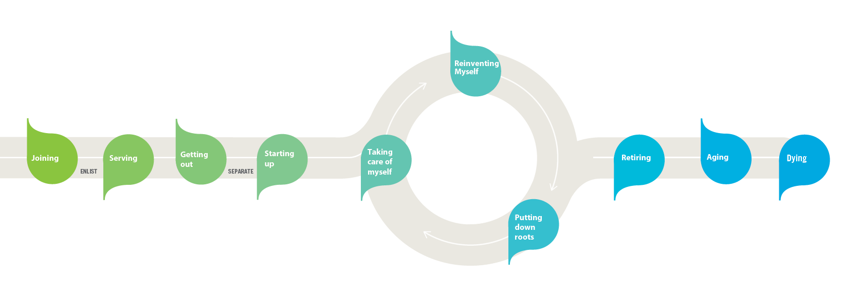
Perspectives of the VA as a system
VA from a VA Perspective
VA from a Veterans Perspective
Secretary
- - - - - - - - - - - - - -
Deputy Secretary
The Veterans Journey Map* identifies key moments that matter to Veterans and aligns VA care, benefits and memorial services available according to the Veteran’s life journey.
Staff Offices
Veterans Health Administration
Veterans Benefits Administration
National Cemetery Administration
*The Veteran Journey Map is foundational to VA’s Strategic Plan, available at: www.va.gov/oei/docs/VA2018-2024strategicPlan.pdf.

Slide 10

Systems Thinking in Healthcare (cont.)
The Checklist Manifesto, by Atul Gawande:
“We are obsessed in medicine with having great components - the best drugs, the best devices, the best specialists - but pay little attention to how to make them fit together well. Berwick notes how wrongheaded this approach is. “Anyone who understand systems will know immediately optimizing parts is not a good route to system excellence.”
Notes:
Gawande, A. (2010). The Checklist Manifesto: How to Get Things Right. Henry Holt and Company. ”” ( p 185)
Discuss how having one great component doesn't help the system.
"We don't rise to the level of our goals, we fall the limitations of our systems."

Slide 11
Why Think in Systems – A Comparison
Traditional Analysis
Systems Thinking
Traditional analysis focuses on the separating the individual pieces of what is being studied; in fact, the word “analysis” actually comes from the root meaning “to break into constituent parts.”
Systems thinking, in contrast, focuses on how the thing being studied interacts with the other constituents of the system—a set of elements that interact to produce behavior—of which it is a part.
Notes:
Stroh, D. P. (2015). Systems Thinking For Social Change: A Practical Guide to Solving Complex Problems, Avoiding Unintended Consequences, and Achieving Lasting Results. (P. 21-22
Suzanne hit on this in the video.
Traditional analysis focuses on separating the individual pieces vs looking at the collective whole.
Obesity example is can’t just focus on the PCP without looking at dietician, etc. to be effective
Analysis actually means to break into its constituent parts. Whereas systems look at how all those parts interacts

Slide 12
Why Think in Systems?
Thinking systematically meets four common challenges of change:
Motivates people to change behavior because they discover their role in exacerbating the problems they want to solve.
Catalyzes collaboration because people learn how they collectively create the unsatisfying results they experience.
Focuses people to work on a few key coordinated changes over time to achieve systemwide impacts that are significant and sustainable.
Stimulates continuous learning, which is an essential characteristic of any meaningful change in complex systems.
Notes:
Stroh, D. P. (2015). Systems Thinking For Social Change: A Practical Guide to Solving Complex Problems, Avoiding Unintended Consequences, and Achieving Lasting Results. (P. 21-22
So, why? This will come up again in Change Management. Type of thinking addresses four common challenges and why change fails.
Remember the system doesn’t care what the output is. It does what they system is designed to do.
Caregiver example: if all program pieces are all in the room pointing fingers, very unlikely to solve the problem versus looking at the overall system
Catalyzes-data tells you there’s a problem, so it allows just to face facts instead of arguing the data is incorrect.
Focuses-going back to comment about data, whatever is the simplest answer is usually the right answer. Folks will look for very complex reasons on why something is not working. Rapid Team site visit, where hospital had ongoing issues with infection control and sepsis. Team spent an entire day with about 20 people. First and foremost, they argued about the protocols and were they valid and then argued on what should be done. That produced a massive plan to try to address this one problem because all the viewpoints had to be considered. In the end, they overlooked the obvious that following sepsis protocols was all that was required. They found the forest, but they walked right past the trees. Don’t try to boil the ocean. Find what the data is telling you, and when you find that, fix it and work off from that momentum to tackle the next issue.
Learning-ties into HRO and learning environment. There is an idea that contrary to common sense, if you have robust HRO and patient safety reporting program, you won’t see a decrease in safety reports, you’ll see an increase because increased learning capacity and increased psych safety and all those incidents become opportunities for learning. So, its kind of frustrating that it’s not a one and done thing. Once you address the moments that matter or this data, you build on that success to put a good structure in place to address the other moments/data points that need attention.

Slide 13
What Happens When We DON’T Think in Systems?
We typically implement solutions that:
Address symptoms rather than underlying problems.
Seem obvious and often succeed in the short term.
Achieve short-term gains that are undermined by longer-term impacts.
Produce negative consequences that are unintentional.
Lead us to assume that we are not responsible for the problem's recurrence.
Notes:
Stroh, D. P. (2015). Systems Thinking For Social Change: A Practical Guide to Solving Complex Problems, Avoiding Unintended Consequences, and Achieving Lasting Results. (P. 13)
Don’t address long term game
Unintended consequences
“I implemented the tool, why does the problem still exist.”

Slide 14
Key Principles of Systems Thinking
Everything is interconnected.
There are no simple solutions to complex problems.
Today’s problems are yesterday's solutions.
Small, well-placed interventions can have big impacts.
There is no blame in complex systems.
Humans make linear systems – nature makes circular ones.
Parts are elements of a complex whole.
‘Failure’ is discovery in disguise.
Notes:
https://www.disruptdesign.co/blog/2017/8/18/11-key-principles-of-systems-thinking
All is interconnected
We are guilty of making linear systems whereas, nature makes circular ones
Journey maps all linear, e.g. But not real life, just no good way to visualize in a simple manner
HRO continuous learning. Failure is not a bad thing, neither is change. As an organization, VA struggles with change, fairly

Slide 15
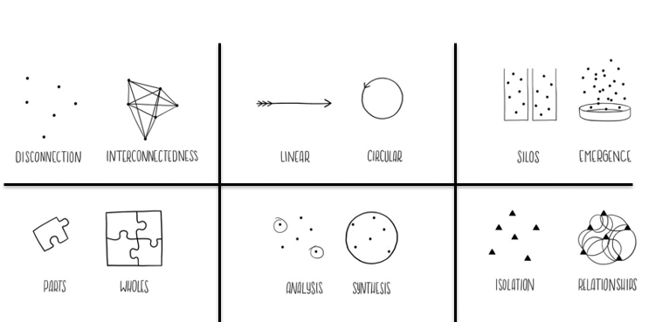

Tools of a System Thinker
Notes:
Let’s look at some tools of a systems thinker.
These are just the graphic representations and there are more out there if you want to learn more.
When thinking about the ADKAR tomorrow, think about these 6 particular tools
When thinking about a change project, who are the key players? Make sure you have all the right people
Then how can you think about your program less linear? How can you represent it more realistically?
Silos- we kill ourselves by thinking in silos. One of biggest ways PC has broken down silos is the PACT team model. Now have a collective team and idea of emergence rather than silos
Parts
Analysis- think back to data, if new to data that was overwhelming. How do you take all these parts together and capture. We talk about data analysis, but we should be thinking about data synthesis. How can you pull those key moments that matter in some of the lowest scoring components in VSignals and cross walk those with your SHEP data and PATS data. Looking at in total will tell you where you are likely to get the most impact.
Isolation-with this large organization with its 300+k employees, also kinds of lives and dies on relationships
More details and will talk more in Change Management

Slide 16
Review Learning Objectives
Define System(s)
Identify principles of Systems Thinking
Describe tools of a System Thinker
Notes:
Review learning objectives

Slide 17

Questions
Notes:
Close Out:
Are there any questions?
Please go into TMS and complete the survey to ensure you get credit for this class.
Thank you so much for all you do for our Veterans. Have a great day.

