Slide 1



The Loneliness Epidemic
(Beyond Medical Intervention)
Prince Taylor
Deputy Director
VA Center for Development & Civic Engagement
Notes:
Good afternoon, everyone. It’s really cool to get to speak with you, because our work is quite closely aligned. Dr. Pai asked me to speak with you about one of our programs designed to offer non-clinical social support to Veterans. Particularly homebound Veterans.
What’s funny is we had a program like that in a pilot stage and couldn’t get it to grow until the pandemic forced us to convert it to a different program.
What we’ve learned and a little of what I’ll talk about today is that there’s this terrible social determinant of health that we were all but ignoring because no one quite understood where it fit in the ecosystem of healthcare, because the condition is not clinical.
So, let me ask you a couple of questions. What percentage of calls to the crisis line do you think are not by people in crisis? How much time do you think doctors and other clinicians are spending with patients talking about non-medical issues? Quick follow-up, would we consider that the best use of their time? And second follow-up, why do we think something like that might be happening in the first place? What if I told you that right now, we have the tools and opportunity to reduce non-crisis calls to the crisis line. That we can give clinicians up to 8 hours of their week back. And, we can greatly improve the patient experience in the process. And not to ingratiate myself, but I know that you know this isn’t with snake oil and it doesn’t even require a great deal of money. It’s putting just a little more focus on the non-clinical aspects of healthcare. And if we do this right, coupled with many other wonderful things we’re already doing together, we might actually start to see a downward trend in our death by suicide rates.
So, what are exactly you talking about Prince? Well, I’m talking about the pandemic we don’t talk about. And how it’s connected to all types of social determinants of health.
I am talking about loneliness…and social isolation. And I hope that by the time the sandman comes and yanks me off the stage, I would have impressed upon you just how important our partnership is and how much more impactful it could be to the lives of our Veterans, their families, and their caregivers.

Slide 2

What is loneliness?

Slide 3
Loneliness is subjective – often defined as the self-perceived gap between the expectations and reality of one’s social connections – Dr. Ezeji-Okoye, Chief Medical Officer, Crossover Health

Slide 4
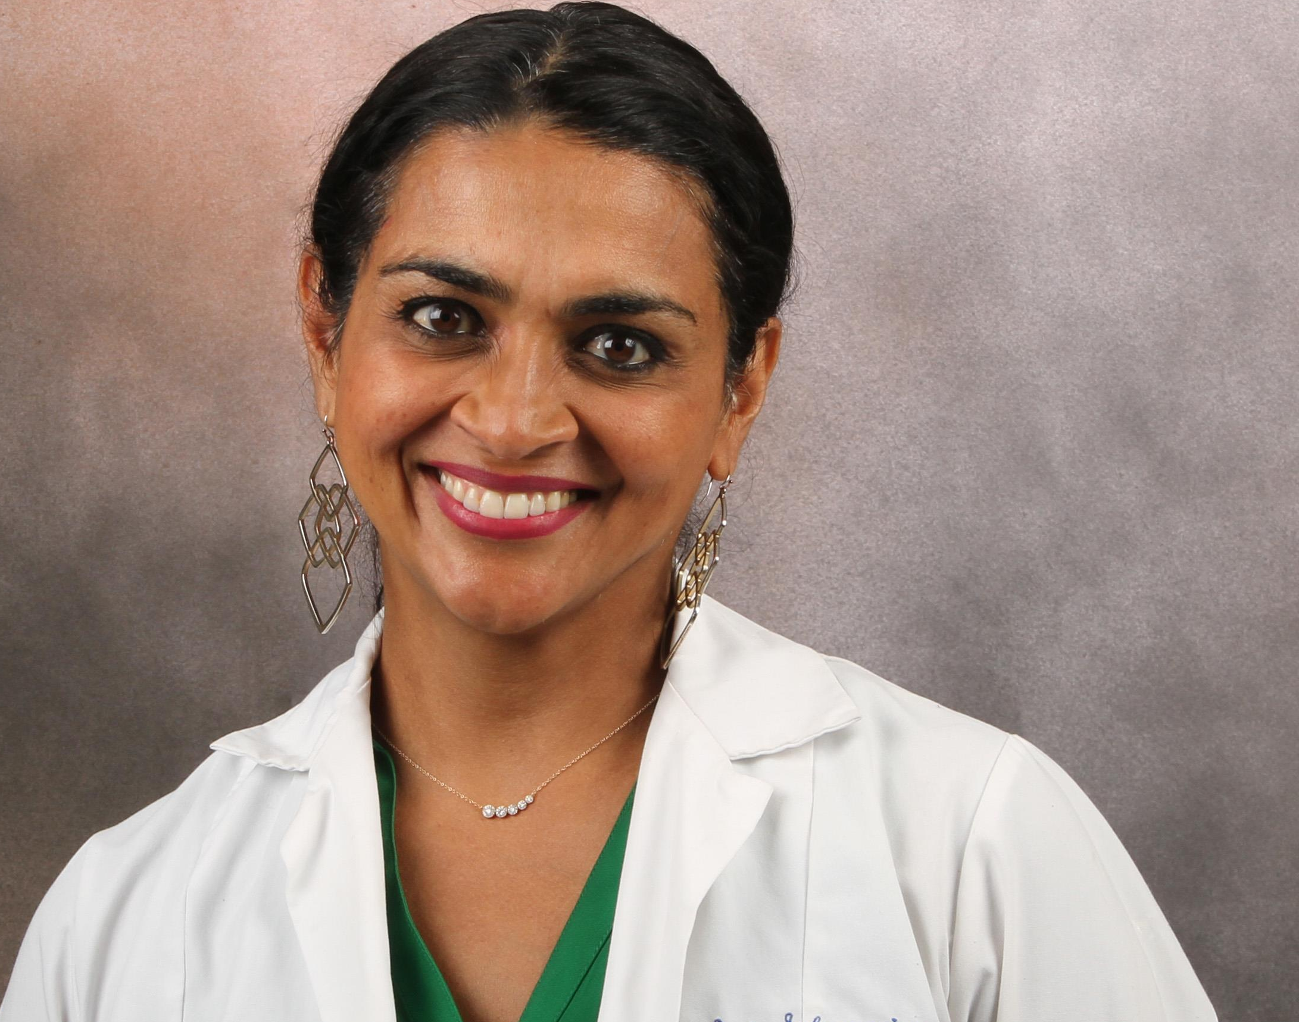

Slide 5
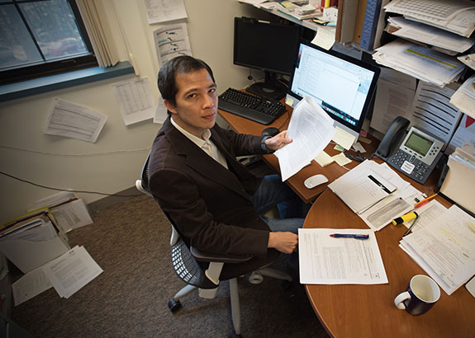

Slide 6
Loneliness and Health Issues
Pre-Clinical
Loneliness
Social Isolation
Clinical
Depression
Anxiety
High-risk
Suicide ideation
Mortality
Memory Loss
Heart issues
Notes:
endogeneity

Slide 7
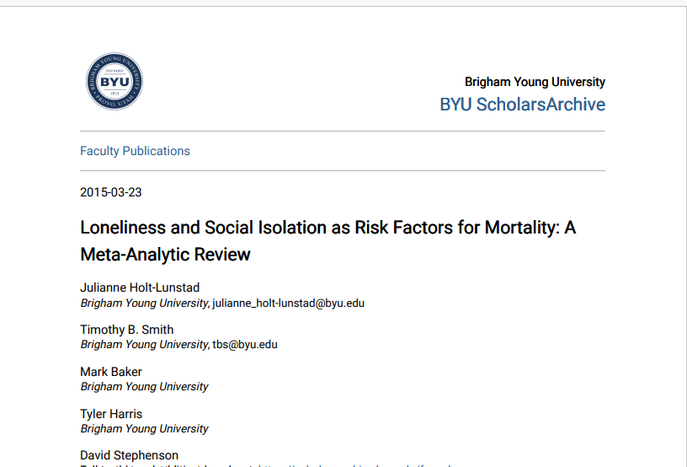

Slide 8
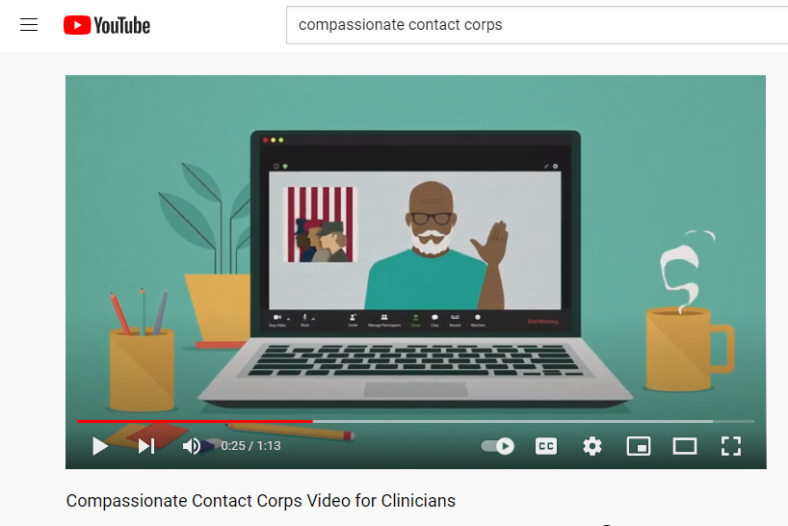

Slide 9
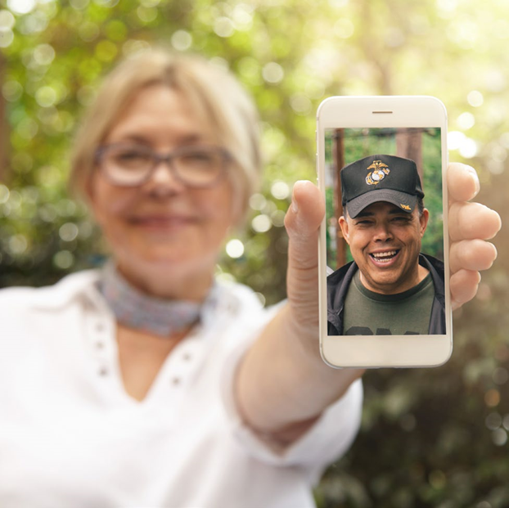

Compassionate Contact Corps
Award-winning
Non-clinical
Social prescription
Notes:
Now, let me color in a little more about what Compassionate Contact Corps is. In 2020, the VA Center for Development & Civic Engagement (formerly known as VA Voluntary Service) started a social prescribing program where trained volunteers phone Veterans that have been identified as lonely or socially isolated by their clinicians and referred to the program. Now we know, one VA is one VA, but let me run through ideally, how it should and is working in places like Columbus, Ohio and Fargo, North Dakota, because it’s not a lot of additional work

Slide 10
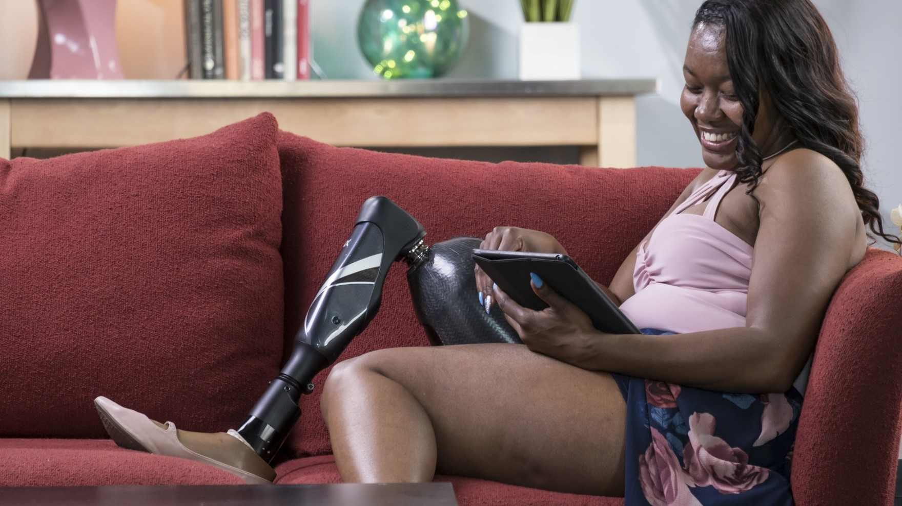
Compassionate Contact Corps
No medical advice
No legal advice
No proselytizing
No financial advice
Notes:
Still, this is not a clinical program. Our volunteers do not offer medical, legal, or financial advice and they do not proselytize. However, they do let us know if they hear, suspect, or notice something that might adversely impact the Veteran or caregiver. The beauty of this is that we might be able to offer necessary and critical interventions sooner, up to and including crisis support, which has occurred several times.

Slide 11
Making an Impact
Notes:
In March we sent out a questionnaire to see what Veterans thought of the program. 86% said the program made them feel less lonely, which is great, so I could stop there, but in addition to helping them feel less lonely…

Slide 12
Making an Impact
Notes:
72% said the program increased their overall well-being. These are subjective questions, but the subjectivity is the point, right?
And it’s even more significant when taken in this context …

Slide 13
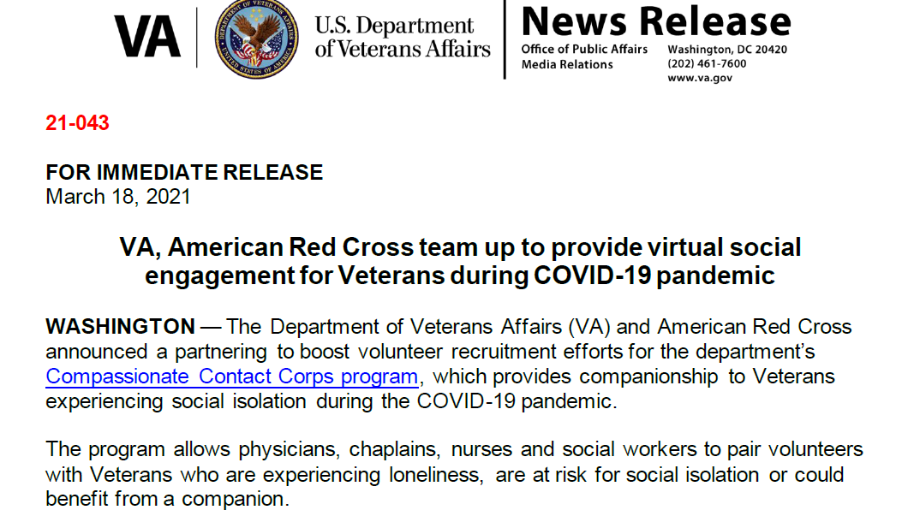
Notes:
So this is me talking to you about Compassionate Contact Corps. It’s been lauded. 10 of our original program coordinators received the Secretary Honor Award earlier this year. We got second place in The Beryl Institute’s international Patient Experience Innovation Award competition. One of our coordinators actually won their Volunteer Professional Award of Excellence. We’ve been shouted out by The New York Times in their series on The Future of Healthcare, the program has been nominated for the Dr. Robert L. Jesse Award for Excellence in Innovation, and we are a finalist for VHA’s Shark Tank.
But this is a summit on caregiver support. And what I haven’t said is that all of this…the reason we were able to act so fast and effectively and garner all of this attention and accolade is because of the in-home visitor program, which functioned as a caregiver support program, that I suspended at the start of the pandemic. We did not expect Compassionate Contact Corps to grow like it did. We did not expect it to address loneliness or social isolation. But we’re glad that it did, because we’re now connecting with Veterans that were beyond our reach before.
This program may not be for ever Veteran with a caregiver, but I submit that it should be considered, because we ask a lot of our caregivers. And this is a way to lighten that load a little bit. On the other side of this, we will go back to in home visitors. And we’re going to need your support. Our volunteers are trained, vetted, most come from veteran service organizations, and they will make your work easier. But more than that, they will add value to the lives of our Veterans and their caregivers. I should also tell you that The American Legion Family is looking into doing something similar to what the American Red Cross did for Compassionate Contact Corps and naming the Volunteer In-Home Visitor program as one of their signature programs. So, support for these programs is not mutually exclusive. They can and should work in tandem in the best of circumstances.
We’re only at about 2,000 matches right now. But we all know the need is much greater than that.
I told your directors at the VEO Patient Experience Symposium earlier this month that by the end of next year, we should be looking at 10,000 matches, with great nostalgia. That’s a national average of less than 60 matches at each of our 172 urban and rural primary care facilities. There’s need, there’s research, there’s time-savings and cost-savings, we have trained volunteers in wait, and we know the incredibly positive impact felt by our Veterans.
So, if any of this has been the least bit persuasive to you, my request is that you let your leadership team know; your doctors, your colleagues, your psychologists, psychiatrists, other social workers, and your Voluntary Service or CDCE Chief. We are on the precipice of something amazing that can only work if we work together. My team is ready to deploy one of our eight national implementation mentors to give support and help scaffold facilities through the process. We have monthly calls for the program managers with structured opportunities to ask questions and learn best practices from each other, and we have the capacity to prepare quarterly reports on the progress of your program. I wish I had a stronger close for you, you deserve that, but I have great confidence that together we can do incredible things. And I look forward to it. Thank you.

Slide 14
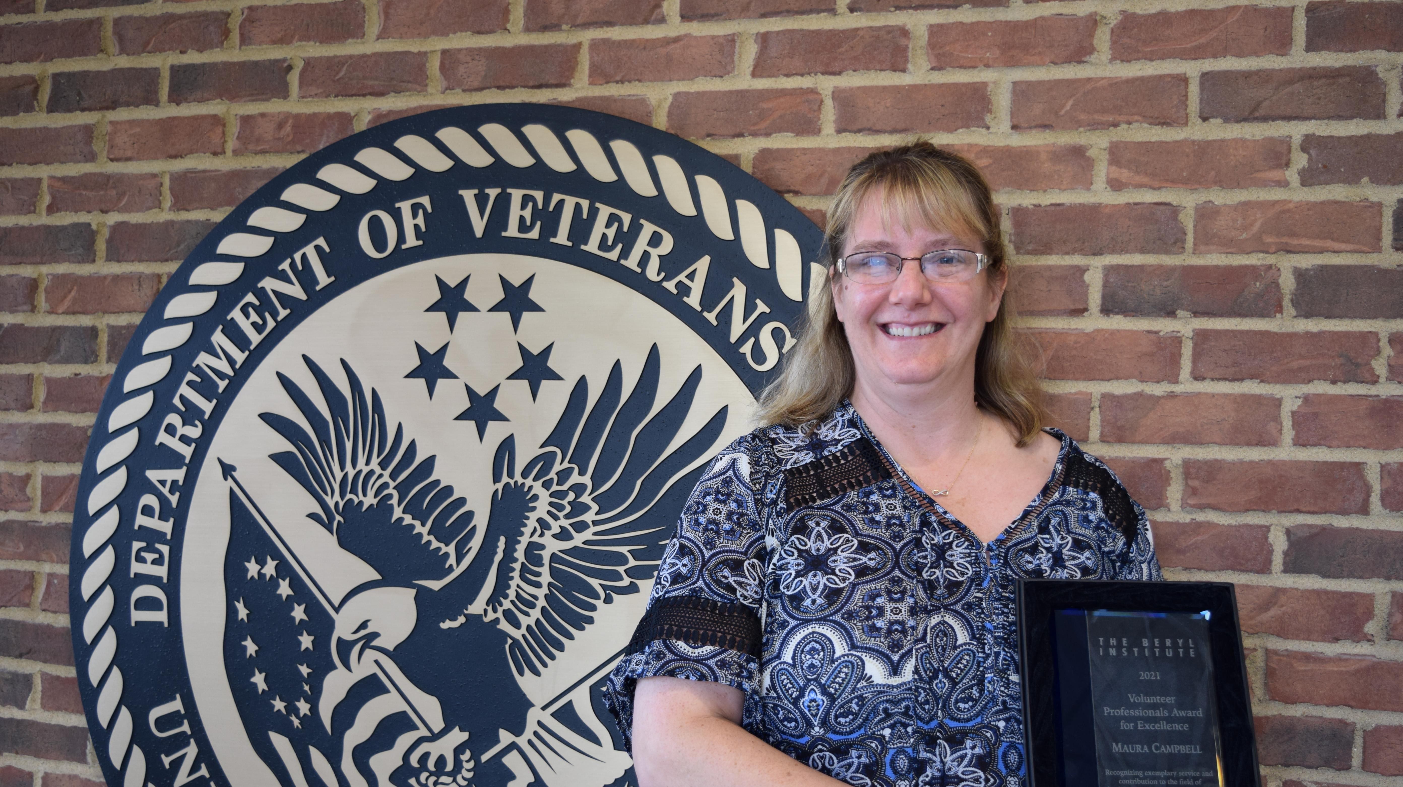

Slide 15
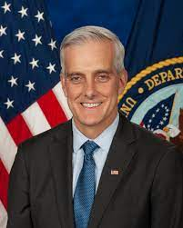

Slide 16
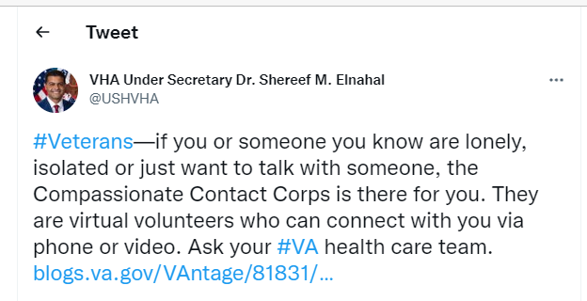
Notes:
Sent from USH account in December 2020

