Slide 1
VEO Omnichannel Strategy
John Lundy
Division Chief, Channel Strategies and Engagement
Multichannel Technology Directorate, Veterans Experience Office

Slide 2

Omnichannel Strategy Overview
Omnichannel Strategy Goal:
To meet our customers where they are within their journey, supporting their preference for communicating with VA at that moment in their journey.
Current State:
Transactional for VA (one phone call, text message, etc.) but lifelong conversations for Veterans and customers.
Future State:
Design the experience to change the paradigm and be a continuing, lifelong conversation regardless of channel used, to deliver impactful outcomes.

Slide 3
High-Level Omnichannel Business Strategy and Desired Outcomes
Strategic alignment between VEO, OIT, and VA Administrations to improve VA’s digital communication customer experience by designing and implementing an integrated Enterprise Omnichannel platform.
Key Principles:
Prioritize our channel strategies based on customer expectations
Cost efficiencies and scaling
Session Highlights:
  Customer Journey
  Human Center Design Insights
  Customer Facing Channels & Integration
  Omnichannel project status
    Chatbot
    Voice Virtual Agent (Voicebot)
    Ask VA (AVA)

Slide 4
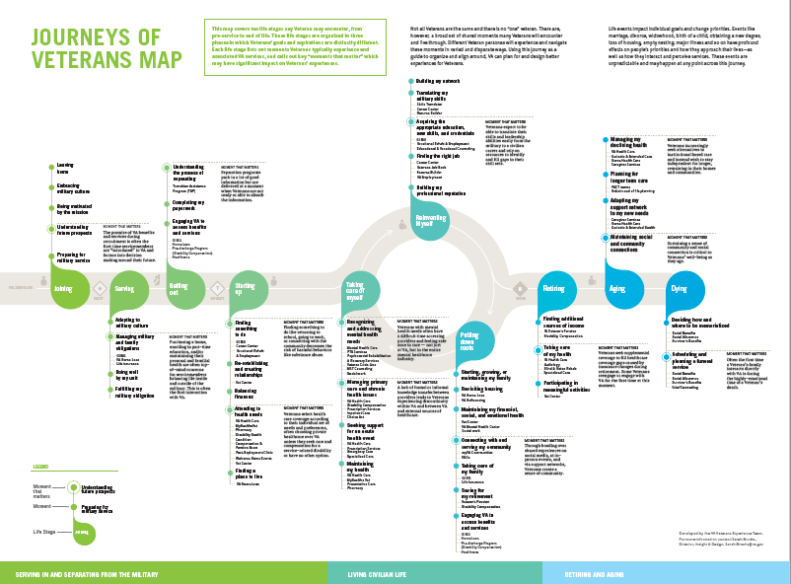
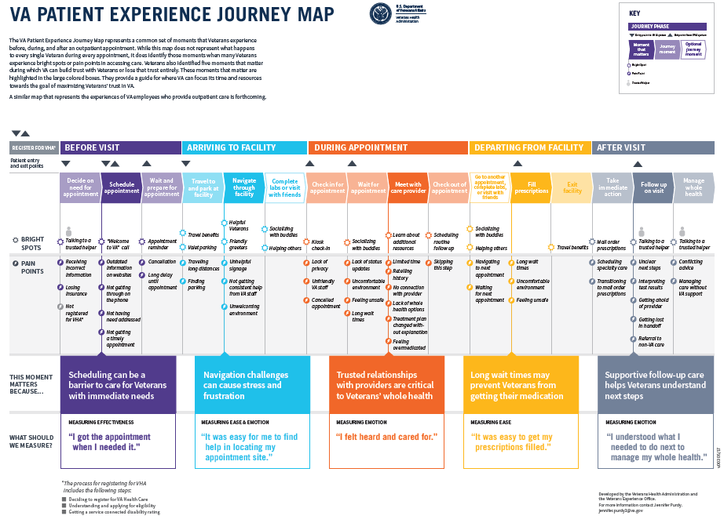

Customer Journey
Discover
HCD methodology: Qualitative interviews Map the journey Identify moments that matter, pain points, bright spots During this journey, eligible customers can receive a wide range of benefits and services from VA throughout their lifetime. These services are delivered through a large and complex organizational structure.

Slide 5










Complexity of the Current Journey
CURRENT STATE
Linear journeys fragment across siloed products and contact centers.
FUTURE STATE
Integrated journeys interact with multiple touchpoints in the Omnichannel Ecosystem.

Slide 6









Simplify the Journey
Conversational IVR determines James has a Disability Claim Inquiry
James’ Claim inquiry is handled
Offer the customer the ability to choose their preferred channel.
Within the blended channel experience, providing the options for multiple modalities to service customer inquiries.
Mary is able to see all of James’ info and schedules a video call with his Primary
James’ Rx Renewal is Handled
James is connected with VBA Agent Jane
James clicks a link to connect with a nurse
James Calls ‘any’ VA number
James’ Eligibility inquiry handled
James is transferred to Nurse Mary
Agents are alerted that James has an Rx Renewal coming up
James also has a question about eligibility
James
James chats with Agent Alice
James
Issue escalated to Live Agent
James also receives an update on his open claim in the email
James logs into www.va.gov
www
AI algorithm determines that James is due for an Rx Renewal
James clicks on the self-service link for ‘check my claim status’
James is sent a message with embedded “calls to action”
James’ Claim inquiry is pre-emptively handled
Virtual Assistant finds and reports James’ Claim status
James’ Claim inquiry is handled

Slide 7

Human Centered Design Insights
The hierarchy and relationship between these components should be defined and consistent across VA channels so experienced and novice customers can easily navigate regardless of their understanding of each component.
A disconnected journey lowers confidence in all channels.
Lack of integration and tracking between and within systems lowers trust.
Customers want clear expectations for what can be done in each channel before they engage.
Context, confidence, and direction drive channel selection.
Customers prefer methods that provide a paper trail such as secure messaging or mail for non-urgent issues.
Channel Accessibility is key to serving a large population of Veterans with disabilities.
Those with a visual impairment were more likely to use a Tablet, but less likely to use a Landline Phone.
  “Two-factor authentication is much harder with a screen reader.”
Those with a hearing impairment most likely used a Laptop or Mobile Phone.
Those with a mobility impairment were most likely to use a Mobile Phone to reach the VA.

Slide 8








Human Centered Design Insights
Chat/Virtual Assistant
Chats with live agents are desired by most Veterans for quick response.
Chatbots are ok with most users, IF they connect/escalate to agents.
  “Live chat is convenient for a quick response.”
  “I would use a chatbot to ask quick questions.”
  “I expect the chatbot to be concise and professional.”
  “If the chatbot can’t access my information, then it needs to connect me to an agent.”
Text-based Channels
  “Written communication is good for accountability.”
  “Texting is good for reminders and notifications.”
  “MyHealtheVet is great for non-urgent messaging, refilling prescriptions, and scheduling appointments.”
  “There is a 38% chance I will use my smartphone to access VA.gov.”
Conversational IVR
Appetite for adoption
"It gave me a choice based on what I said, and then we went through the steps to get to the return process"
  "I look forward to VA having something like this in the future"
  "I like that it gave me an upfront answer to my question...“
Phone/IVR
Willingness to use IVR is driven by user emotion and ease of getting support, user confidence and system understandability.
Veterans often find IVRs as confusing, long, and a tedious way just to get to an agent.
  “I like having a direct number to call.”
  “If I call VA, I really need to talk.”
  "I look forward to VA having something like this in the future"
Accessibility
  “Two-factor authentication is much harder with a screen reader.”
  “Screen-based channels can be fatiguing and require extra support for me to be successful.”
  “I have trouble comprehending complex information; I need processes to be simple and straightforward to prevent information overload.”

Slide 9






Channel Integration
Customer-Facing Channels
VA.gov
Phone
Bots (online, voice, text, secure messaging, emails) with the ability to escalate to live person support in the channel that has been initiated or transition to a channel/communication method that betters supports the ability to answer/resolve a request.
Text (automated and interactive)
Messaging (authenticated and unauthenticated; automated and interactive)
Chat (authenticated and unauthenticated; automated and interactive)
Video
Email
Mobile
Postal Mail
Social Media
In-person
Benefits of Channel Integration
Service customer demand, by offering primary and alternative options across all channels.
Provide multiple ways for Veterans to connect with VA to get their issues resolved.
Develop solutions to assist navigating the complexity of VA’s structure.
Channel availability, integration, and availability of information to resolve Veteran issues efficiently.
Provide an integrated platform that enables customers to express their intent and have them connected with the most appropriate agent or service.
Collect and provide access to Veteran conversations from all channels.
Maintain conversation continuity between any channel or agent transition of a customer.
Social
Media
8
Face2Face
www
Phone
Text
Chat
Email
Apps
Mail

Slide 10

Chatbot
The Virtual Agent Chatbot was created to provide a unified, holistic experience across VA.
Customers want a digital way to provide quick, accurate, personalized answers to their questions.
The Virtual Agent Chatbot is a support channel that reduces the time it takes to find actionable information by allowing users to ask questions in a human, conversational tone.
Virtual Agent Chatbot is available 24/7, requires no prior knowledge of VA.gov website and the VA organizational structure, and will allow for a seamless handoff to another support channel in a future phase.
By the Numbers:
March 2, 2022 – Unauthenticated Launch, 25% scaled to 100%
15,000 people used the Chatbot (launch – current)
  Education, Claims, Health Benefits, others
May - June, 2022 –Authenticated Claim Status Launch, Scaled to 100%
6,800 people used the authenticated Chatbot (launch – current)
  Averaging 250 per day
July 7, 2022 – Authenticated Appeals Status Launch
Usage trends:
50% of people who see the Chatbot engage
Average 3+ minutes on the page
9

Slide 11

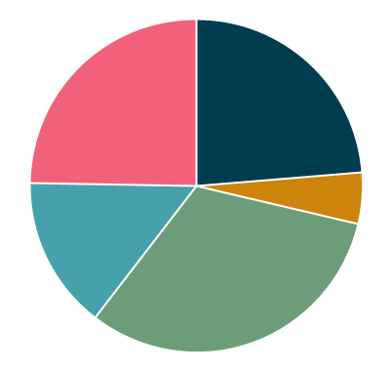





Virtual Agent Chatbot: Usage and Data Analytics
Who are VA.gov’s chatbot users?*
How do we gather information about chatbot usage?
Understand who comes to the chatbot page and what they’re doing
What at VA.gov’s chatbot users asking about?
Allow users to provide feedback through a survey at the bottom of the chatbot page
Education
Claims
Warehouse for chatbot data for use by Power BI and our data scientist
*goal of using CxDW in the future
*According to Medallia survey results
Clinical / Health
Visualize engagement data and provide admins with an interface to view conversational logs
Benefits
General
Data scientist creates weekly report with deeper insights by performing transformations on raw conversational logs using models

Slide 12


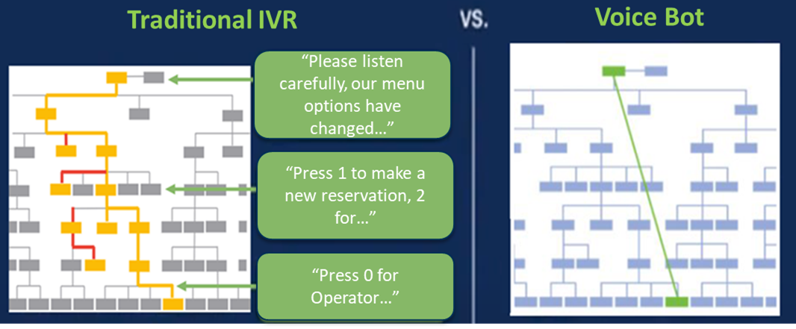
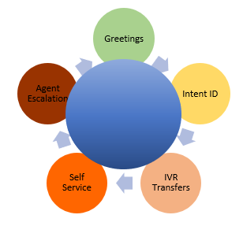
Voice Virtual Agent (Voicebot)
The extensive HCD research conducted by VEO highlighted that Veterans feel that the current VA IVR phone trees are long, and this confusion leads to a suboptimal customer experience. To eliminate the confusion and improve the customer experience, Voice Bots can be leveraged that turn the IVR phone tree models into conversational models.
Voice Virtual Agent Benefits
Accurate intent matching enables accurate routing → Reduced call transfer error rate
Determining intent quickly → Reduction in call time
Self-Service functions → Lower call volume to contact centers
Switching between languages mid-conversation → Supports customers in multiple languages
Sentiment analysis → Enables escalation
One time authentication to process multiple needs → Efficiently supports multiple customer needs on one phone call
Improved customer experience
Voice Virtual Agent Capabilities
The Voice Virtual Agent is able to determine customer intent, match that intent to a specific topic, and route the caller to the right agent group assigned to service that specific topic.
Desired Outcome: To provide a better customer experience by leveraging Voice Virtual Agents to assist with navigating the VA landscape, increase self-service options, and service the customer efficiently.
11

Slide 13










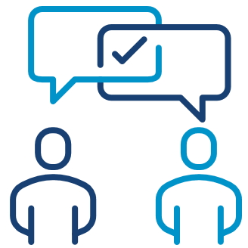

Ask VA (AVA)
Ask VA (AVA) launched in October 2021, as an online service all Veterans, family members, beneficiaries, and members of the public to submit email inquiries related to benefits and services, questions, concerns, and recommendations to VA. The second part of AVA consists of a Microsoft Customer Relationship Management (CRM) tool used by VA staff to receive and respond to inquiries. End users in the system can then open, route, track, resolve and close requests and cases.
Benefits of the New Tool:
  Provides Veterans a secure portal experience
    Portal safeguards for Veteran identity and health information through ID.me, MPI match, and login.gov
  Inquiry tracking through unique inquiry number for customer convenience
  Developed for closed loop communication within VA by leveraging queue management features and functionality
  The portal provides business and professional dashboards to separate inquiry access based on the submitter’s relationship to the Veteran
  Integration with PowerBI so internal users can access real-time data tools
By the Numbers:
(since launch – Oct 2021)
13,000 monthly submitters
300,000 secure correspondences
270,000 inquiries submitted
98% solve rate
5.8 average days to solve
Governance
Insights
Patient Experience
Employee Experience
Effectiveness
Design
Data
Communication
Trust
Ease
12

Slide 14
Summary
Goal: To meet our customers where they are within their journey, supporting their preference for communicating with VA at that moment in their journey.
VEO will partner with OIT and VA Administration to align on digital communication strategies and technical solutions.
Leverage HCD to deliver an impactful experience that will be a continuing, lifelong conversation regardless of communication channel preference.
This multiyear strategy will focus on channel availability, stakeholder readiness, integrations, and availability of authoritative data to resolve customer inquiries.
Support President’s December 2021 Executive order 14058, Transforming Federal Customer Experience and Service Delivery to Rebuild Trust in Government.
  SecVA has committed VA to provide on-demand customer support through the channels that work best for customers, including personalized online chat with a virtual or live agent.

