Slide 1
What Does Private Industry Do to Improve CX?
A Deep Dive into Industries and the Surprisingly Similar Secret Sauce.

Slide 2
























External Benchmarking

Slide 3




Travel Industry
  CX Key Practices
  Registration/booking
    Arriving at VA facility for services, checking in, Claims Intake
    Center
  Food experience
      Facility waiting rooms, cafeteria’s, staff lounge
  Entertainment experience
      Welcome Kit, Digital VA.Gov experience
  Cost experience
      Time required/invested to achieve outcome
  Service experience
      Direct correlation​
  Employees included in the design process
      VA HCD​
  Personalized service recovery
  CX Lessons Learned
  The experience focused on four main dimensions: sense, feel, think and act. ​
  Hire right with questions designed to find “Culture Ambassadors”​
  Leaders are engaged, conduct rounding and discuss CX with employees
  Employees are included as part of design solutions​
  Employee Recognition Programs​
  Useable data
Notes:
Sense is based on the impact of marketing on the person’s five senses. ​
Feel is related to the human affective component, including memories and personal feelings. In parallel, ​
Think is related to the human cognitive component, whereby the experience should move a person’s thoughts. ​
Finally, ‘Act’ is the last step (maybe the most important from a marketing perspective), which reflects whether the experience produces actions (such as purchase, recommendation or return)

Slide 4
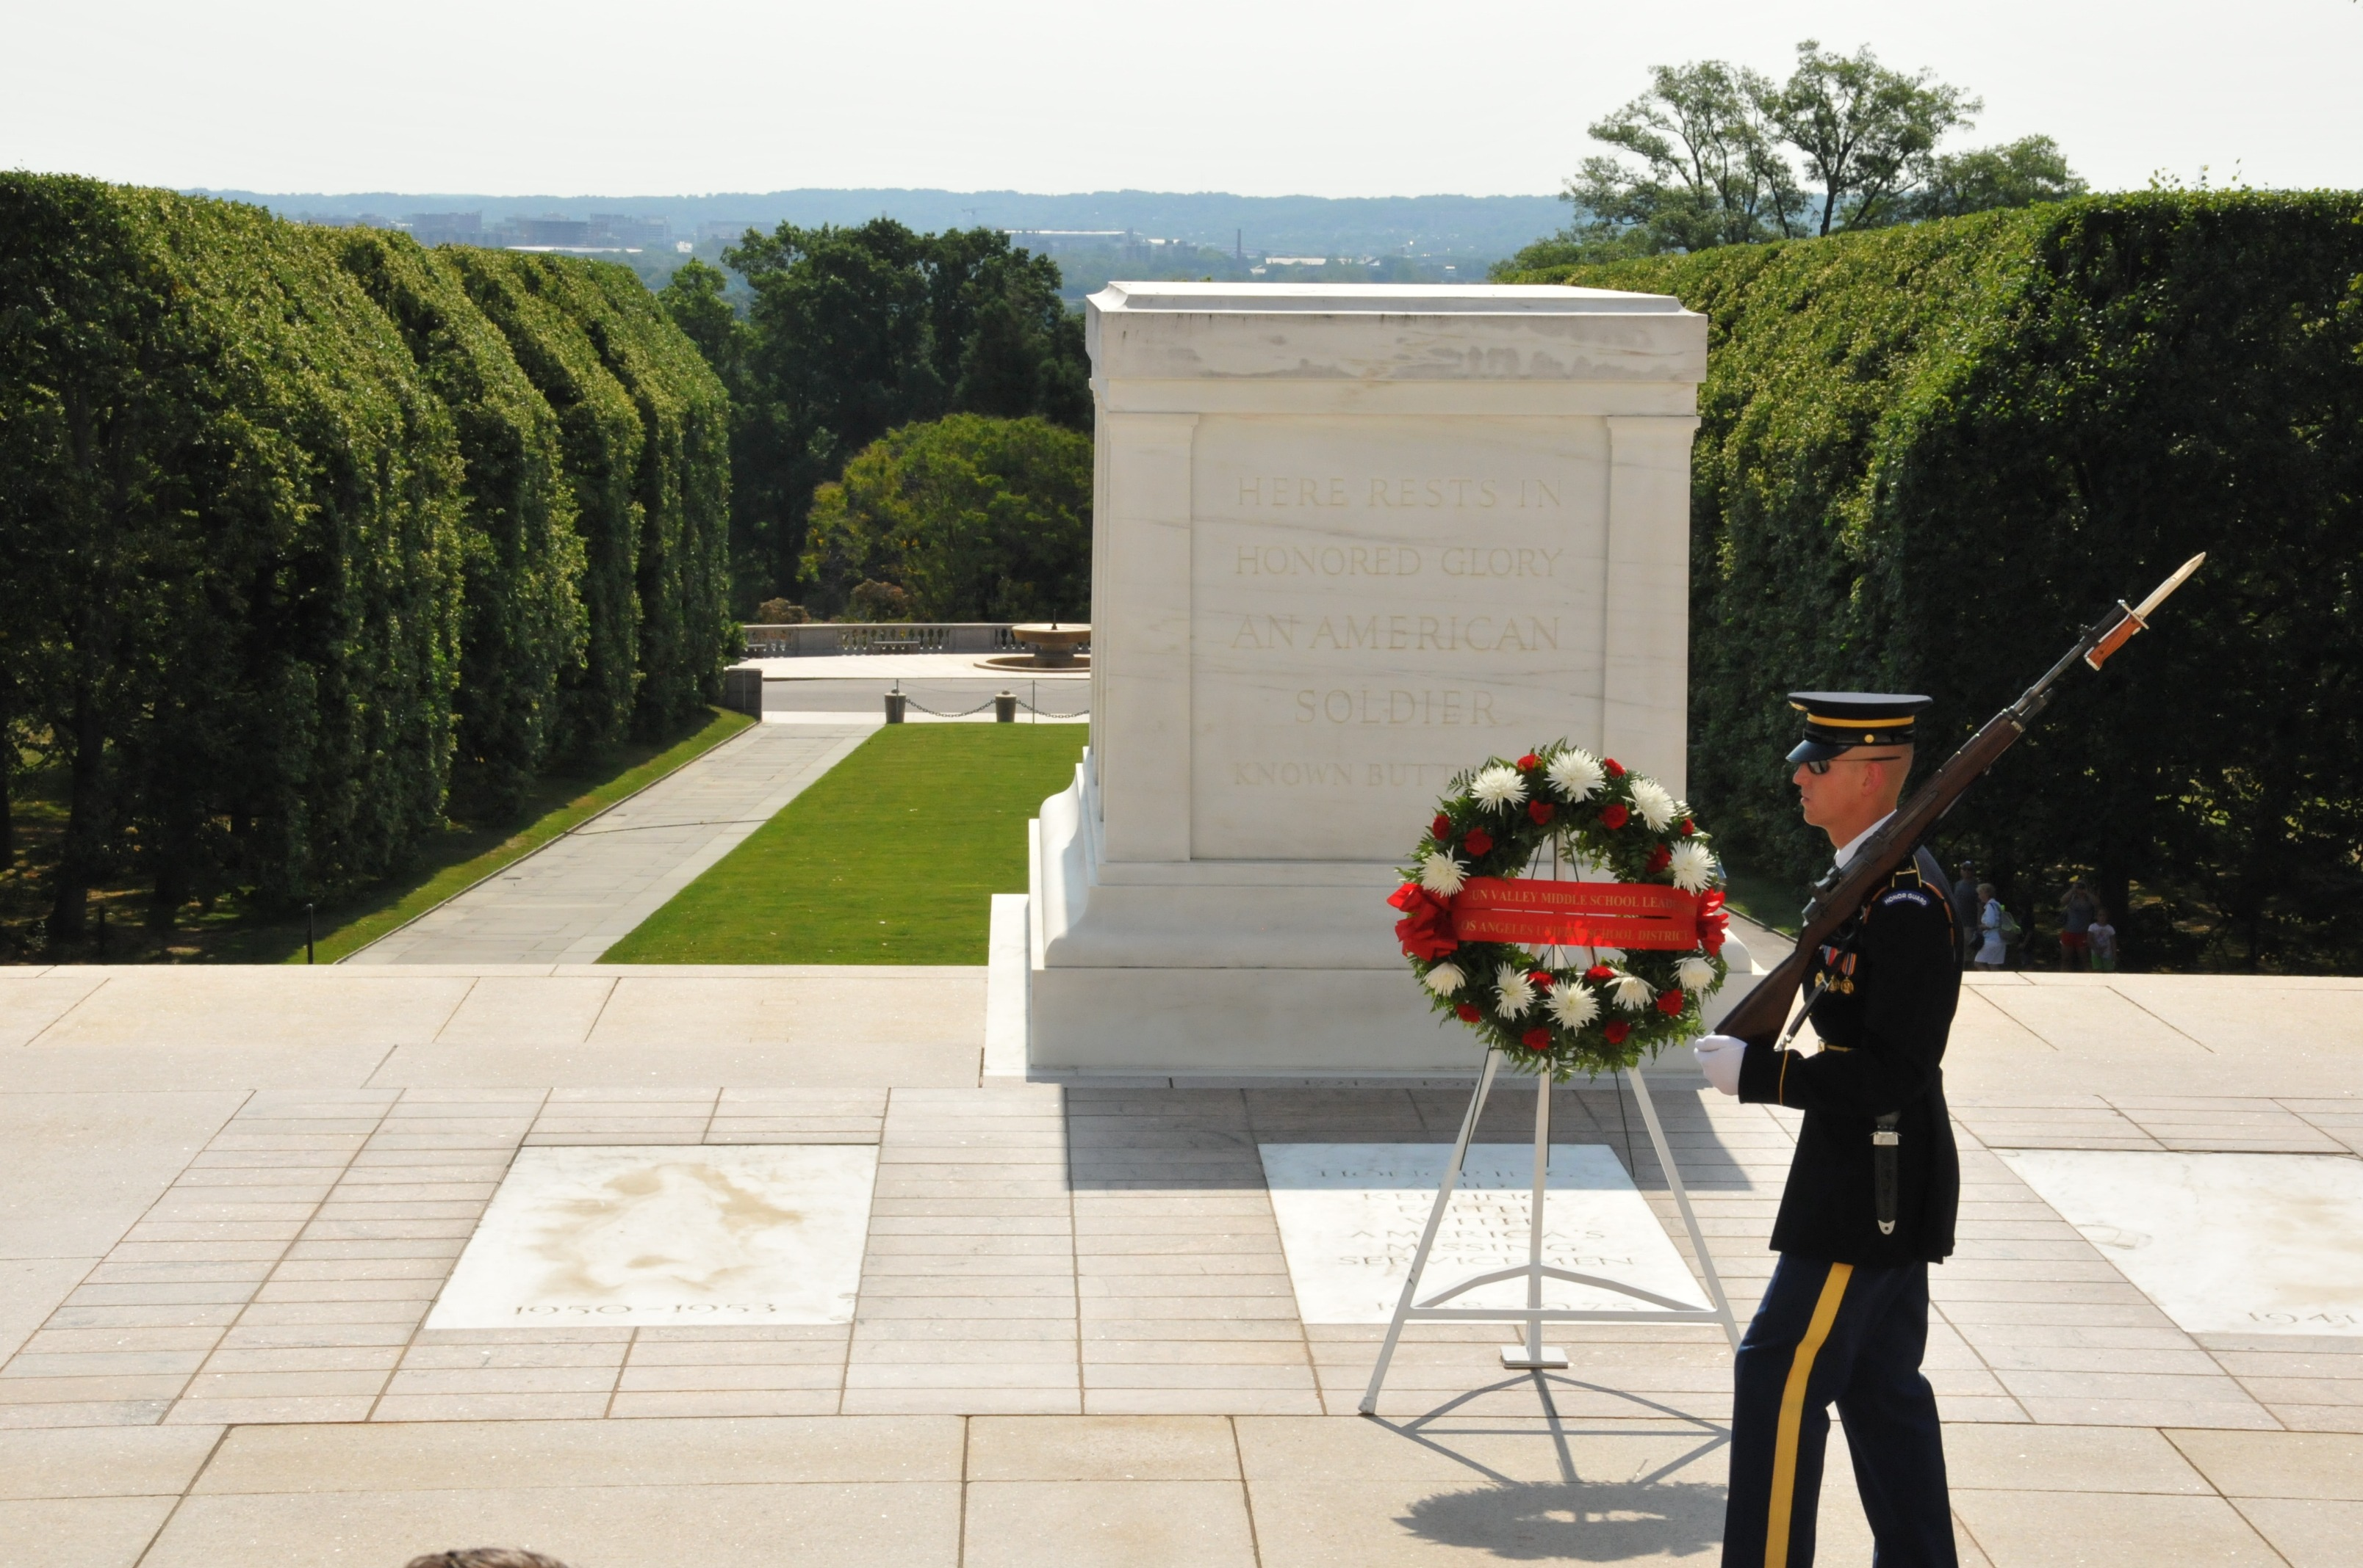
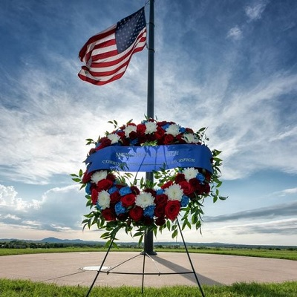
Memorial Services Industry
​CX Key Practices
Investing in employees
  VA Employee Engagement initiatives
Community partnerships
  Veteran Community Partnerships (VCPs) program
Inclusivity and diversity are key components
  VA Office of Resolution Management, Diversity & Inclusion (ORMDI)
Telling the story of every individual is paramount​
  My Life, My Story, Moments that Matter, Messages for the Moment
Tailoring experiences​
  Veteran centric approach to services
Journey Mapping, customer surveying and HCD​
  VA Journey Mapping, VSignals, HCD
Transcend generations with dignity and honor​
  NCA honors Veterans and their eligible family members with final resting places in national shrines and with lasting tributes that commemorate their service and sacrifice to our Nation.
​
CX Lessons Learned
Dignity and honor are key components
Striving for perfection - you only have one opportunity
Customized services
A focus on employee engagement and training
Diversity and inclusion
Industry leaders' partner to enhance experience
Importance of telling a customer's story

Slide 5


Insurance Industry
    CX Key Practices
  Why choose them
      Earn trust
  Voice of the Agent AND Voice of the Customer
      Voice of the Veteran and Employee, SHEP, VSignals, All Employee Survey
  Customer focus groups (research)
      VA HCD process
  Performs complaint/detractor deep dives
      Patient Advocacy Program, Root Cause Analysis, VA OIG
  Performance Measures
      VA Performance Measures
    42% of customers do not trust them
    25% of customers would switch to a new carrier
    60% of the industry lacks a customer experience strategy
CX Lessons Learned
Consumer flexibility - omnichannel
Changing language in documents and communication to use less jargon​
Offering hybrid experiences​
Engaging with customers throughout the year
Equally focused on gaining new customers and retaining existing customers
Efficient (24/7 access, SAME DAY payment once claim resolved)
Guides the journey (Clear videos on coverages and claims)
Employee experience is given equal focus to the customer experience
Survey fatigue is address through segmentation
This Photo by Unknown Author is licensed under CC BY-NC-ND
Notes:
OmmniChannel = denoting or relating to a type of retail that integrates the different methods of shopping available to consumers (e.g., online, in a physical store, or by phone)

Slide 6


Retail
  CX Key Practices
Customer engagement and product commitment
    VA offers data, tools, technology, and engagement to support the delivery of care, benefits, and services
Staff training on what matters to customers
    Own the Moment
Improving lives​, remaining relevant, improve services, lifelong relationships
    From Service to Burial. Training, education and home loan options.
Integrity, honesty, and respectful communication
    I CARE (VA Core Values)
Call customer by name/fully attentive through interactions
    Commit to Sit, Take a Moment
Ease of website navigation
    VA.gov, My HealtheVet, eBenefits, VA Twitter, NCA Online Grave Locator, MyVA411
CX Lessons Learned
Provide outstanding service every day, one customer at a time ​
Always remember core values
Place customers at the center​/Customized experience
Hire the right people​
Demonstrate genuine care for your employees – make it a family​
Build a leadership model/development plan that supports all
Identify what success looks like – measure, iterate, implement and repeat
Preparing Employees for Success
Anticipate customer needs and design services/products proactively

Slide 7


Banking Industry
  CX Key Practices
Build long term relationships
  From Service to Burial. Training, education and home loan options in-between
Prepare the future generation for financial success​
  Veterans Benefits Banking Program (VBBP), VA Home Loan, Veteran Small Business loans
Bridge the digital divide​
  VA.gov, My HealtheVet, eBenefits, VA Twitter, NCA Online Grave Locator, MyVA411
Simple customer service goals​
  38 C.F.R. §§ 0.600-0.603, Office of Management and Budget’s (OMB) Circular A-11 Circular Section 280, VA Customer Experience Directive (0010), Own the Moment
People (not computers) provide better customer service and promote trust among customers​
  Own the Moment Training
CX Lessons Learned
Build lifelong relationships and obtain high levels of trust
Poor service is the top reasons customers leave
Barriers to access = socioeconomic status, technology gaps, policy involvement
Customer journey mapping is standard practice in the banking industry
Conduct customer service surveys
Understand and practice customer service principles

Slide 8


Automotive Industry
CX Key Practices
It doesn’t matter if you’re in banking, government, or automotive. What your customers are going to remember is how you made them feel.
    Ease, Effectiveness, and Emotion
Customer and quality first
    Veteran centric approach to services
Servant leadership
    VA Servant Leadership
Employee centric
    VA Employee engagement
Automation with a human touch
    My HeatheVet, Ask AVA
Listening to the Voice of the Customer (VOC), acting, on feedback
    Voice of the Veteran
Quality, teamwork, transparency, and innovation
    I CARE Values
CX Lessons Learned
Focus on continuous improvement Six Sigma
Important to highlight the distinction between service and experience
Consider the emotions our customer experiences as they engage with the organization
Seek opportunities to invest in EX and CX
Establish a robust employee engagement strategy to build trust and sense of value
Seek ways to not only empower staff but provide options to use for service recovery or experience enhancement

Slide 9


Entertainment Industry
CX Key Practices
Amplify common purpose and sustain values/vision through effective Leadership
    I CARE Values
Create a sustainable culture for the organization that engages inspires and empowers
    Own the moment
Strive for exceptional customer experience
    Ease, Effectiveness, and Emotion
Delight the customer
CX Lessons Learned
Create an organizational common purpose.
Understand customers holistically.
View exceptional service as an asset rather than an expense. Return on investment associated with lifetime customer relationships often justifies the short-term costs .
Protect and retain the relationship. Branding begins in the in the home at a very young age and continues.

Slide 10
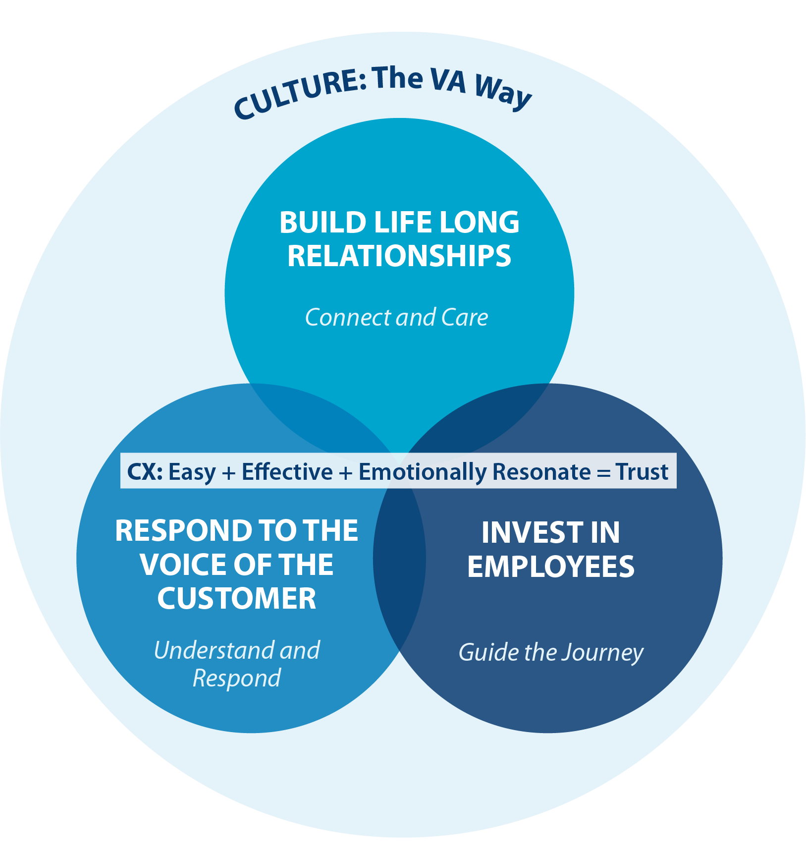
What’s the Secret in the Sauce?
Build Lifelong Customer Relationships
Customer Loyalty/ Sense of Belonging
Anticipate customer needs
Stay relevant
Standardized branding
Create atmosphere of service excellent
Respond to Voice of the Customer
  Perform Service Recovery
  Employ Continuous Improvement
  Empower employees to solve problems
  Conduct Customer Listening Sessions
  Make Data Actionable
Invest in Employees
Hire Right
Educate and Train
Provide Psychological Safety
Embrace DE&I
Prioritize Employee Engagement
Recognize and reward
Set CX Service Expectations

Slide 11
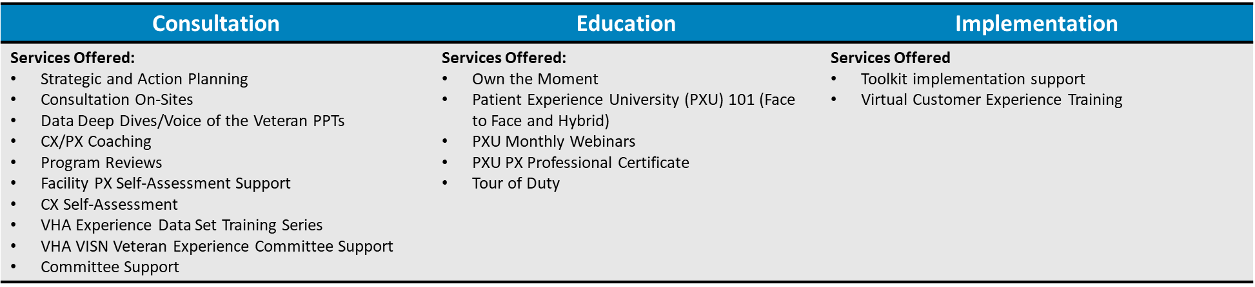
What can VEO do to help you:
Contact Information
    Jennifer R. Purdy, LCSW, CPXP
        jennifer.purdy2@va.gov
Services:
Tools and Implementation Contact Information:
    General email inquires: vapx@va.gov
    SharePoint: Veterans Patient Experience (VA PX) - Home (sharepoint.com)
    Service Request Portal: VEO Customer Portal – Power Apps
Martina Malek, FACHE
  martina.malek@va.gov

