Slide 1
2021 Presidential Rank Award Recipients
Veterans Affairs fiscal year 2021 presidential rank award ceremony
May 10, 2022

Slide 2
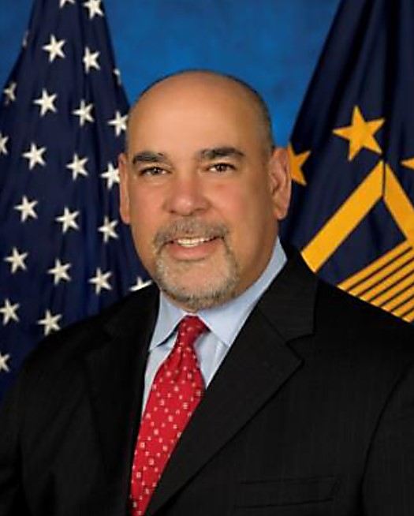
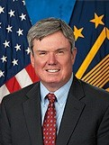
Distinguished Executive Winners
Fernando O. Rivera, VHA
Executive Director, Southeast Louisiana Health Care System
New Orleans, LA
Edward J. Murray, OM
Principal Deputy Assistant Secretary for Management and Deputy Chief Financial Officer
Washington, DC

Slide 3
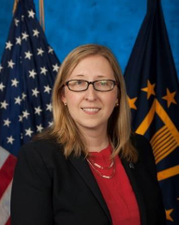
Distinguished Executive Winners
Jessica Bonjorni, VHA
Chief human capital management, office of human capital management
Washington, DC

Slide 4
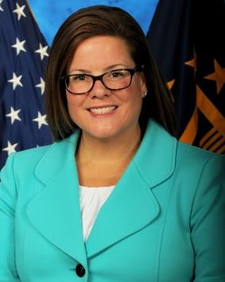
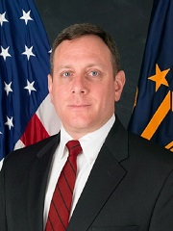
Meritorious Executive Winners
Lisa J. Pozzebon, NCA
Executive Director for Cemetery Operations
Washington, DC
Stephan J. Frank, NCA
Executive Director, Southeast District
Atlanta, GA

Slide 5
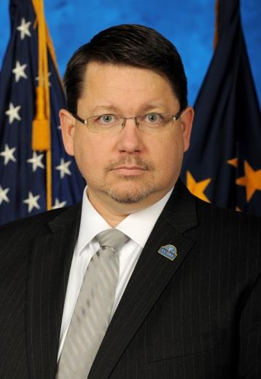
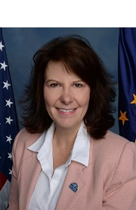
Meritorious Executive Winners
Bradley L. Houston, OIT
Deputy Chief Information Officer, Benefits, Appeals and Memorials
Austin, TX
Victoria P. Brahm, VHA
Network Director, Great Lakes Health Care System
Westchester, IL
*Retired

Slide 6
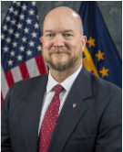
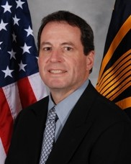
Meritorious Executive Winners
Timothy J. Cooke, VHA
Executive Director, Orlando Health Care System
Orlando, FL
Ralph T. Gigliotti, VHA
Network Director, Rocky Mountain Network
Glendale, CO

Slide 7
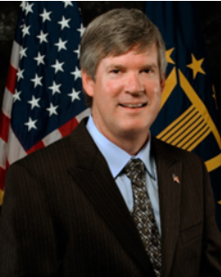
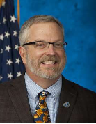
Meritorious Executive Winners
Timothy W. Liezert, VHA
Network Director, VISN 4 Health Care
Pittsburgh, PA
Larry A. Mole, VHA
Chief Consultant, Population Health Service
Washington, DC
*Retired

Slide 8
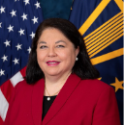
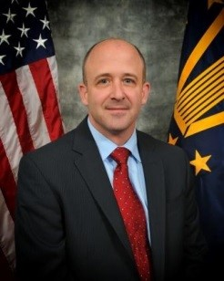
Meritorious Executive Winners
RimaAnn O. Nelson, VHA
Assistant Under Secretary for Health for Operations
Phoenix, AZ
James W. Rice, VHA
Executive Director, Iron Mountain Health Care
Iron Mountain, MI

Slide 9
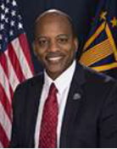
Meritorious Executive Winner
Christopher R. Sandles, VHA
Executive Director, South Texas Health Care
San Antonio, TX

